Slide 1
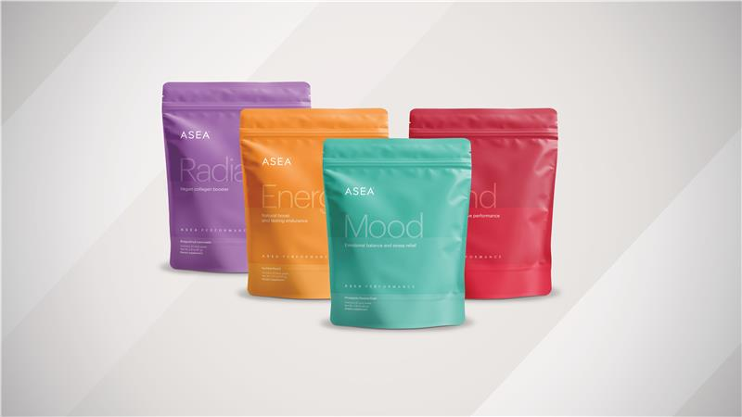

Slide 2
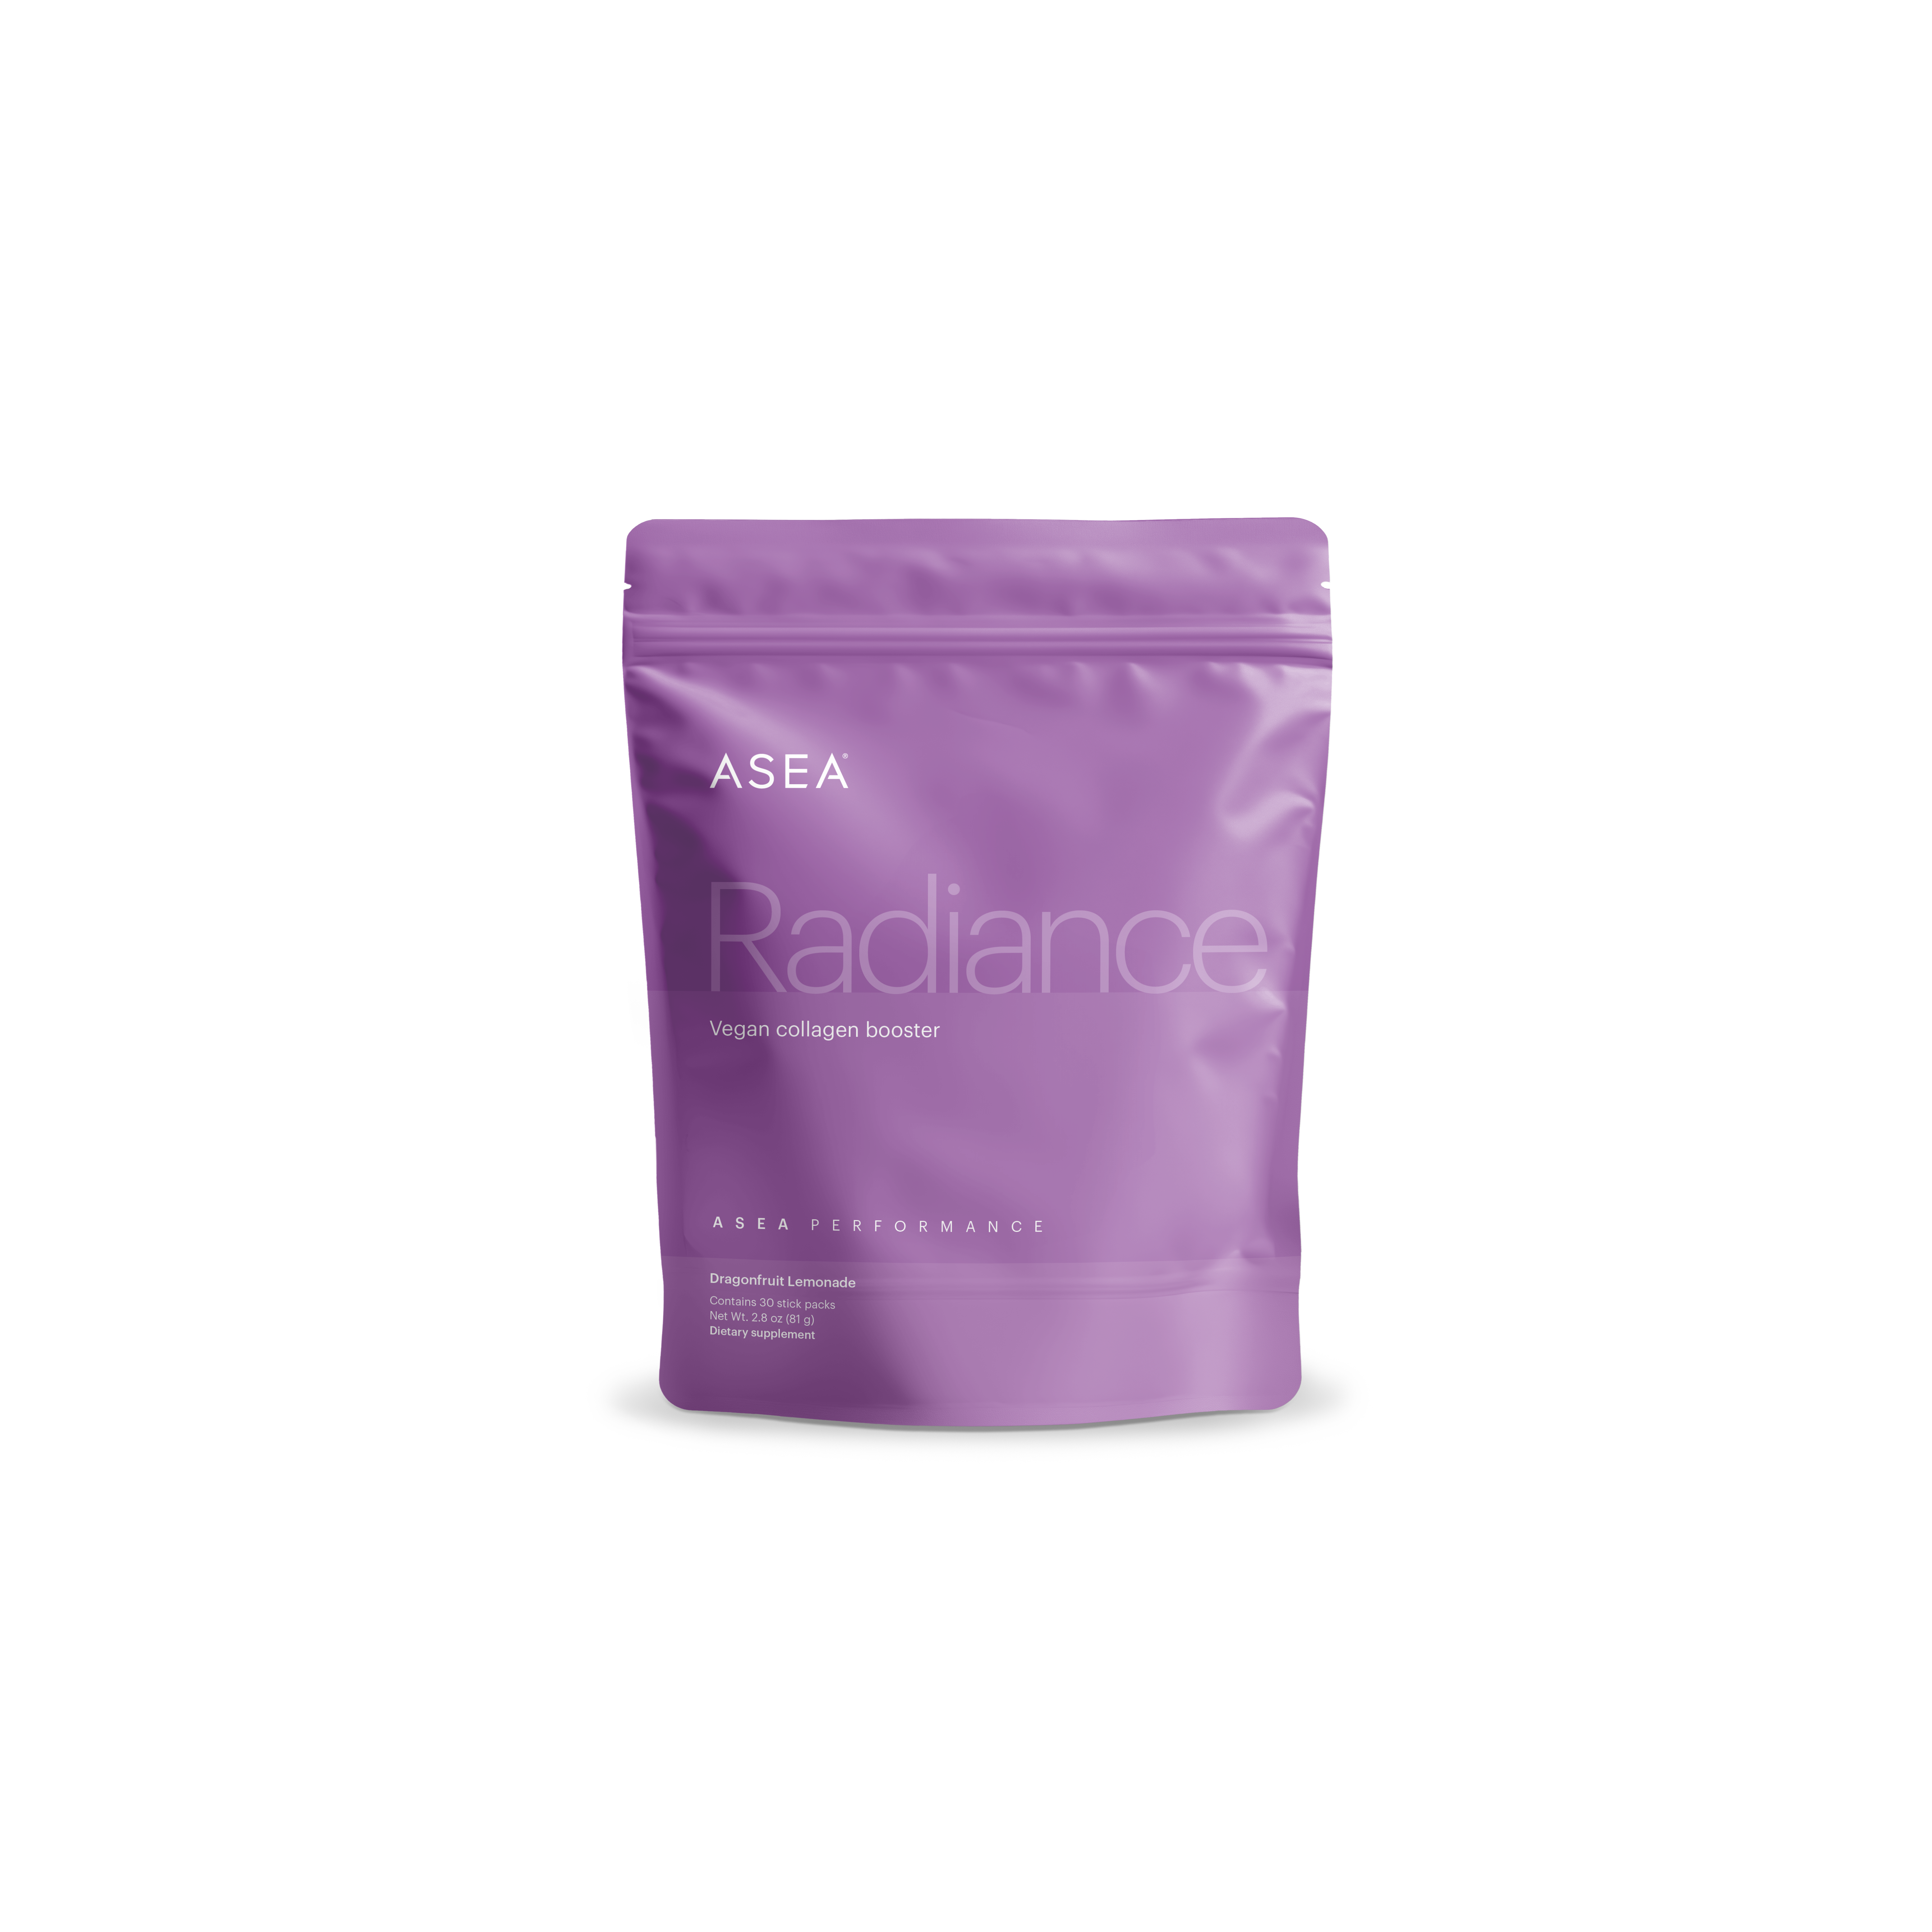
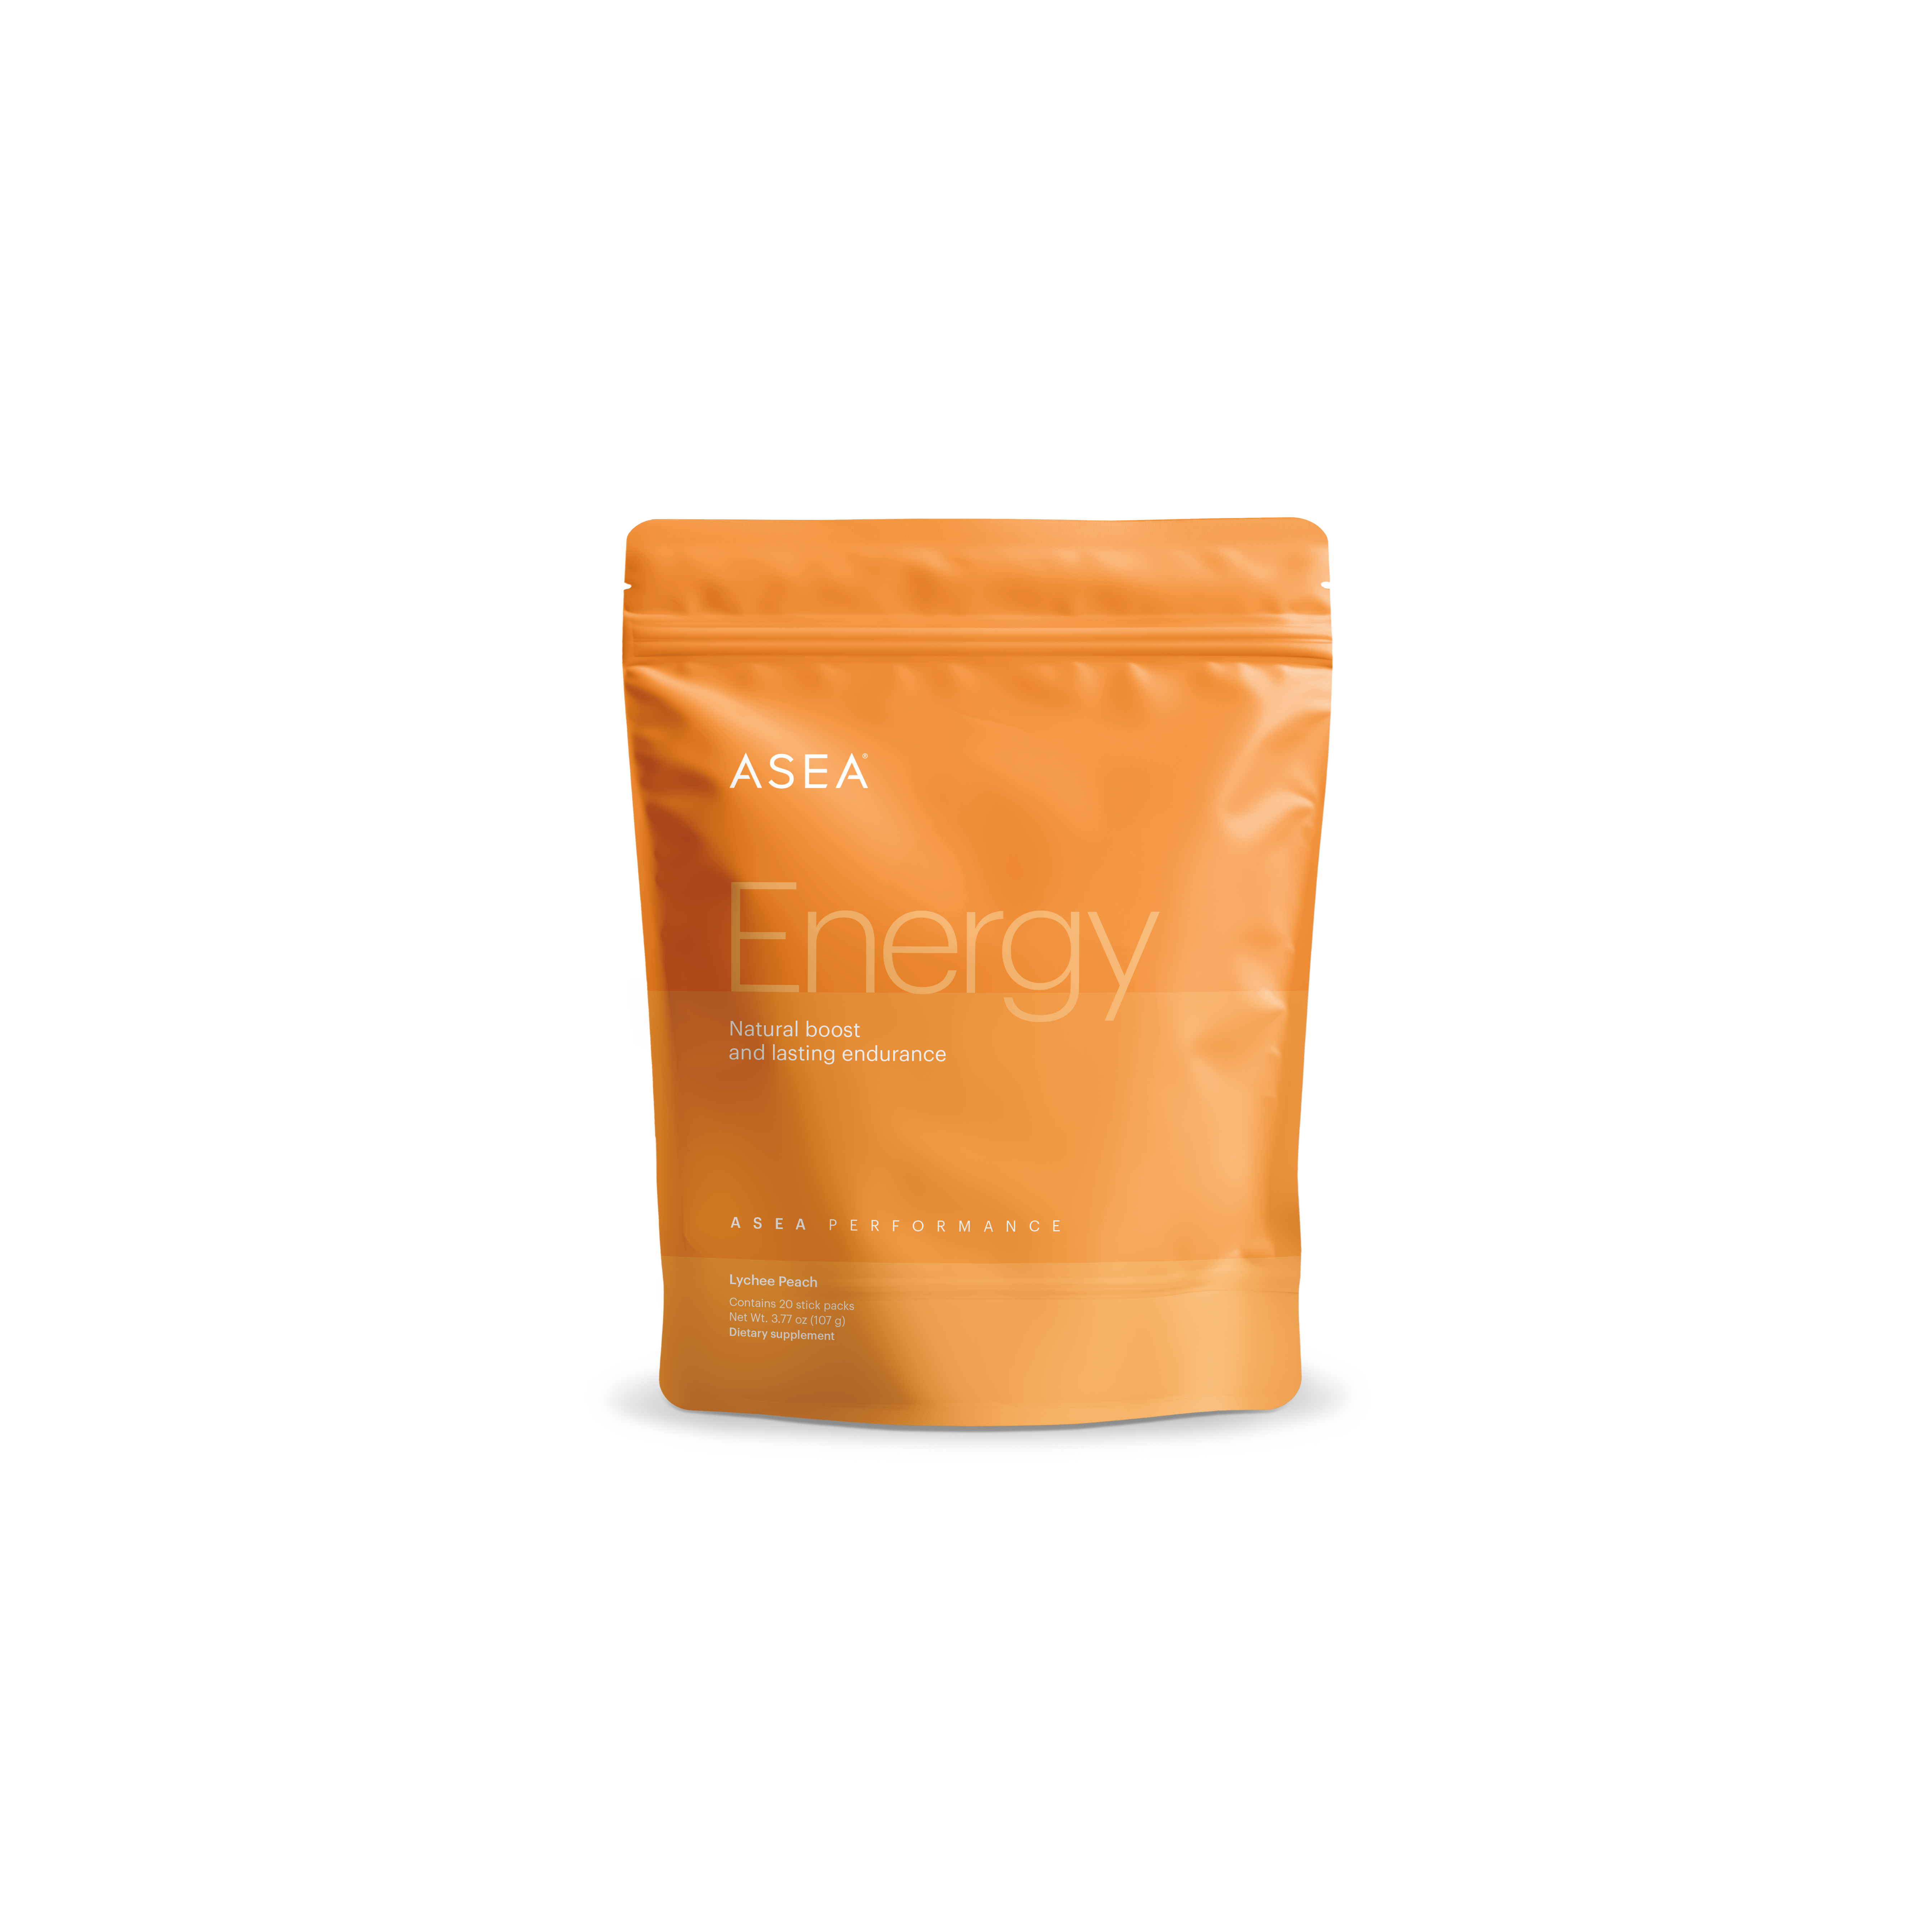
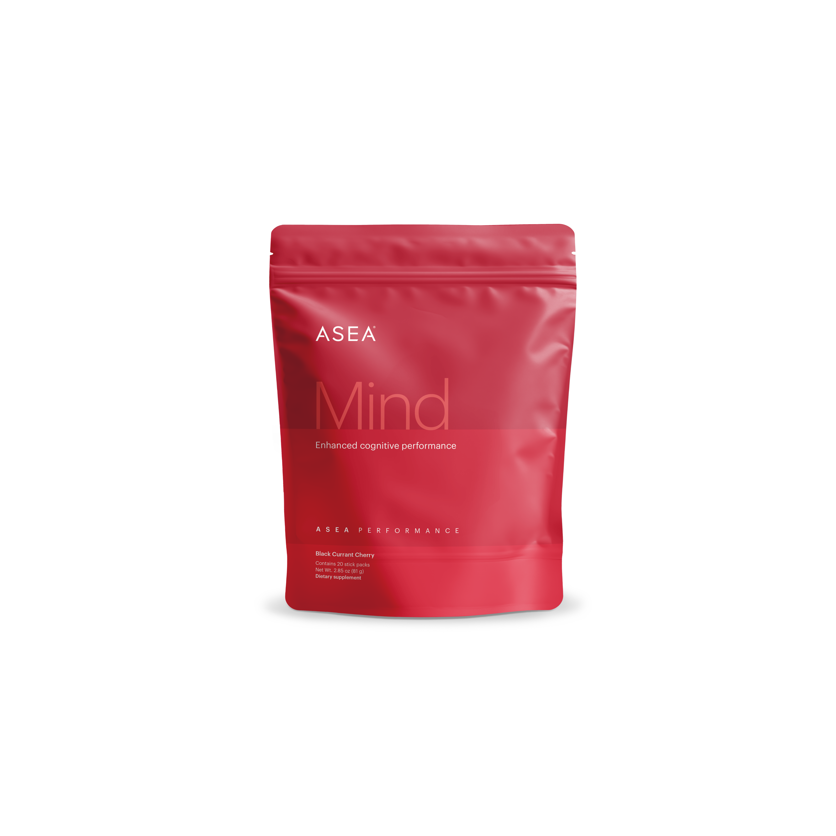
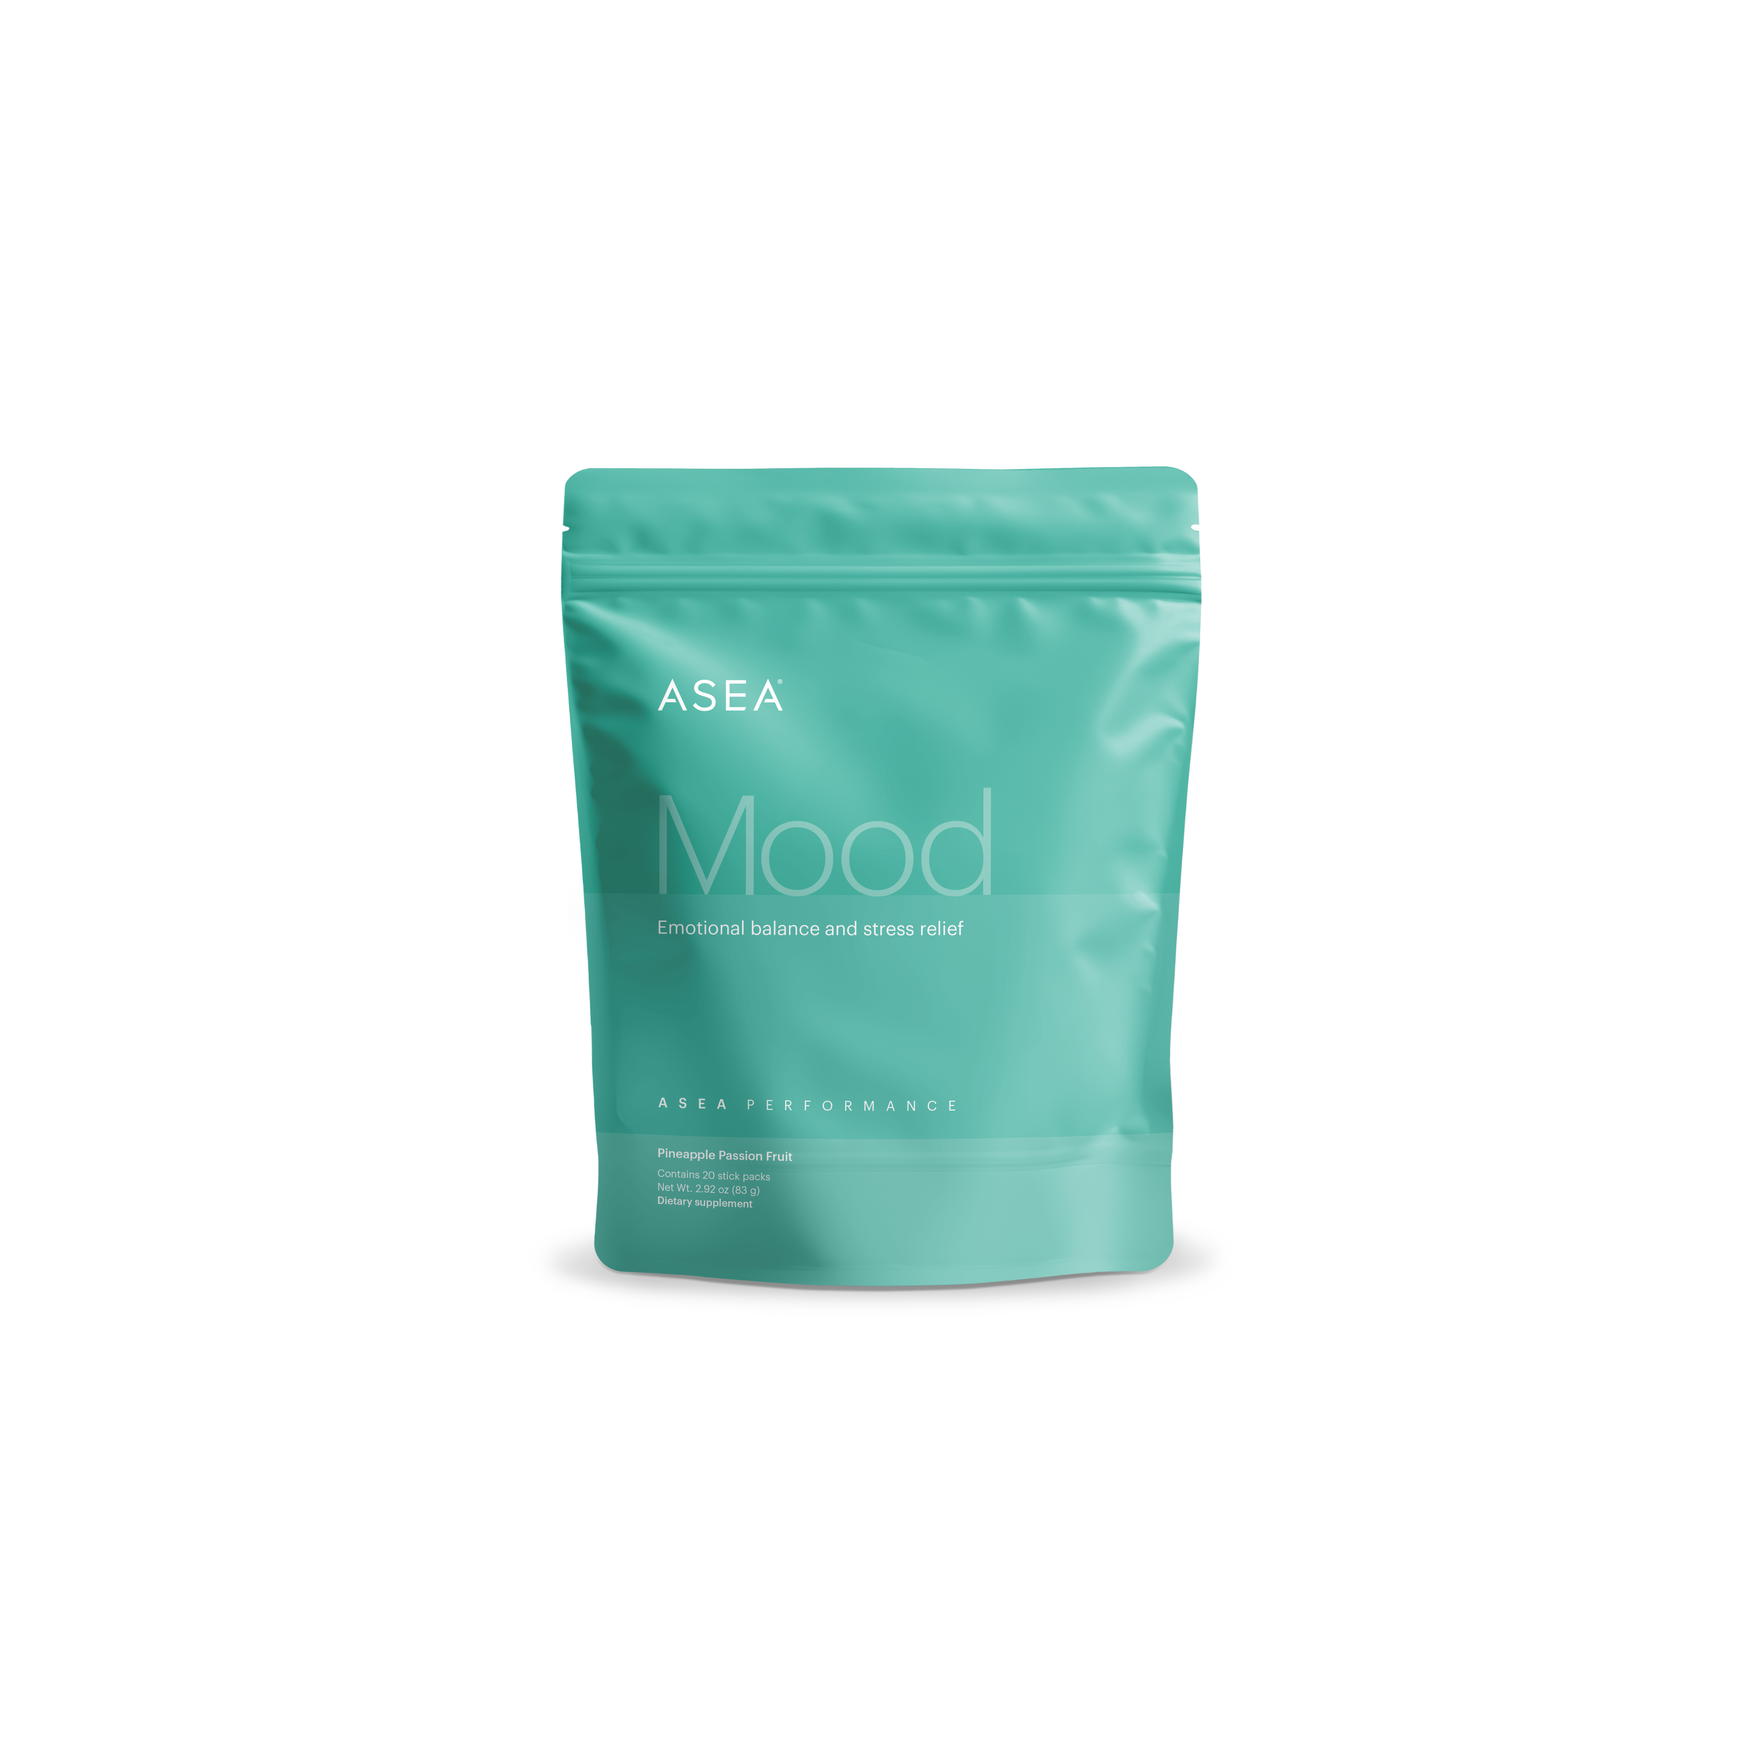

ASEA Performance
• Bioavailable
• Smart
• Clean

Slide 3
Bioavailable
ASEA Performance’s ingredients are all in the most bioavailable forms. This means they are easy for your body to use.

Slide 4
Smart
ASEA Performance’s smart ingredients work together to deliver powerful results. These formulas don’t just give a short-term boost; they provide long-lasting benefits.

Slide 5
Clean
Clinical grade ingredients that work without the fluff. ASEA Performance is formulated with only functional and necessary ingredients. No additional colors, fillers, or preservatives.

Slide 6
Energy : Key Ingredients
L-Theanine
Panax Ginseng
Vitamin B3 (Niacinamide)
Vitamin B6 (Pyridoxine)
Vitamin B12 (Methylcobalamin)
Peak ATP
Acetyl-L Carnitine
Beta-Alanine
Beet Root Extract
Agmatine Sulfate
Guarana
Caffeine (from Green Tea)
Mental Clarity and Reduced Anxiety
Muscle Growth, Recovery,
and Cellular Energy
Athletic Performance and Endurance
Sustained Energy
Notes:
With this formula, we don’t just fight fatigue. We amplify performance.

Slide 7
Mind : Key Ingredients
Alpha-GPC
Lions Mane (30% B-Glucans)
Huperzine A
Choline
Nicotinamide Riboside (NR)
Phosphatidylserine
Zinc
Caffeine (from Green Tea)
Cognitive Performance
Neuroprotection and Long-Term Brain Health
Mental Energy and Focus
Notes:
Cognitive performance meets neuro-nutrition.

Slide 8
Mood : Key Ingredients
Affron (Branded Saffron Ingredient)
Ashwagandha
Rhodiola Rosea
L-Tyrosine
GABA
Vitamin B5
5-HTP
Mood and Emotional Regulation
Resilience to Stress
Relaxation and Calm
Notes:
Resilience is the ability to respond to stress. Don’t distract your self from stress, enhance your ability to face it head on.

Slide 9
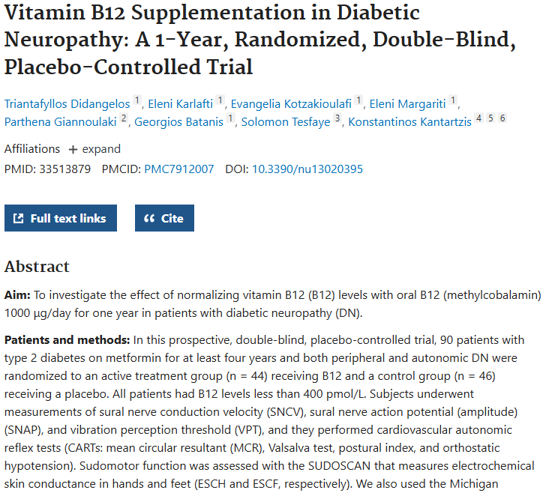
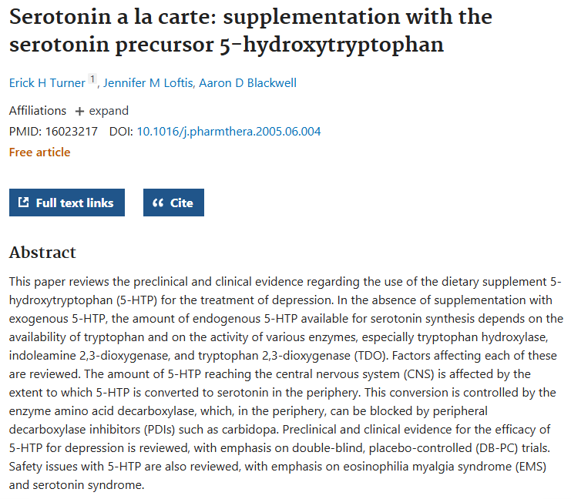
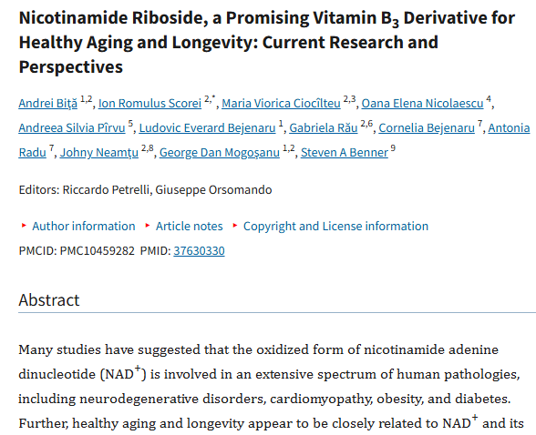
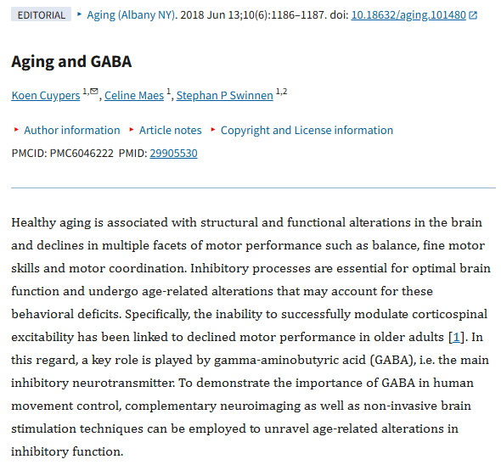
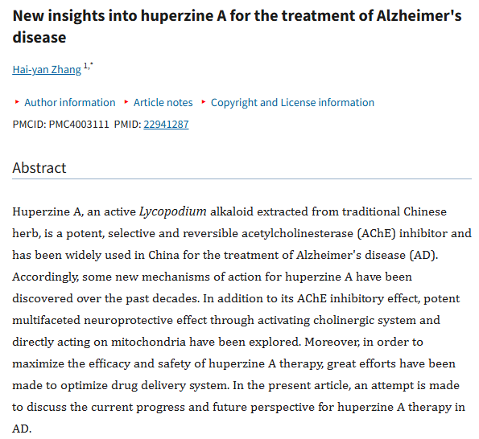
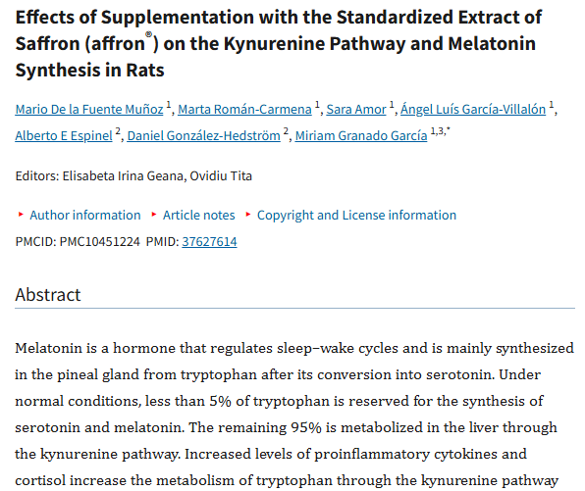
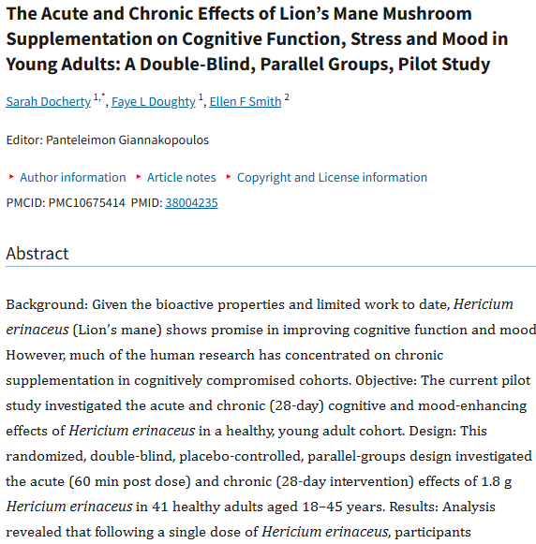
Backed by Science
Over 900,000 studies on PubMed on ASEA Performance ingredients

Slide 10
Functional Stacking
For when you need to be sharp and smooth
Ultimate get it done combo

Slide 11
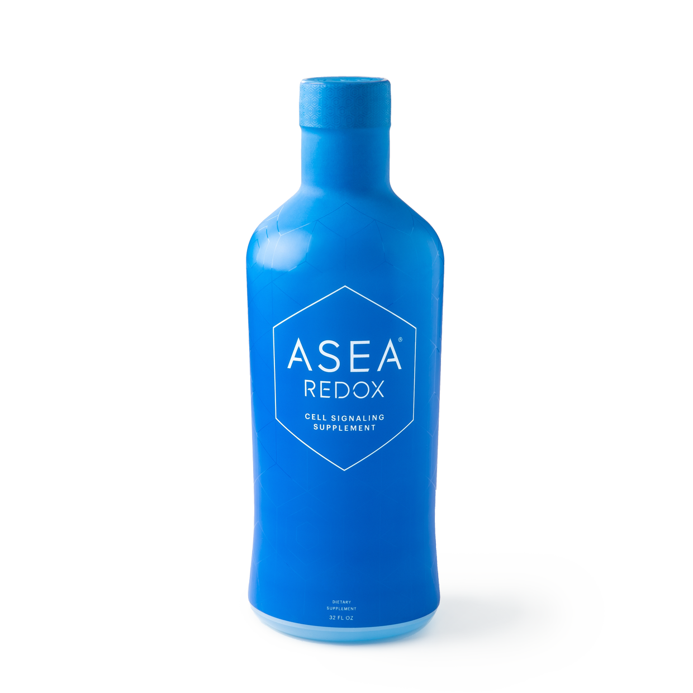
Functional Stacking with REDOX
For when you need to be sharp and smooth
Ultimate get it done combo
Prime your body with REDOX

