Slide 2
METHOD
6M
A system for your ASEA business
Notes:
[0:00–0:20 | WALK-ON] Before you speak: let the opening ASEA mark sit in silence for a beat as the room settles. This is your entrance — walk to center stage during that beat and take one real breath before you start.
Reiterate how we got here and the role it plays in the success model. Over the past two years we’ve been going through an evolution, first with ASEA One – his programs shows HOW you are rewarded and recognized, and then with ClubOne introduced – it shows HOW focusing on key behaviors can influence success in a fun way. Well,---- knowing how you are rewarded and what are the behaviors does not necessarily mean that everyone coming into ASEA has the innate skills to optimize the plan. However, we are definitely on the right track, to optimize the plan and increase each Brand Partners success, we wanted to introduce a model that completes the success path for each person in ASEA. Now its not rocket science but if worked it is a scaleable set of skills so you understand and new Brand Partners know how your DO the work.
Now name the gap: 'The difference between the partner who quits in week one and the partner who's still here ten years later was never talent. It was never luck. It was THE ACTION they took whether from who someone handed them four steps or when the began sharing because of excitement.
Excitement analogy: When are they most excited? Just after they committed and purchased.
Now name it: Now we have support that can channel that excitement. 'We call it LIFT. Four steps. One direction. Up.'
[Let the word LIFT sit on screen for a second before you keep talking. This is your title — don't rush past it.]

Slide 3



THE JOURNEY
Invite
Launch
Activate
Club One
Club One Plus
EMP / Residual
Activate with Depth
Key Moments – Make or Break Duplication
Notes:
[5:30–6:30 | THE ARC] Zoom out to the whole picture: 'Here's what that looks like laid end to end.'
Move quickly left to right, one line per stage, like flipping through a calendar:
'Day one — watch, build your story, tell people.'
'Week one — LIFT writes the messages, you just send them.'
'Weeks two through four — four small actions a day. We'll get to those in a second.'
'Day thirty-one and onward — you teach someone else what you just did.'
Land the reframe: 'That's not a to-do list. That's a business being born, one day at a time.'
Call out the gold bar under the timeline: "Notice Activate isn't one of the four boxes -- it runs underneath all of them. It can happen day one, it can happen day fifteen. It's not a phase, it's a moment, and it's not locked to any one of these four steps."

Slide 4
Success Model
A system for your ASEA business
Repeatable, clear, simple and built for you.

Slide 5
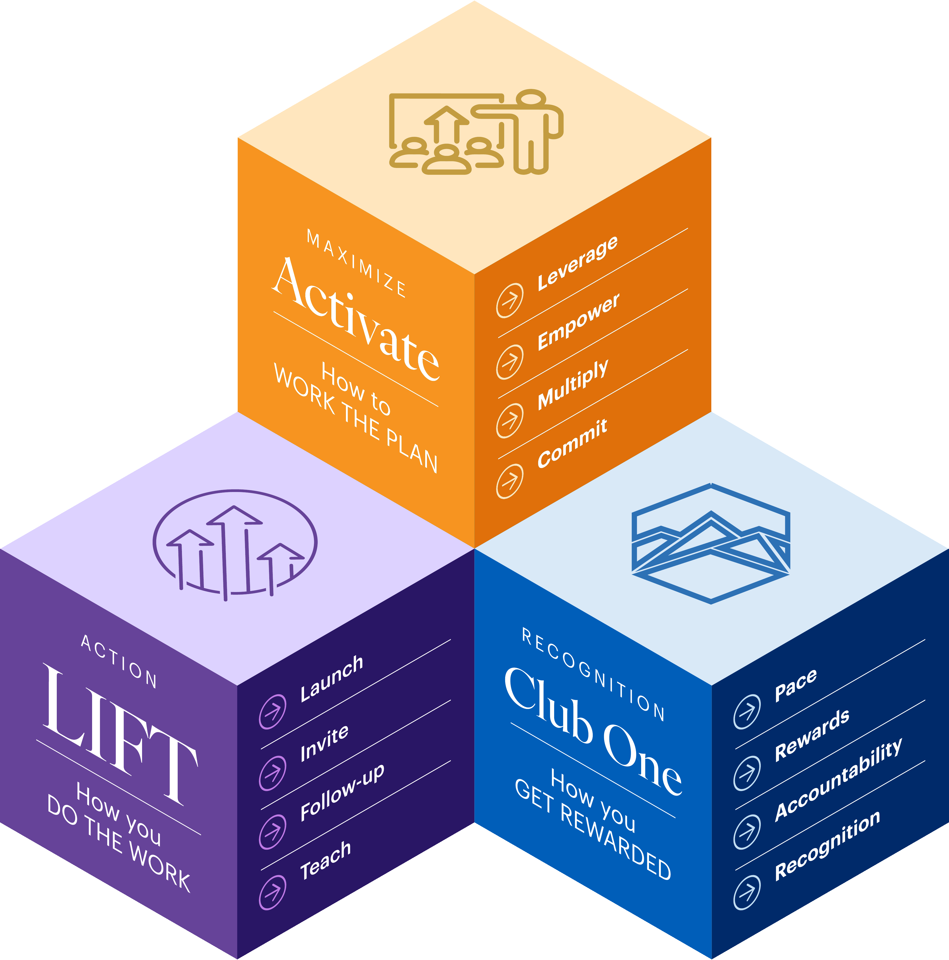



Success Model
One model.
Three systems.
Each system built in a progression and part of a cycle. Know the system and manage your business
LIFT
Day one to first activation. Focus on what matters and remove the noise.
Club One™
Recognition and rewards for the right behaviors.
Activate
Depth, and compounding growth build a legacy

Slide 6

LIFT has a single objective: Activate a new Brand Partner. By building confidence and focusing on what matters:
Loving and believing in the product (subscribe)
Having tools that make sharing easy and simple (share)
Knowing how to enroll (activate)
01
LIFT
The activity system
Once activated – your new BP is only 1 activity away from Club ONE!
Notes:
The block bleeds top and bottom and the cube straddles the seam, which stitches the two halves together. Room on the right for a line that sets up the section.

Slide 7

CLUB ONE has a multiple objectives:
Drive repeatable behaviors through recognition and rewards
Establish cadence and pace of a successful business
Guide to a residual income
02
Club One™
The recognition system
Once mastered – Ready to focus on and leverage the power of Activation.
Notes:
The divider does work instead of only announcing. The audience sees the four moves before the presenter starts, so the detail slide that follows confirms rather than introduces.

Slide 8

03
ACTIVATE focuses on maximization of the ASEA One compensation plan:
Though activation effort is multiplied and eventually exponential
Without activation a business will eventually succumb to attrition
High activation is the most pertinent leading indicator of successful duplication.
Activate
The maximization system
How do we ACTIVATE? LIFT. Ensuring our BPs successfully launch.

Slide 9
METHOD
Success Model
A system for your ASEA business
Notes:
[0:00–0:20 | WALK-ON] Before you speak: let the opening ASEA mark sit in silence for a beat as the room settles. This is your entrance — walk to center stage during that beat and take one real breath before you start.
Reiterate how we got here and the role it plays in the success model. Over the past two years we’ve been going through an evolution, first with ASEA One – his programs shows HOW you are rewarded and recognized, and then with ClubOne introduced – it shows HOW focusing on key behaviors can influence success in a fun way. Well,---- knowing how you are rewarded and what are the behaviors does not necessarily mean that everyone coming into ASEA has the innate skills to optimize the plan. However, we are definitely on the right track, to optimize the plan and increase each Brand Partners success, we wanted to introduce a model that completes the success path for each person in ASEA. Now its not rocket science but if worked it is a scaleable set of skills so you understand and new Brand Partners know how your DO the work.
Now name the gap: 'The difference between the partner who quits in week one and the partner who's still here ten years later was never talent. It was never luck. It was THE ACTION they took whether from who someone handed them four steps or when the began sharing because of excitement.
Excitement analogy: When are they most excited? Just after they committed and purchased.
Now name it: Now we have support that can channel that excitement. 'We call it LIFT. Four steps. One direction. Up.'
[Let the word LIFT sit on screen for a second before you keep talking. This is your title — don't rush past it.]

Slide 10
LIFT SUCCESS SHARING
LIFT
Four steps. One direction. Up.
A shared coaching framework for every Brand Partner — new or tenured — to launch, build, and lead with the same rhythm.
Notes:
[0:00–0:20 | WALK-ON] Before you speak: let the opening ASEA mark sit in silence for a beat as the room settles. This is your entrance — walk to center stage during that beat and take one real breath before you start.
Reiterate how we got here and the role it plays in the success model. Over the past two years we’ve been going through an evolution, first with ASEA One – his programs shows HOW you are rewarded and recognized, and then with ClubOne introduced – it shows HOW focusing on key behaviors can influence success in a fun way. Well,---- knowing how you are rewarded and what are the behaviors does not necessarily mean that everyone coming into ASEA has the innate skills to optimize the plan. However, we are definitely on the right track, to optimize the plan and increase each Brand Partners success, we wanted to introduce a model that completes the success path for each person in ASEA. Now its not rocket science but if worked it is a scaleable set of skills so you understand and new Brand Partners know how your DO the work.
Now name the gap: 'The difference between the partner who quits in week one and the partner who's still here ten years later was never talent. It was never luck. It was THE ACTION they took whether from who someone handed them four steps or when the began sharing because of excitement.
Excitement analogy: When are they most excited? Just after they committed and purchased.
Now name it: Now we have support that can channel that excitement. 'We call it LIFT. Four steps. One direction. Up.'
[Let the word LIFT sit on screen for a second before you keep talking. This is your title — don't rush past it.]

Slide 11

02
WHY IT WORKS
Confidence comes from action
not preparation.
30
You don't need to feel ready. You can just need to follow the steps.
Most new partners stall because they're waiting to feel prepared. LIFT removes the guesswork so momentum can start on day one — activate within 30 days, ideally within your first week.
DAYS OF ACTION
Actions: you’ve used the product, shared your story, and helped a person say yes. this is rhythm
One shared language. The same four steps work for a brand-new partner and a stage leader alike — simple enough to hand off in five minutes.
Notes:
[1:20–2:20 | THE INSIGHT] This is the one idea the whole talk hangs on — say it slowly: 'Confidence doesn't come before action. It comes from it.'
Give the room permission: 'You don't need to feel ready. Nobody does. You can just follow the steps until the feeling catches up.'
Land the promise with a number — numbers stick: 'Every partner who follows LIFT can activate within 30 days — ideally within their first week. Not because it's easy — because they're never standing there wondering what action they should do next.'
Plant a seed for later: 'One shared language' — for a brand-new partner and a stage leader, same four words. I'll come back to this at the close.

Slide 12
04
THE GOAL
LIFT has one job:
get two things right.
2
Everything else is in service of these two outcomes.
We don't need new Brand Partners to learn the comp plan on day one, or master Club One. We need two things: they see the value of the product, and they get their first activation — the single biggest predictor of whether they're still here in a year.
THINGS THAT ACTUALLY MATTER
① On subscription, loving the product.
② Their first activation.
Everything below is just how. Launch, Invite, Follow Through, Teach are the how. If they remember nothing else, they should remember the two goals above.
Notes:
[THE ANCHOR SLIDE] Everything you say for the next ten minutes should trace back to this. Slow down here.
'LIFT has exactly one job: that is to get two things right. So they see the value as a Brand Partner —
they're on subscription, they love it.
And they get their first activation.'
'That's it. Not the comp plan. Not Club One. Just those two things.'
[IF ASKED FOR THE INTERNAL VERSION] The company-level framing behind this is quality enrollments, healthy retention, strong activation — keep that phrasing for leader conversations, not for this slide.

Slide 13
05
WHY WE DON’T WAIT
The 30-day window
isn't a suggestion.
97%
Activation can start as early as Day 1 — and the data says it should.
Brand Partners don't need product in hand to activate — they need to be excited and willing to tell one person.
That excitement is highest on day one, rather than day thirty. The longer we wait, the more excitement fades.
DON'T ACTIVATE IN 30 DAYS — AND NEVER DO
The urgency is the point: don't wait for the product to arrive to start sharing the excitement.
Don't wait for perfect. The moment they're excited is the moment to move. That's the whole point of Day 1 activation.
Notes:
[THE URGENCY BEAT] This is the number that should make the room sit up. Say it, then pause — let it land before you talk again.
'Ninety-seven percent of brand partners who don't activate in their first thirty days never do. Not eventually. Never.'
[Pause. Let it sit.]
'And here's the part we hesitate on—and therefore because we think, they think they need the product in hand to start. They don't. They need to be excited and willing to tell one person. That excitement is highest on day one, not day thirty.'
Optional, if it fits your time: the buy-something-on-Instagram analogy — 'When's the last time you bought something that you were excited about? How long did it take you to go and tell someone about that? Many did it the same day! not three weeks later. Same thing here.'
[VERIFY BEFORE STAGE] The 97% figure is the number Franco used in review — confirm it against real data before this goes in front of 400 people. If it can't be verified in time, swap in whatever number Marketing can stand behind, or soften to 'the vast majority.'

Slide 14
06
HOW IT WORKS
The four steps
Each step hands you the words and the next move — you never have to figure it out alone.
L
I
F
T
Launch Yourself
Invite with Intention
Follow Through
Teach to Lead
Six questions to build your own story, so you always know what to say.
Think of who you'd want on this journey — we help write the message for each one.
Relationships are built here. Consistency wins, every time.
Now share what you know to one person and watch what it turns into.
Notes:
[2:20–3:30 | THE FRAMEWORK] Speed matters here — this is the 'here's the whole map' beat. Don't linger on any one card.
Name all four fast, like a drumbeat: 'Launch. Invite. Follow Through. Teach. L-I-F-T.'
One breath per letter, one image per letter:
'Launch — finding your own story.'
'Invite — the people who already came to mind, the second you said yes to this.'
'Follow Through — showing up again after the first conversation, when it's not exciting anymore.'
'Teach — the one that changes everything, because now you're not the only one doing it.'
Close the beat: 'Four steps. Every single one of them something you already know how to do.'

Slide 15

10
THE JOURNEY
Your first 30 days.
A clear path, from day one
ACTIVATE — CAN BEGIN AS EARLY AS DAY 1, NOT BOUND TO ANY ONE PHASE
DAY 1
DAYS 2–7
DAYS 8–30
DAY 31+
Launch
7-Day Sprint
Find your Rhythm
Teach
8-minute welcome video, build your story, tell people you've started.
Picture the people — we write each message and sort them for you.
Four small actions a day build a rhythm, under an hour, every day.
Teach one person what you just did. That handoff is what makes growth compound.
Notes:
[5:30–6:30 | THE ARC] Zoom out to the whole picture: 'Here's what that looks like laid end to end.'
Move quickly left to right, one line per stage, like flipping through a calendar:
'Day one — watch, build your story, tell people.'
'Week one — LIFT writes the messages, you just send them.'
'Weeks two through four — four small actions a day. We'll get to those in a second.'
'Day thirty-one and onward — you teach someone else what you just did.'
Land the reframe: 'That's not a to-do list. That's a business being born, one day at a time.'
Call out the gold bar under the timeline: "Notice Activate isn't one of the four boxes -- it runs underneath all of them. It can happen day one, it can happen day fifteen. It's not a phase, it's a moment, and it's not locked to any one of these four steps."

Slide 16
12
THE CONCEPT · STARTS DAY 1
The Daily 4.
We asked our top builders what they do every day. It came down to four things — under an hour, starting the day after Launch.
Connect
Share
Follow Up
Recognize
Reach out and open the door.
Give people something worth talking about.
Circle back — answer objections without guessing.
Celebrate the wins, however small.
Notes:
[6:30–7:30 | THE HABIT] This is your 'discipline beats motivation' beat — a good place for a short, quotable line. The slide now opens with "we asked our top builders" — lean into that: this is researched best practice, not a rule handed down.
'Motivation gets you started. It will not get you to day thirty. Discipline will.'
Move fast through the four: 'Connect. Share. Follow up. Recognize. Under an hour a day.'
Give it a stake: 'Do these actions daily, and by day thirty you don't have a good intention — you have a rhythm. And rhythms don't require motivation. They just require showing up.'
[IF ASKED | HANDLING HESITATIONS] The workbook carries four common hesitations — money, time, "isn't this MLM," "I'm not a salesperson" — each with a one-line response starter. Don't unpack them on stage; that's a workbook job, not a talk job. Keep this beat about the rhythm, not the objections.
[DAY 30 READINESS SCORECARD] "Finish with your readiness scorecard" points to six honest yes/not-yet checkpoints in the workbook — story, first customer, first partner conversation, consistency, teaching someone. Name it, don't read it.

Slide 17
11
THE RECAP
Two goals.
Four steps to get there.
1
You just walked the how. Here's the why, one more time.
1800693277
ACTIVATION AWAY FROM CLUB ONE
Every Brand Partner who comes out of LIFT should be on subscription, loving the product, and have their first activation. Launch, Invite, Follow Through, Teach is simply how we get them there — nothing more to memorize.
If they’ve made it this far, that’s exactly where they stand.
What's next. Once LIFT gets them activated, Club One is how we recognize and reward what happens next.
Notes:
[THE RECAP + HANDOFF] This is the bridge into Linda's section. Don't wrap up like a conclusion — set up the next act.
'So let's bring it back to where we started: two goals. On subscription, loving the product. And their first activation. Launch, Invite, Follow Through, Teach is just how we get there.'
Land the bridge line deliberately — this is the transition, say it slowly: 'And by the way — if they've made it this far, they are one activation away from Club One.'
Hand off warmly: 'In a minute you're going to hear from Linda and some of our top leaders on exactly what that looks like.'

Slide 18
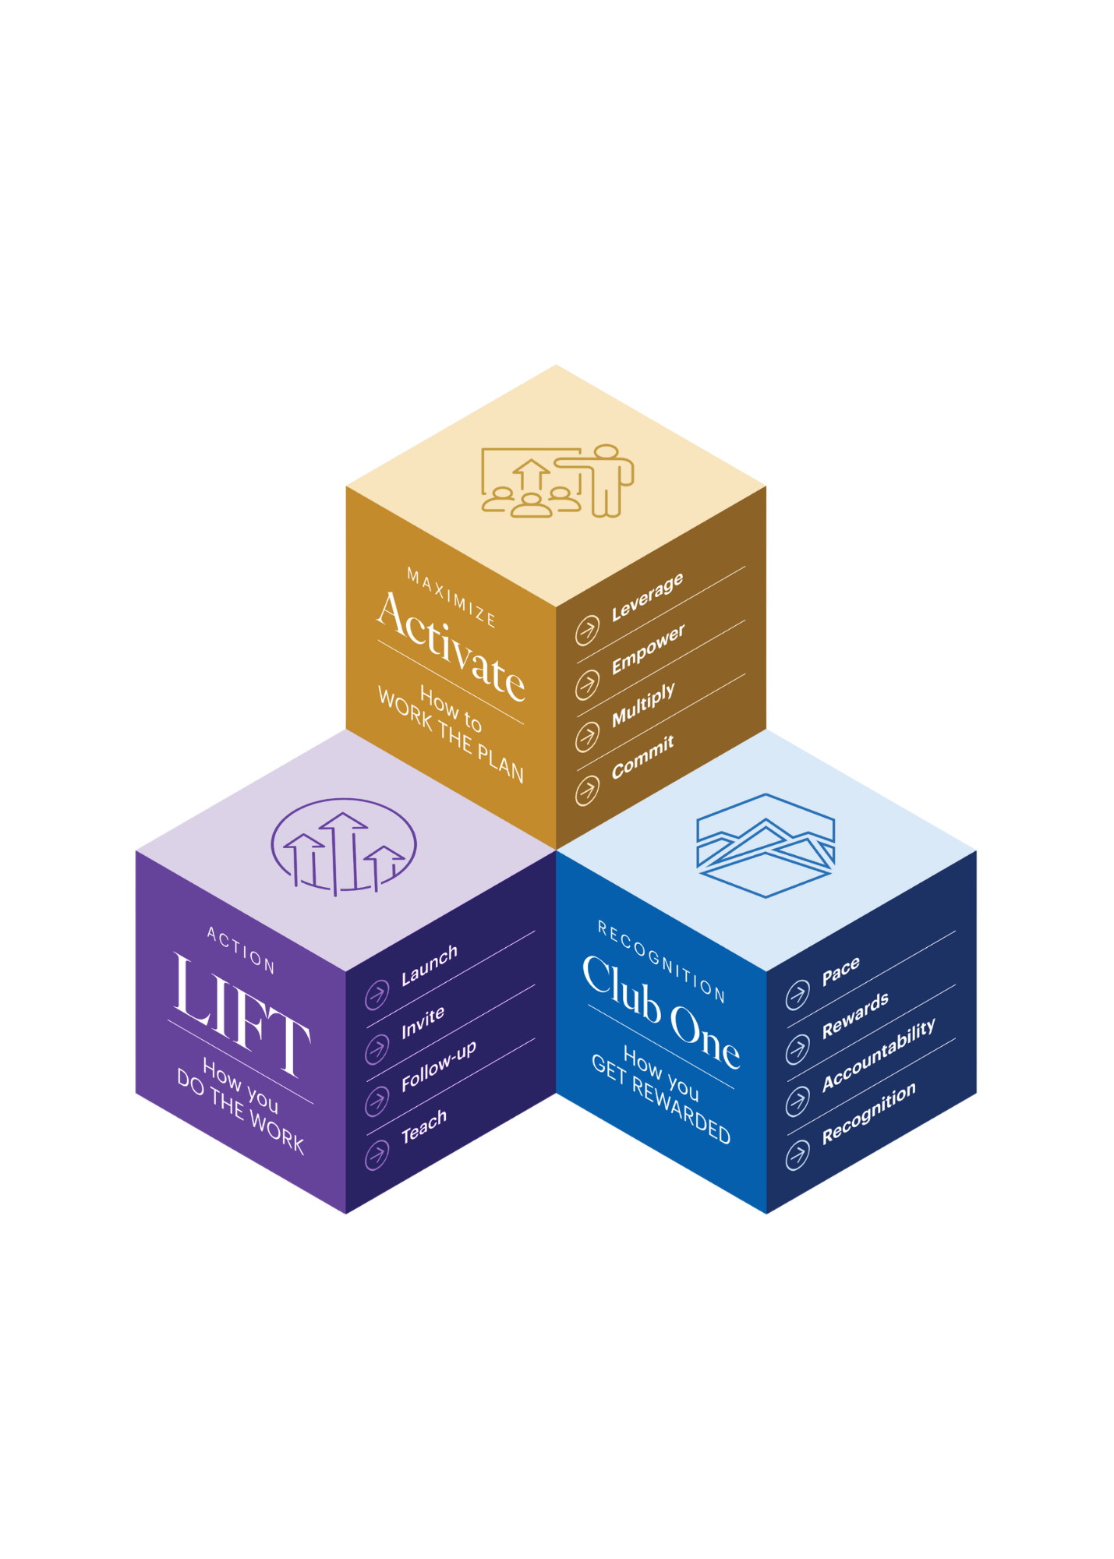
13
THE BIGGER PICTURE
The Brand Partner Success Model.
Every successful Brand Partner does three things: launches and lifts their people, leverages Club One, and maximizes the comp plan.
How you get rewarded
Notes:
[7:30–8:45 | WHY THIS MATTERS TO THE BUSINESS] This is the slide that answers 'so what does this mean for us as a company.' Don't rush it — this is where you talk like a CEO, not a coach.
'Here's what I want every leader in this room to walk away understanding: LIFT isn't a side program. It's the engine underneath everything else we've built.'
Walk the three, plainly: 'LIFT is how you do the work. Club One is how we recognize you for doing it. Activate is how you maximize what you've built. Three systems. One partner. One growth engine.'
This is your growth-loop line — say it deliberately: 'And here's the part that matters most: if Club One activity ever stalls, if Activate numbers ever dip, the fix is almost never in Club One or Activate. It's back here, in LIFT. Check the fundamentals before you chase the symptoms.'

Slide 19
Ready to launch?
You don't need to feel ready.
You can just to follow the steps.
L · Launch I · Invite F · Follow Through T · Teach

Slide 20
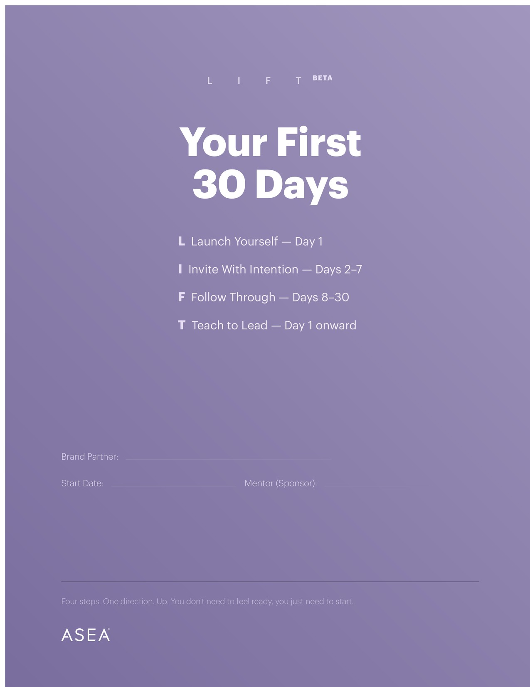
LIFT
WORKBOOK

Slide 21
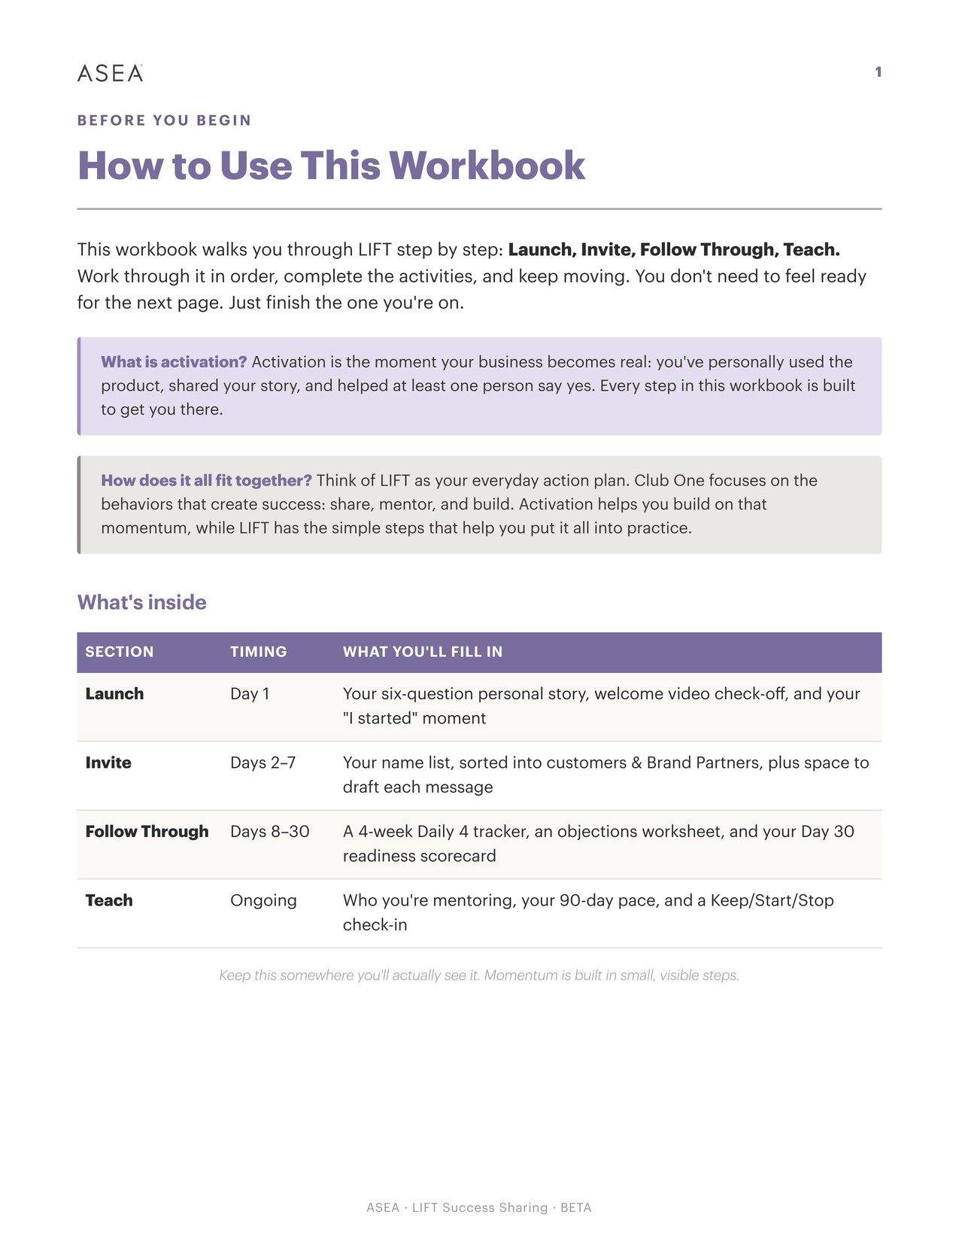
BEFORE YOU BEGIN

Slide 22
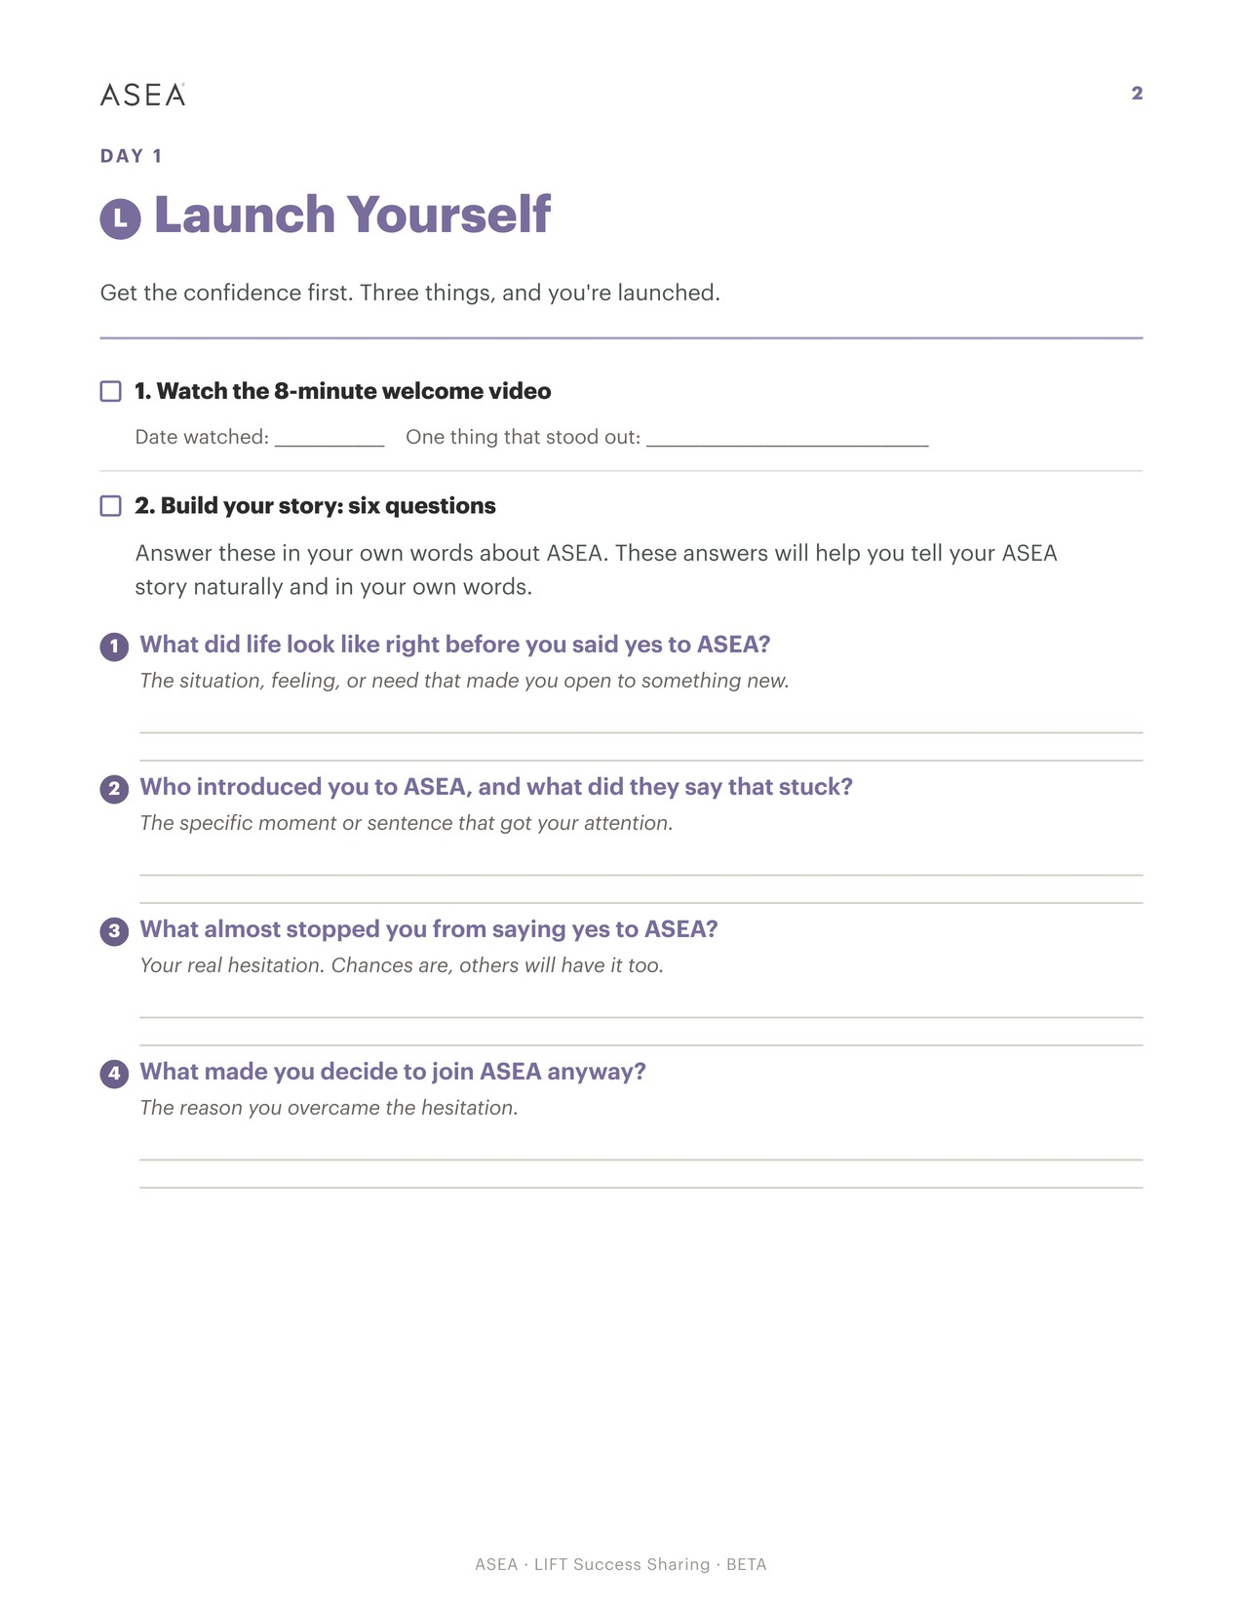
DAY 1
L · Launch ·

Slide 23
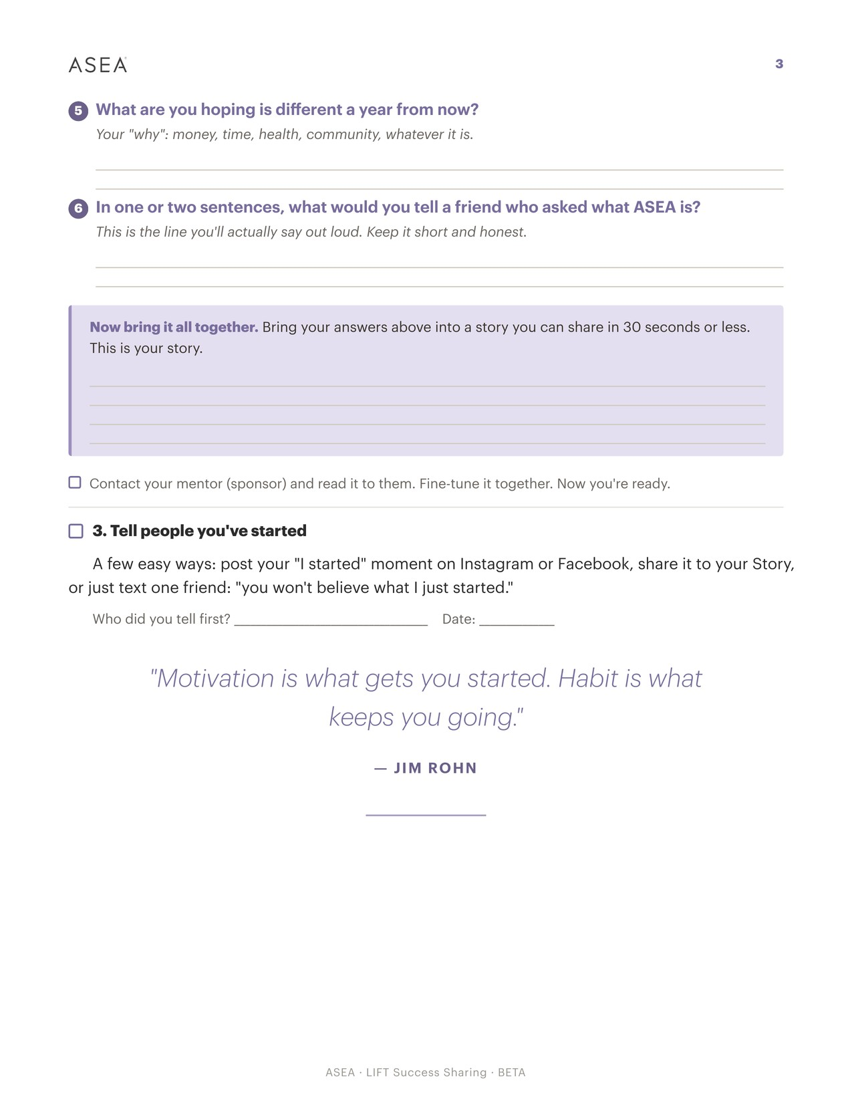
DAY 1 CONTINUED
L · Launch ·

Slide 24
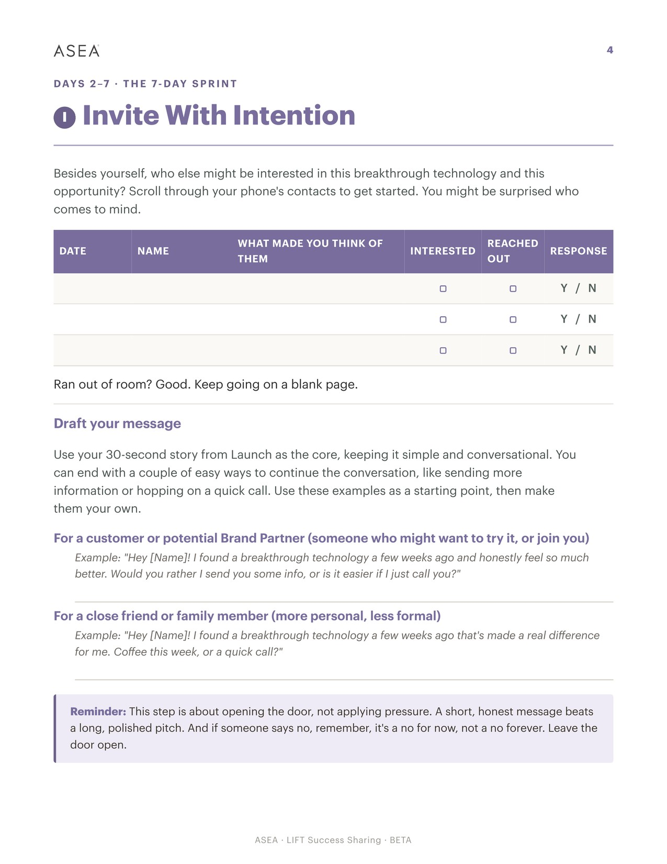
DAYS 2–7 · THE 7-DAY SPRINT
I · INVITE ·

Slide 25
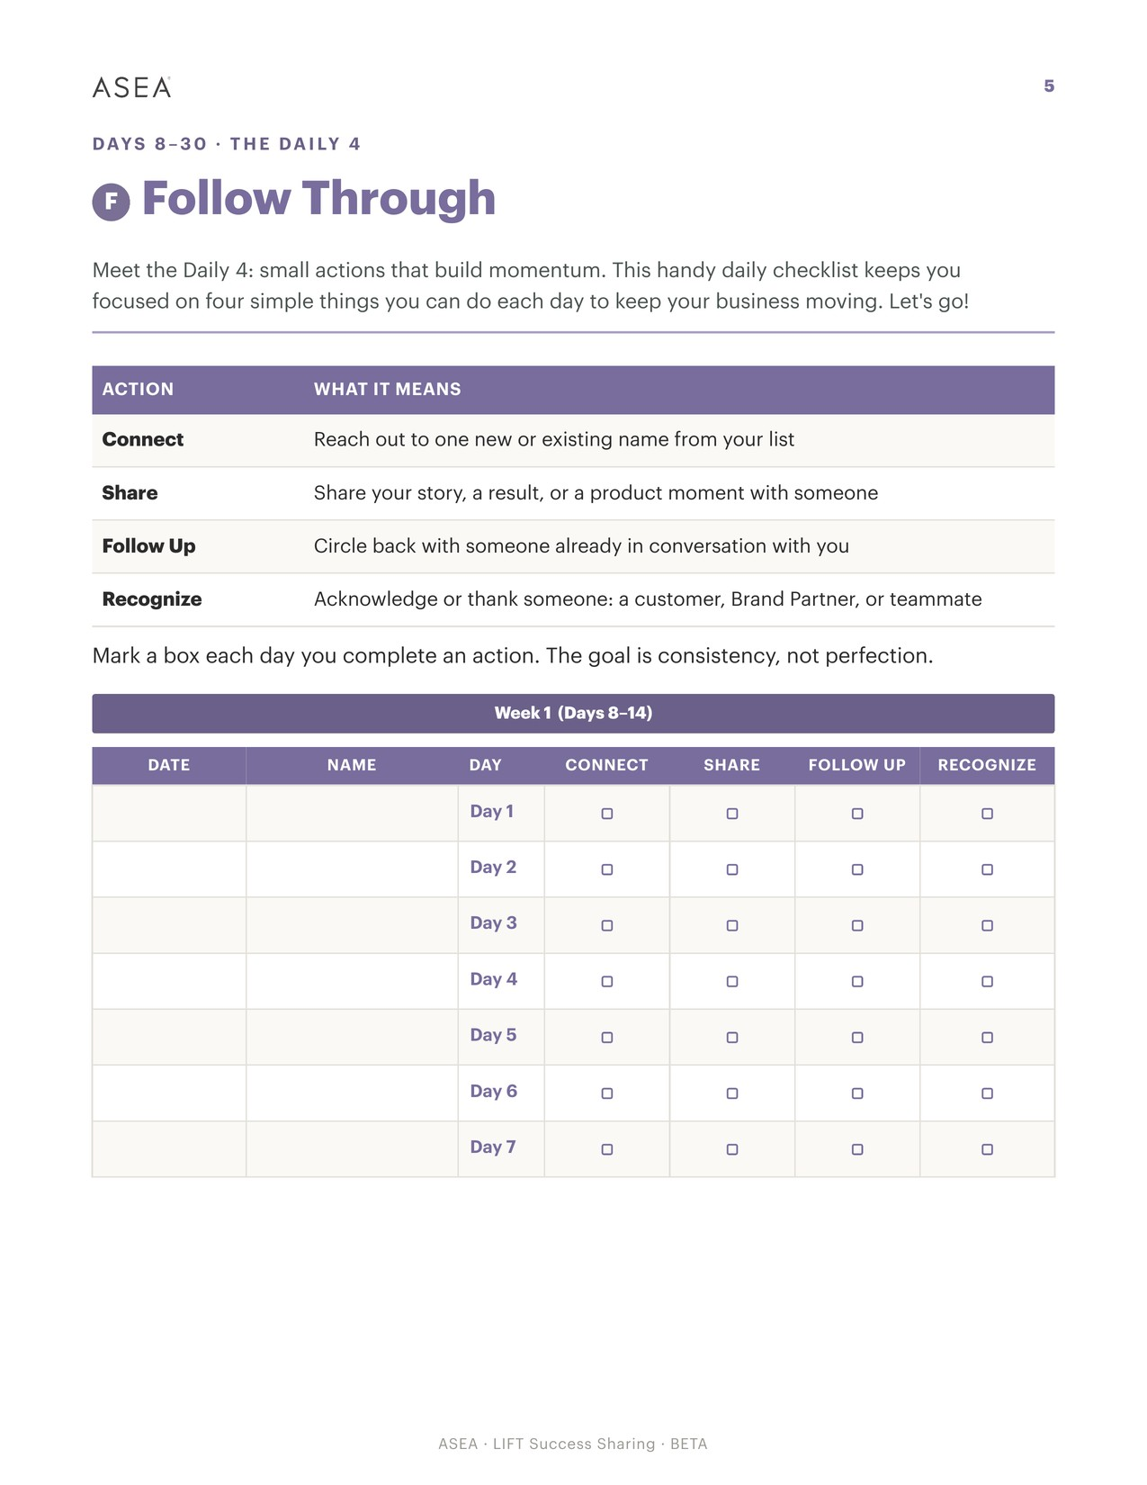
DAYS 8–30 · THE DAILY 4
F · FOLLOW THROUGH ·

Slide 26
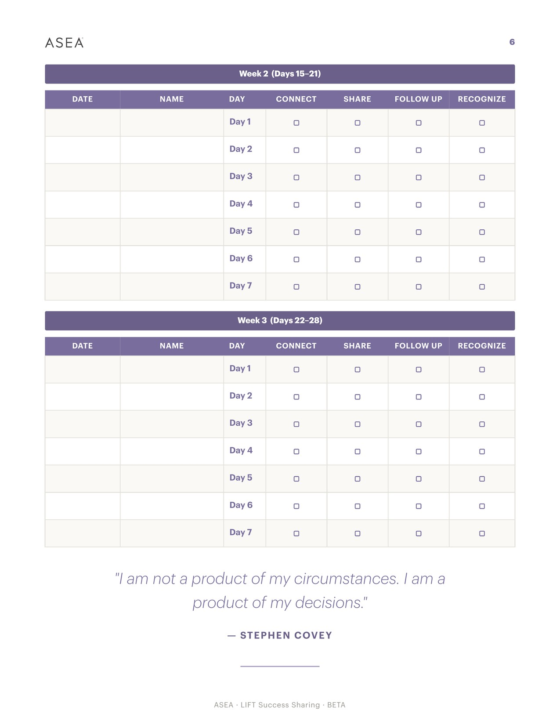
DAYS 8–30 · CONTINUED
F · FOLLOW THROUGH ·

Slide 27
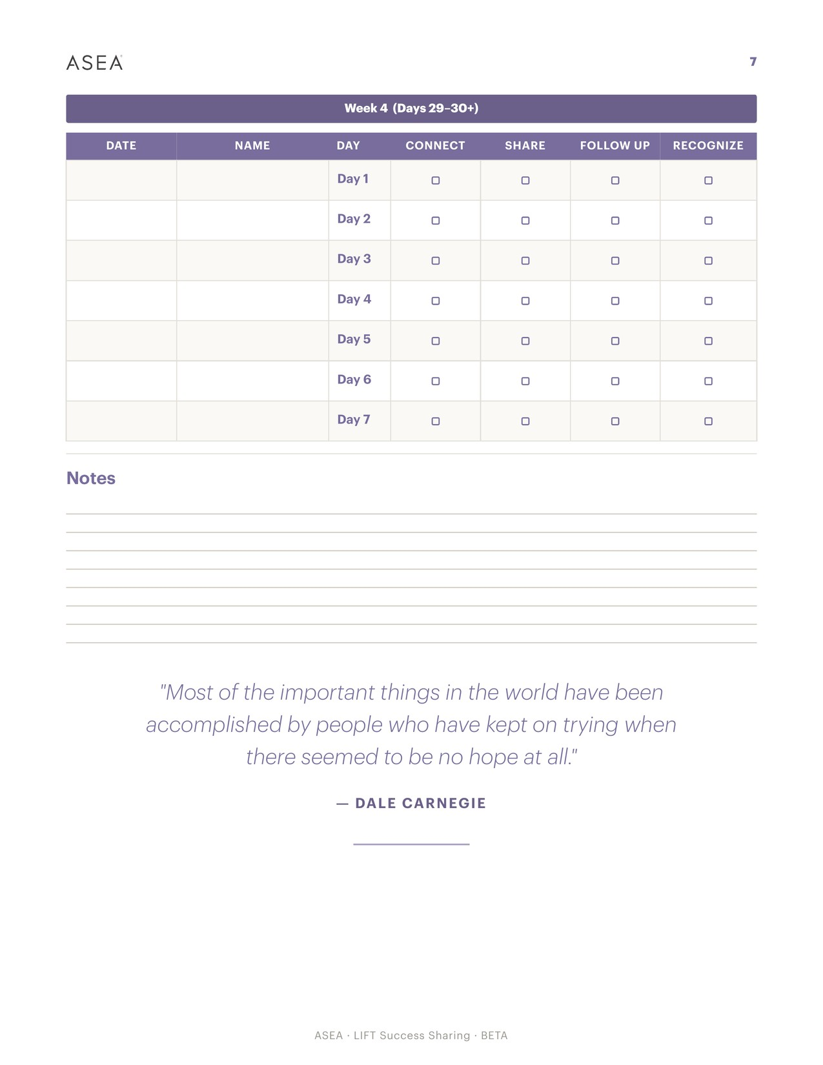
DAYS 8–30 · CONTINUED
F · FOLLOW THROUGH ·

Slide 28
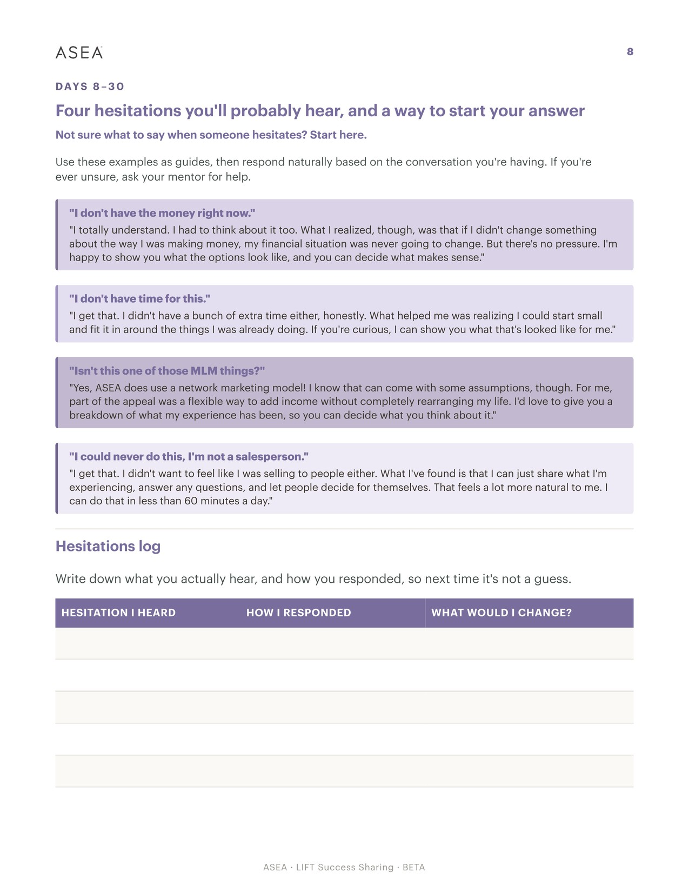
DAYS 8–30 · CONTINUED
F · FOLLOW THROUGH ·

Slide 29
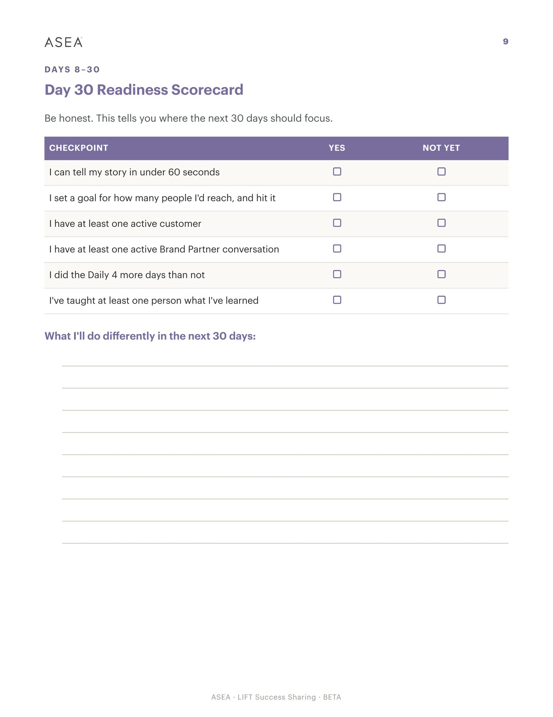
DAYS 8–30 · CONTINUED
F · FOLLOW THROUGH ·

Slide 30
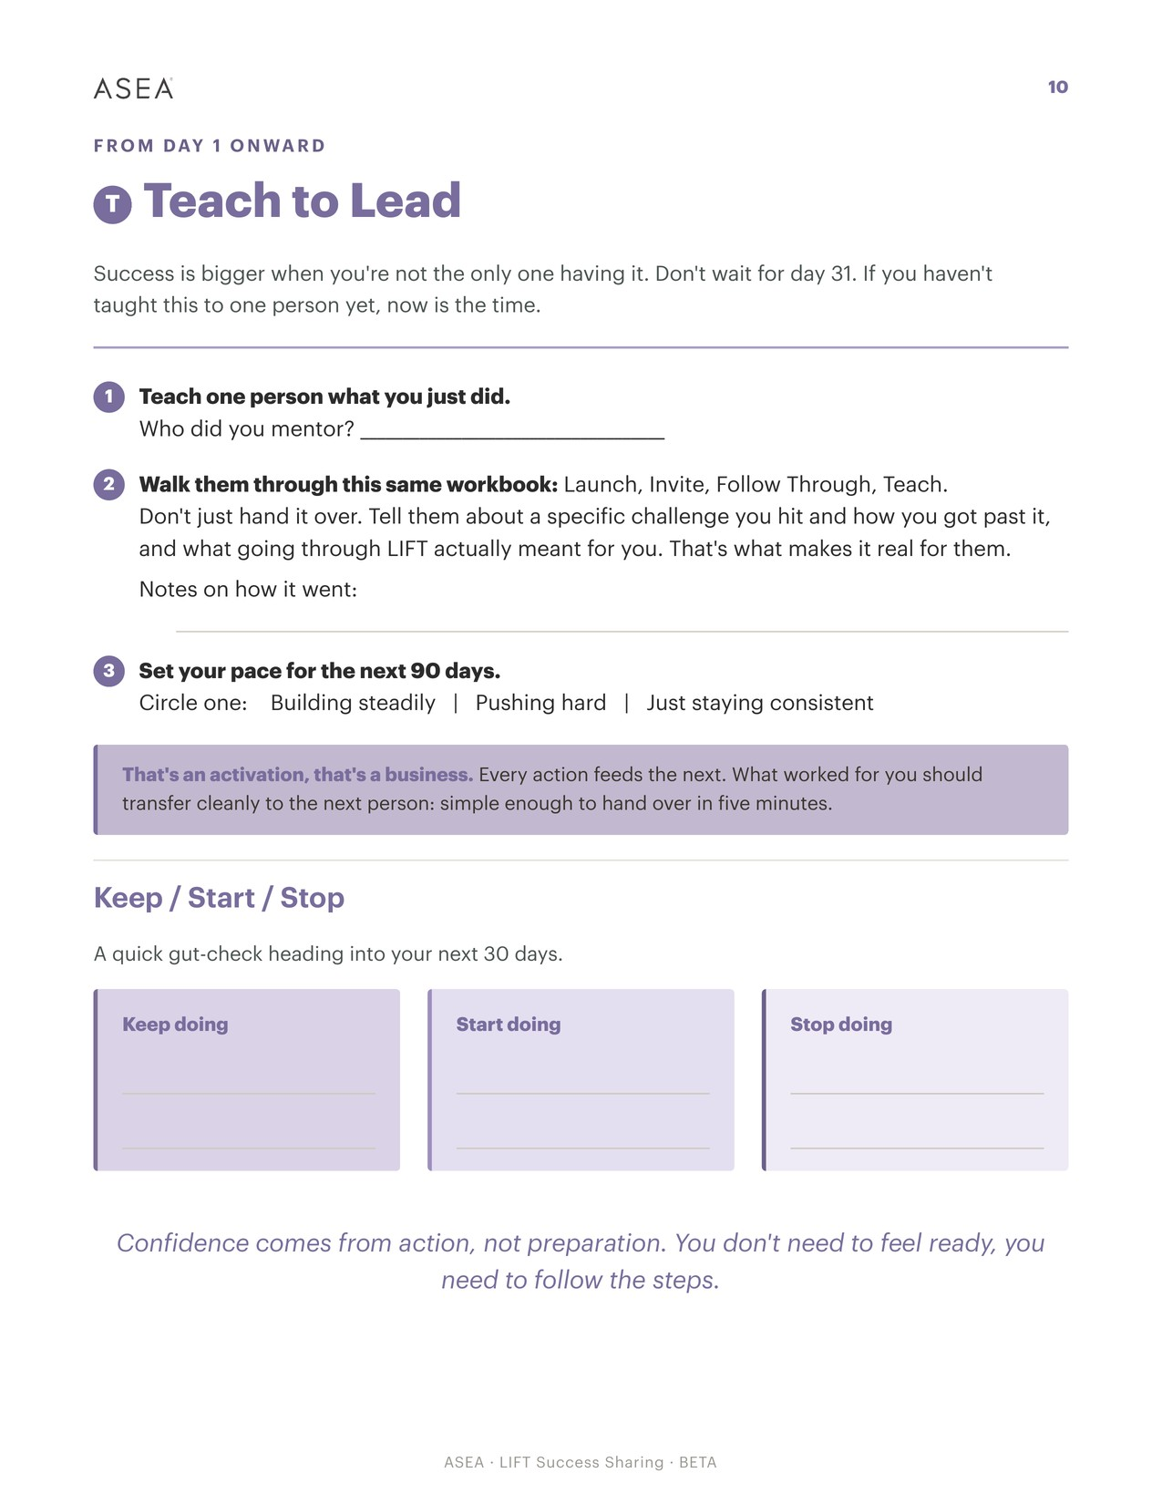
FROM DAY 1 ONWARD
T · TEACH ·

Slide 32
Case Study Team Discussion
Notes:
Over the next hour, you'll work through a business case study. You'll begin in small groups, share ideas at your table, then collaborate with other tables working on the same scenario. Ultimately, each scenario group will select one recommendation to present back to the room.
The objective isn't to find the perfect answer. The objective is to collaborate, challenge each other, and build the strongest recommendation together. As you write your answers, write legibly because we will be digitalizing these to share with you!

Slide 33
Divide your table into three smaller groups
Review your case study
Discuss and collaborate solutions
Select your best recommendation
Notes:
At your table, split into three smaller groups — for most of you, that’ll be two groups of three and one group of four.
Each group has a case study in front of you. Take a minute to read through it, and then start talking through how you would approach it.
You’ll have 10 minutes. Before we wrap up, make sure everyone in your group is clear on the recommendation you want to bring back to your table.
And if you have questions along the way, our team is around the room to help.

Slide 34
Share at your table
Each group shares its recommendation
Discuss similarities and differences
Identify the strongest idea and a table captain to represent it
Notes:
Okay, let’s bring it back to your table.
Go around and have each group share the recommendation you came up with. As you listen, talk through what you agree on, where your approaches were different, and what ideas you might want to combine.
As a table, your goal is to land on one recommendation you want to move forward.
You’ll also need to choose one person to be your Table Captain for the next part. You have 5 minutes to decide this.

Slide 35
Captain Collaboration
Notes:
We’re going to start moving into our Captain Collaboration.
Table Captains, our ushers will help get you connected with the other captains who worked on your same case study.
Once you’re together, you’ll compare what each table came up with, land on one final recommendation, and choose someone to share it with the room.
Ushers, you can go ahead and start helping our captains get into place.

Slide 36
While the captains are discussing, keep this conversation going at your table.
Talk about your case study and share any real-life experiences you’ve had that connect to this.
Notes:
While the captains are discussing, keep this conversation going at your table. Talk about your case study and share any real-life experiences you’ve had that connect to this.

Slide 37
Captains, let’s hear it!
Re-visit the case study for your group
Present your recommendation
Explain why it was selected
Share any key insights
Notes:
(Gather everyone back together) For each case study, we’ll bring your spokesperson up to the stage. We’ll quickly revisit the scenario, and then we want to hear where your group landed.
Tell us what you recommend, why you chose it, and anything interesting that came up as you worked through it together.

Slide 38
Leah – Why Should I Care?
Leah is active and healthy. She knows a lot about wellness already. She knows about food, exercise, water, and supplements.
She has a routine that works for her and she has kept it for a long time. That is not easy to do.
You say the words Cellular Intelligence. To her it sounds technical and far from daily life. You have a short time before her next appointment.
Notes:
Let's begin with the first case study. Would the spokesperson for Leah’s case study please join us on stage?
Thank you. Let's quickly revisit the challenge you were asked to solve.
~ Read slide ~
Let's give them a round of applause.

Slide 39
Maya – It Is Just Salt and Water
Maya reads labels. She asks questions before she tries a new product. This is a good habit.
She turned the bottle over and found two ingredients. She has also heard the words redox signaling and cellular communication, and they did not help her.
She told you she wants to understand the product. She does not want a sales speech. You have good materials, but you do not remember every study in detail.
Notes:
Let’s move on to the next case study. Would the spokesperson for Maya’s case study please join us on stage?
Thank you. Let's quickly revisit the challenge you were asked to solve.
~ Read slide ~
Let's give them a round of applause.

Slide 40
Daniel - I Do Not Feel Anything
Daniel has ordered for two months. He was excited when he started. He told two friends about it.
Today he calls you. He says he does not feel different, and the product is not cheap. He is deciding whether to order again.
He is not angry. He is disappointed. He is also being honest with you, which most people would not bother to do.
Notes:
Would the spokesperson for Daniel’s case study please join us on stage?
Thank you. Let's quickly revisit the challenge you were asked to solve.
~ Read slide ~
Let's give them a round of applause.

Slide 41
Marcus – I Am Not a Salesperson
Marcus has used the products for nine months. He speaks well of them when people ask. Friends now ask him what he uses.
Two coworkers bought the products after hearing him talk. He never tried to sell them anything. He is already doing the thing he says he cannot do.
He has mentioned that extra income would help. He has never asked you about the business. Today at lunch he asks how you got started.
Notes:
Would the spokesperson for Marcus’ case study please join us on stage?
Thank you. Let's quickly revisit the challenge you were asked to solve.
~ Read slide ~
Let's give them a round of applause.

Slide 42
Alex – Why Should I Keep Going?
Alex has spent three years building this team. For the last eight months nothing has moved. Same effort, same routine, no growth.
On a team call, Alex finally says it out loud in front of everyone.
Alex is still showing up. That tells you something. A motivating speech will help for one day.
Notes:
Finally, let's hear from the last case study. Would the spokesperson for Alex’s case study please join us on stage?
Thank you. Let's quickly revisit the challenge you were asked to solve.
~ Read slide ~
Let's give them a round of applause.

Slide 43

Turn insights into action.
Notes:
As you move through Summit and beyond, continue asking questions, learning from others, and challenging yourself to think differently. Thank you for your participation, your engagement, and the thoughtful contributions you brought to today's discussion.
BOTTLE GIVEAWAY BE IN YOUR SEATS AFTER LUNCH

