Slide 2
The Next Stage
Every stage you stand on sets you up for the next one after it.
Notes:
\applies no matter what market you’re in.
You have your larger events, but then you also have all of those moments happening in between — conference rooms, coffee chats, local meetings, and smaller gatherings where people are connecting and prospecting.
Terry talked earlier about creating that rhythm of events. In North America, we started asking ourselves: How can we better support those moments in between?

Slide 3

Activate Event Program
BETA
Use every event as a springboard to the next opportunity.
ACTIVATE
ACTIVATE
ACTIVATE
IGNITE
IGNITE
INCENTIVE
IGNITE
Guadalajara
November 2026
Dallas
February 2027
Punta Cana
May 2027
TBD
August 2027
Notes:
We have our larger corporate-led events throughout the year — Guadalajara this November, Dallas in February, Destination One in Punta Cana in May, and another Ignite event coming in August.
Those are our big moments to come together for training, recognition, connection, and momentum.
But we don’t want our Brand Partners waiting for the next corporate event to create that momentum.
Activate is designed to fill the space in between.
We want to empower our leaders to create meaningful events in their own regions, with their own teams, and then use those events as a springboard into the next opportunity.”

Slide 4
BETA
Activate Event Program
Attendance | Success Criteria | If Successful | If Under Target
150+ | 20% activated (30+) | $3,000 | $500 offset
100 - 149 | 20% activated (20+) | $2,000 | $400 offset
50-99 | 20% activated (10+) | $1,000 | $300 offset
Additional Perks – 150+ Attendance
A corporate representative attends the meeting to deliver a corporate message and lend credibility.
Hosts receive a $500 swag or website credit.
Must have a diamond sponsor *
Notes:
And because we want our leaders to actually use this program, we’re putting real support behind it.
For this North America beta, it will be available to Summit attendees and Diamonds, with a Diamond sponsor required for qualifying events.
And the goal isn’t simply attendance — it’s activation. Ultimately, we want these events to help our leaders activate their businesses locally and carry that momentum into Destination One.”

Slide 5
BETA
Activate Event Program
Attendance | Product Support
150+ | Up to $1,500 in wholesale product value
100 - 149 | Up to $1,000 in wholesale product value
50-99 | Up to $500 in wholesale product value
Brand Partners may run unlimited qualifying meetings and earn tier based perks that meet the criteria!
Must have a diamond sponsor *
Notes:
We’re also supporting these events with product. We want Activate to become part of that ongoing event rhythm — creating another reason to gather, share, and build momentum.” Summit

Slide 6
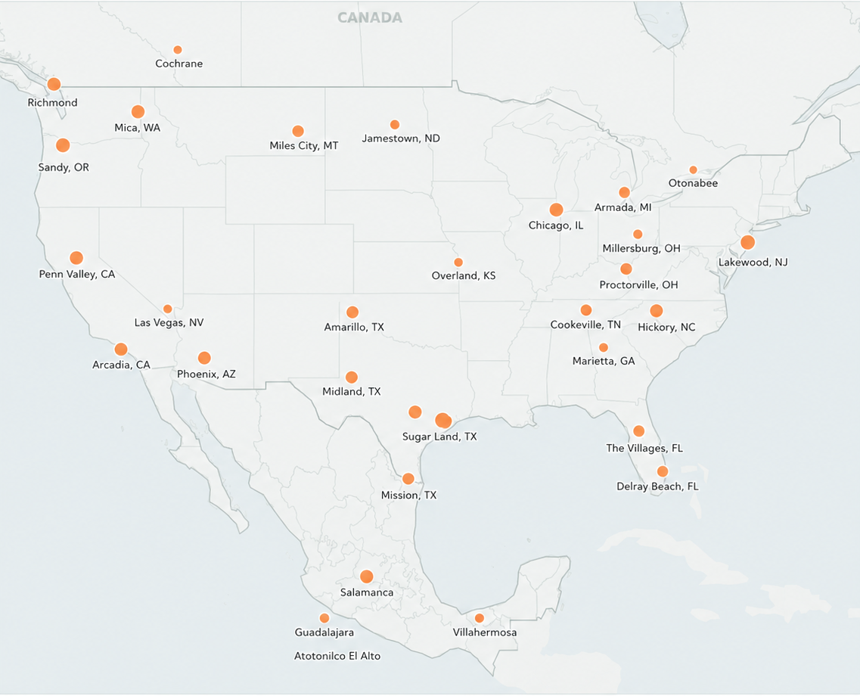
It’s Up To You.
Notes:
And this is where our North America leaders come in.
It’s up to them.
We can create the program. We can provide the resources. We can help offset costs and provide product.
But our leaders know their markets. They know their communities. And they know where the opportunities are.
Our goal is to give them the support to look at this map and ask, ‘Where can we create that next point of momentum?’

Slide 7
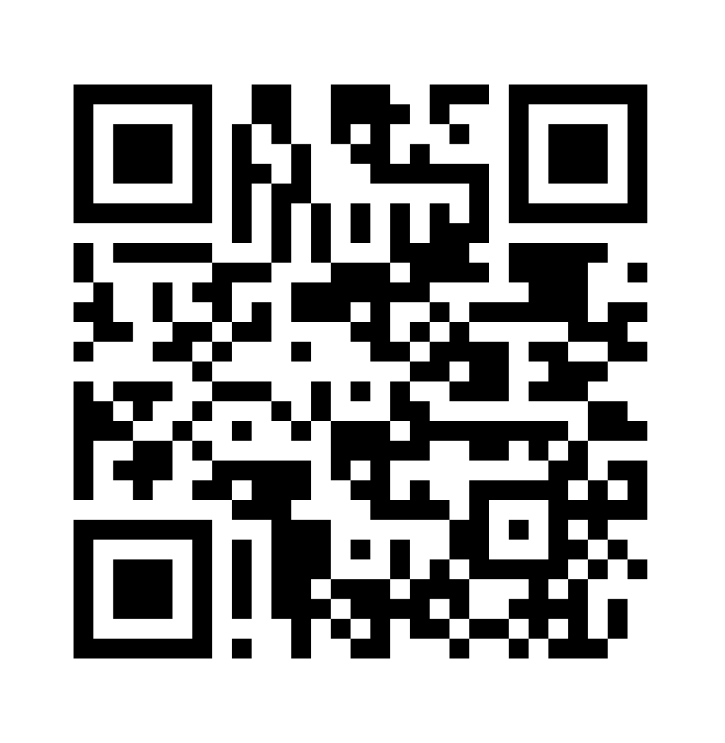
Ready to join us?
Email us at nabusinessdev@aseaglobal.com
with the following:
Your name
Diamond Sponsor
Attendance Tier
Location
Date
Notes:
or our North America leaders who are ready to get started, they’ll be able to scan the QR code or reach out directly to our North America team. Again, this is a beta. We’re going to learn from it, see what works, and continue building from there.
But providing the resources is only one piece of this. What leaders do with the event once they have people in the room is what really matters.
And to talk more about how to make the most of these events and create that rhythm intentionally, I’d like to welcome someone who has tremendous experience doing exactly that.
Please help me welcome Ambassador Triple Diamond Executive, Terry Latham

Slide 8
Creating Your Cover Story
Visualize Your Journey

Slide 9
Creating Your Cover Story
\
Challenges Overcame
Headline
Vision
Greatest Accomplishments
Subtitle
My Supporters
Behind the Scenes
Motivation

Slide 10
