Slide 1
There has been a shift
in a $2 trillion industry…
ASEA

Slide 2
that virtually nobody
knows about.
ASEA

Slide 3
And here is the wild part…
It is with a company that has zero competitors, patent-protected and exclusive technology, in a category it has defined for the past two decades.
ASEA

Slide 4
Naturally I said no at first
(I’m a skeptic)
01
02
03
Is this one of those things?
Who would I even talk to?
I am not a salesperson.
ASEA

Slide 5
Then, without realizing it,
things changed for me.
01
02
03
04
How I feel
Who I know
What I can do
What I am building
ASEA

Slide 6

But you don’t have to take my word for it…
hear about it from someone else.
It is ok. I did not either.
It snuck up on me. I had built it into my life and it all started feeling better.

Slide 7
Use a product testimonial here.
ASEA
Notes:
Play the film here. In the web deck this frame plays automatically.

Slide 8

WHAT CHANGES WITH AGE
At some point, something shifts.
Doing everything you were told would work. And it stops working the way it used to.
Notes:
Slide 64 — At some point, something shifts.
At some point, something shifts.
Let me tell you the story we are going to tell the world. In a few weeks you will be saying it.
It starts like this.
At some point in your forties, something shifts.
You are doing everything you were told would work. And it stops working the way it used to.
Recovery takes longer. Energy drops. You do not bounce back.
Most people call that aging and accept it.
But aging is more than time.
(slow)
It is a communication breakdown. And it compounds.

Slide 9
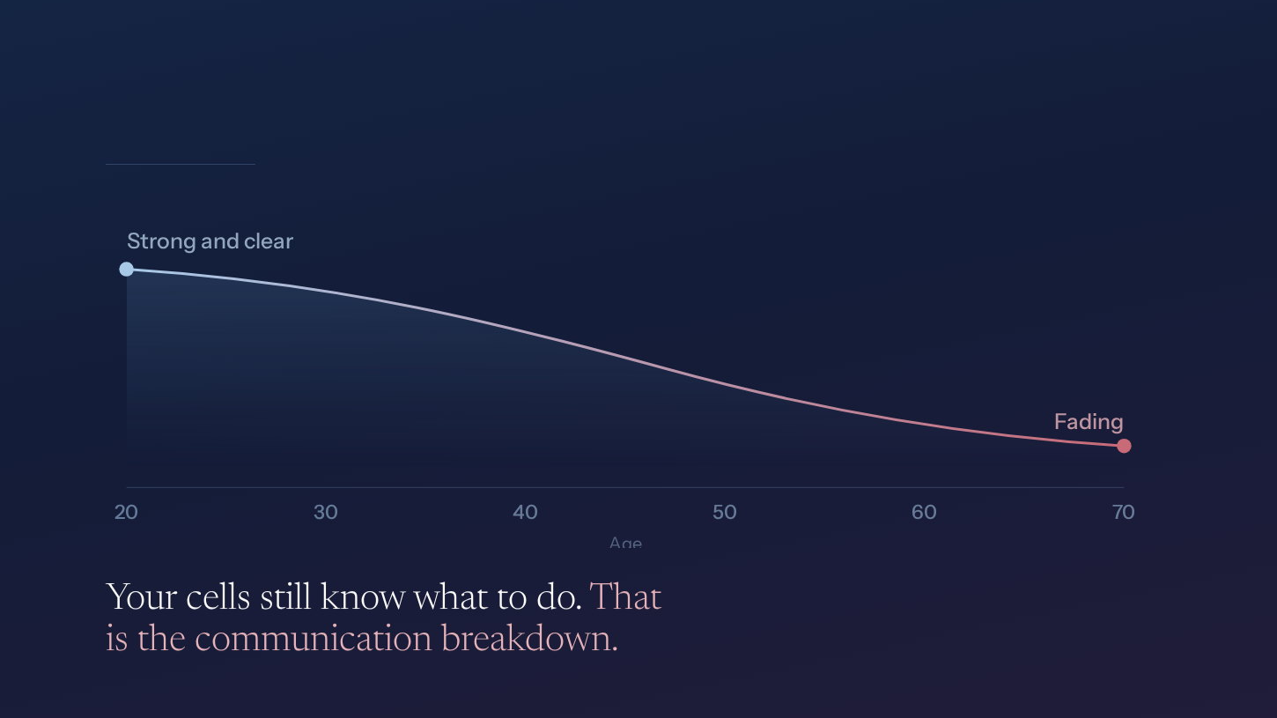
THE DECLINE
The signal fades.
Notes:
Slide 65 — The signal fades.
The signal fades.
When you are young, that signal is strong. Loud. Constant.
And as you age, it fades.
Not your cells. Your cells still know exactly what to do.
The messages that carry the instruction are simply getting quieter.
(pause, then land it)
That is the communication breakdown. That is what we have been calling aging.

Slide 10
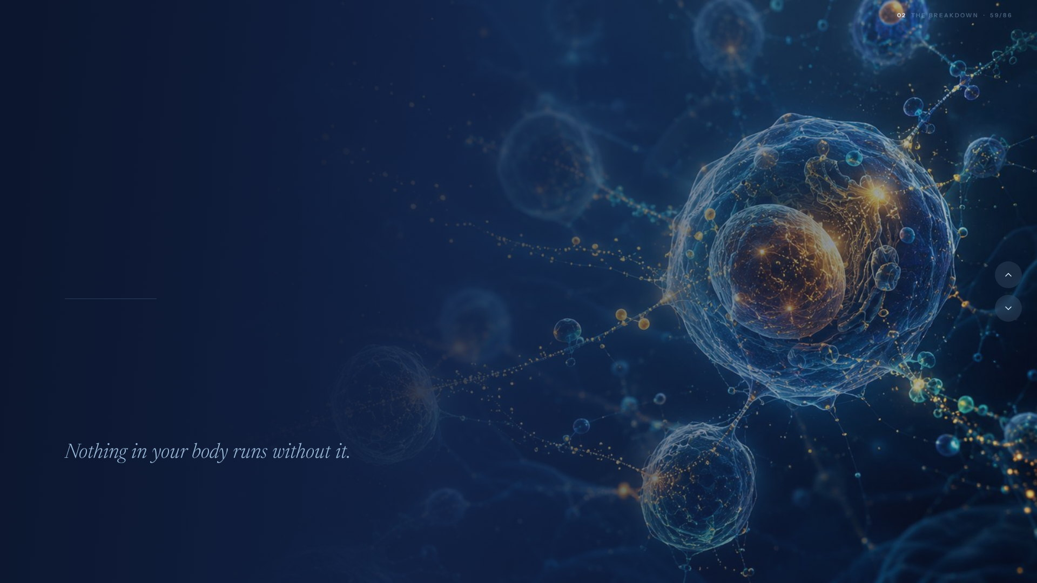
THE LEVEL WE WORK AT
37 trillion cells.
One conversation.
Every one of them has a job, and the intelligence to know how to do it. When to repair. When to recover. When to perform. When to protect.
Notes:
Slide 59 — 37 trillion cells. One conversation.
37 trillion cells. One conversation.
Here is why.
Your body is powered by thirty seven trillion cells, in constant conversation.
Every one of them has a job, and the intelligence to know how to do it. When to repair. When to recover. When to perform. When to protect.
They are talking to each other right now. Every second of your life.
(beat)
Nothing in your body runs without that conversation.

Slide 11
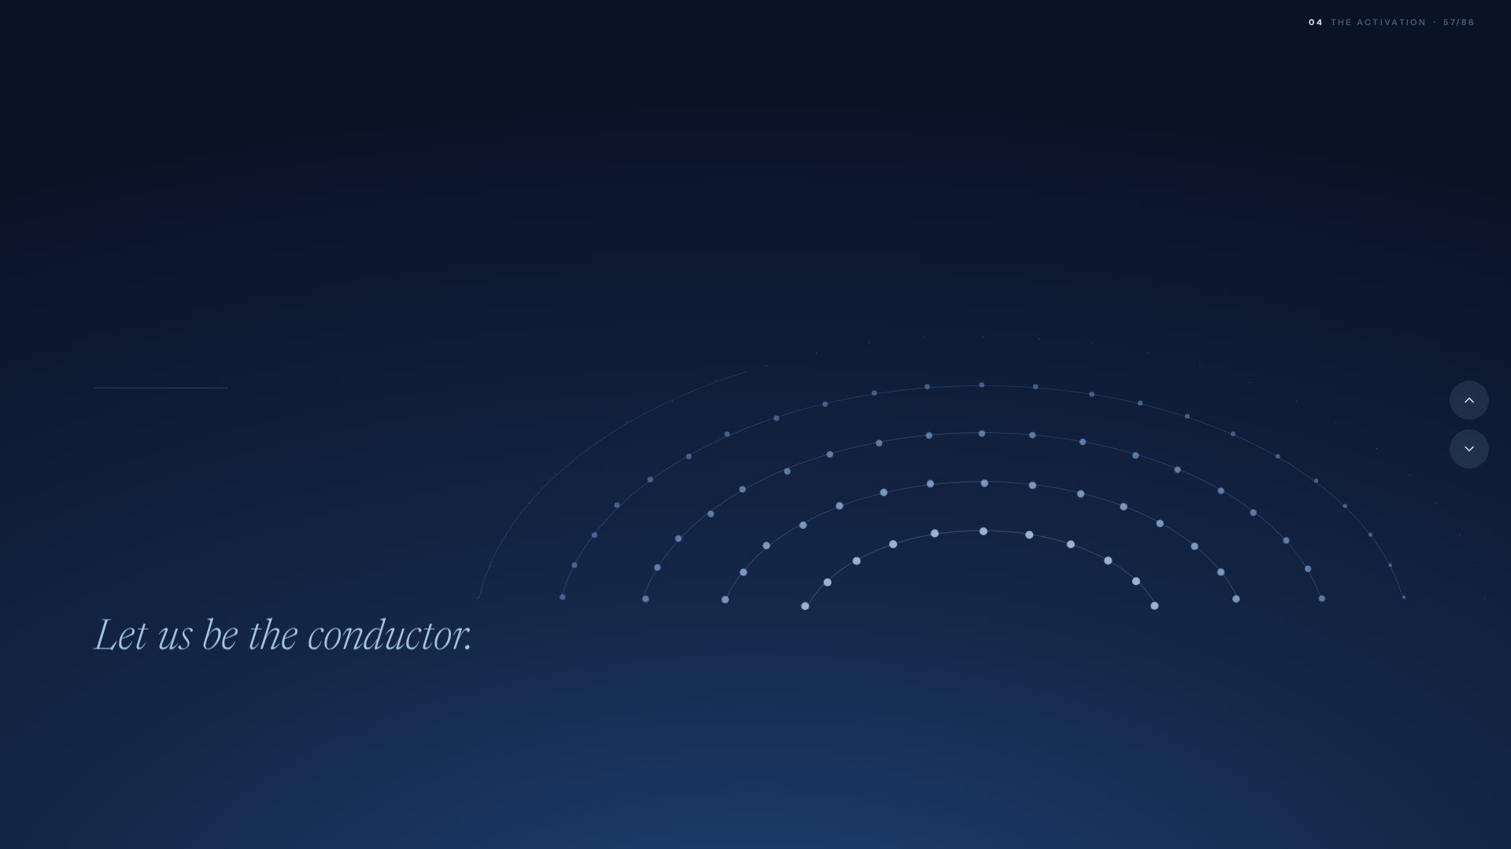
THE ORCHESTRA
An orchestra with no conductor is just noise.
Your body is that orchestra. The training, the food, every supplement in your routine. All of it talent, with no one to lead it.
This technology becomes the conductor.
Notes:
Slide 57 — An orchestra with no conductor is just noise.
An orchestra with no conductor is just noise.
Let me make it plain.
(the orchestra assembles behind you)
An orchestra with no conductor is just expensive noise.
Your body is that orchestra. The training. The food. Every supplement in your routine. All of it talent, with no one to lead it.
(the conductor arrives)
ASEA Redox adds more of those very same signaling molecules.
That is the conductor your cells were built to follow.
One signal. And every section hears it at once.

Slide 12
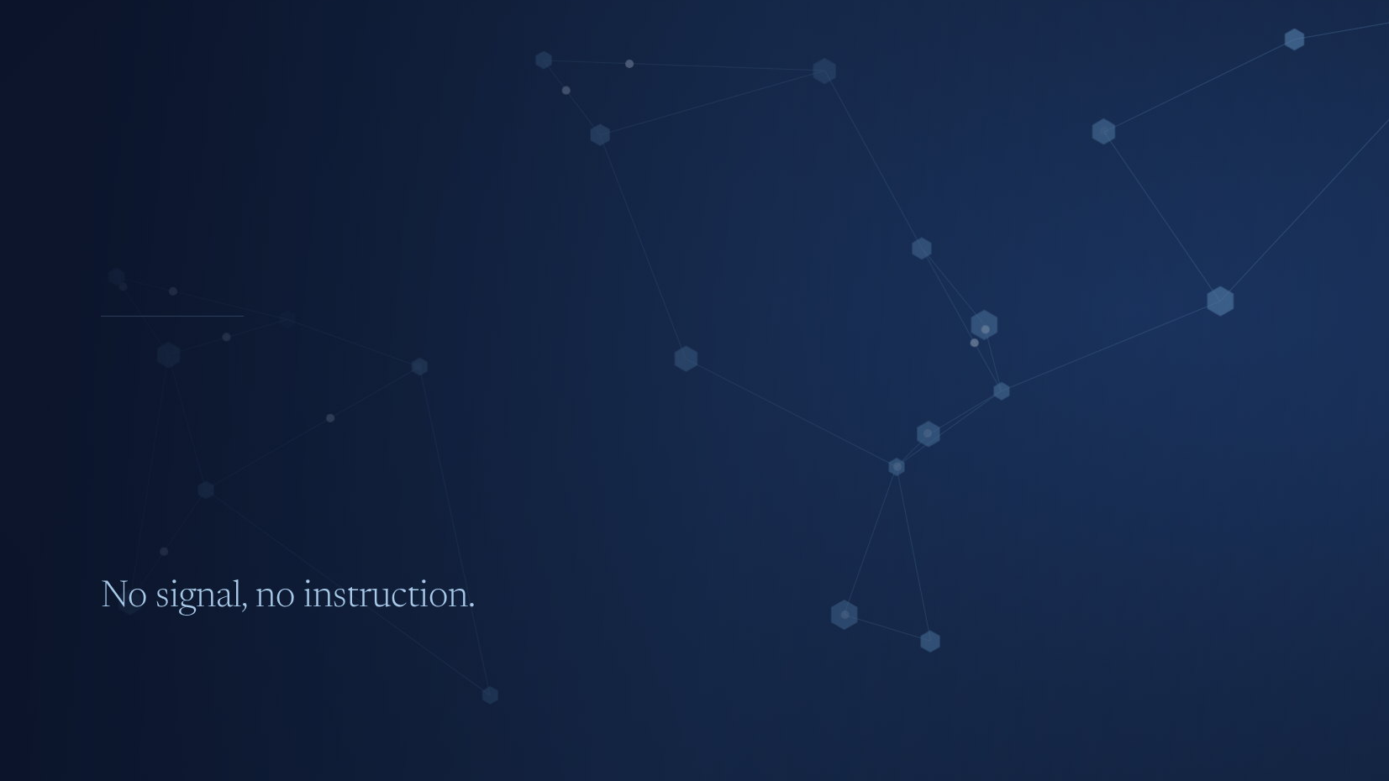
WHAT IT RUNS ON
The conversation runs on signal.
The remarkable ability of your cells to sense, communicate, respond and adapt. It powers the $2 trillion wellness industry.
Notes:
Slide 60 — The conversation runs on signal.
The conversation runs on signal.
And that conversation runs on something physical.
Redox signaling molecules.
They are the messages themselves. Your cells make them, pass them between one another, and read them as instruction.
Repair here. Recover now. Perform. Protect.
They are how the body tells itself what to do.
(let the signal finish travelling, then)
No signal, no instruction.

Slide 13
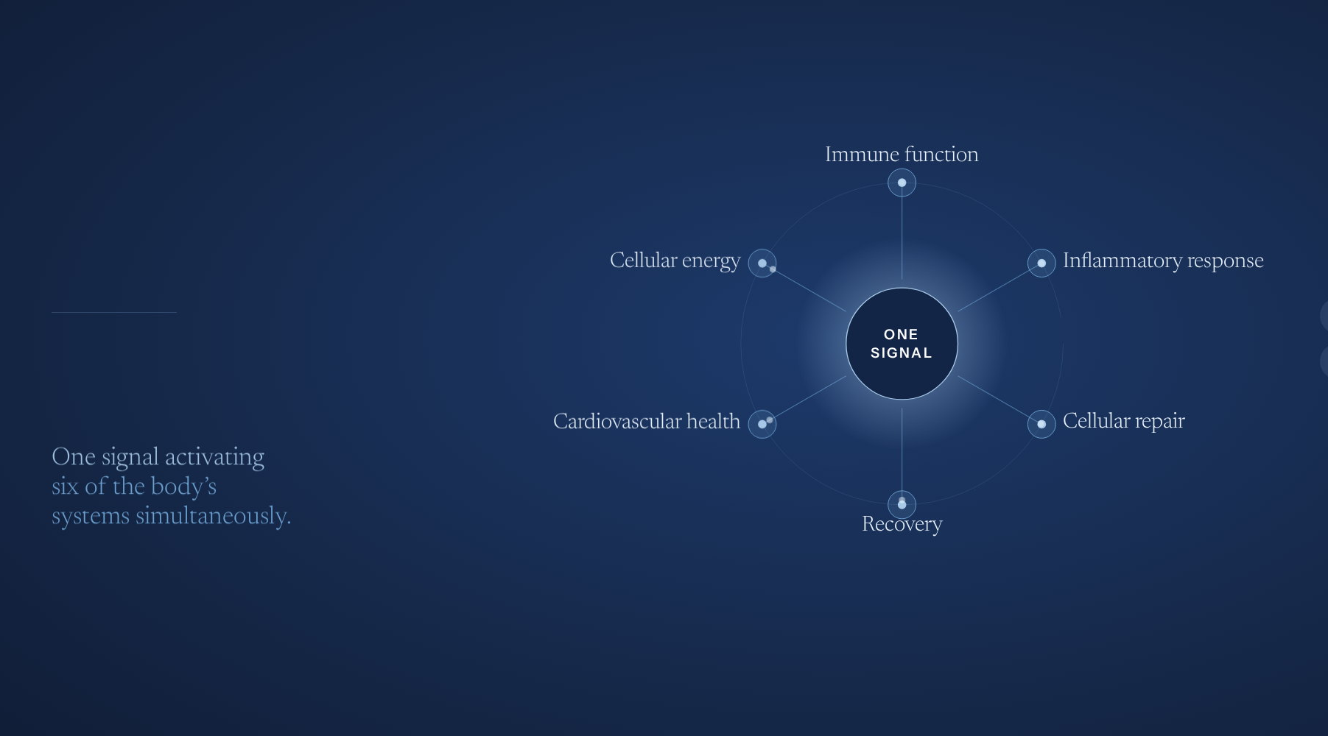
WHAT THOSE BENEFITS ACTUALLY ARE
One signal.
Every system.
The same molecules reach every major system at once, and speak to each one in the language it already knows.
Notes:
Slide 54 — One signal. Every system.
One signal. Every system.
So what does it actually do.
The same molecules reach every major system at once.
Immune function. Inflammatory response. Cellular repair. Cellular energy. Cardiovascular health. Recovery.
One signal activating six of the body’s systems simultaneously.

Slide 14
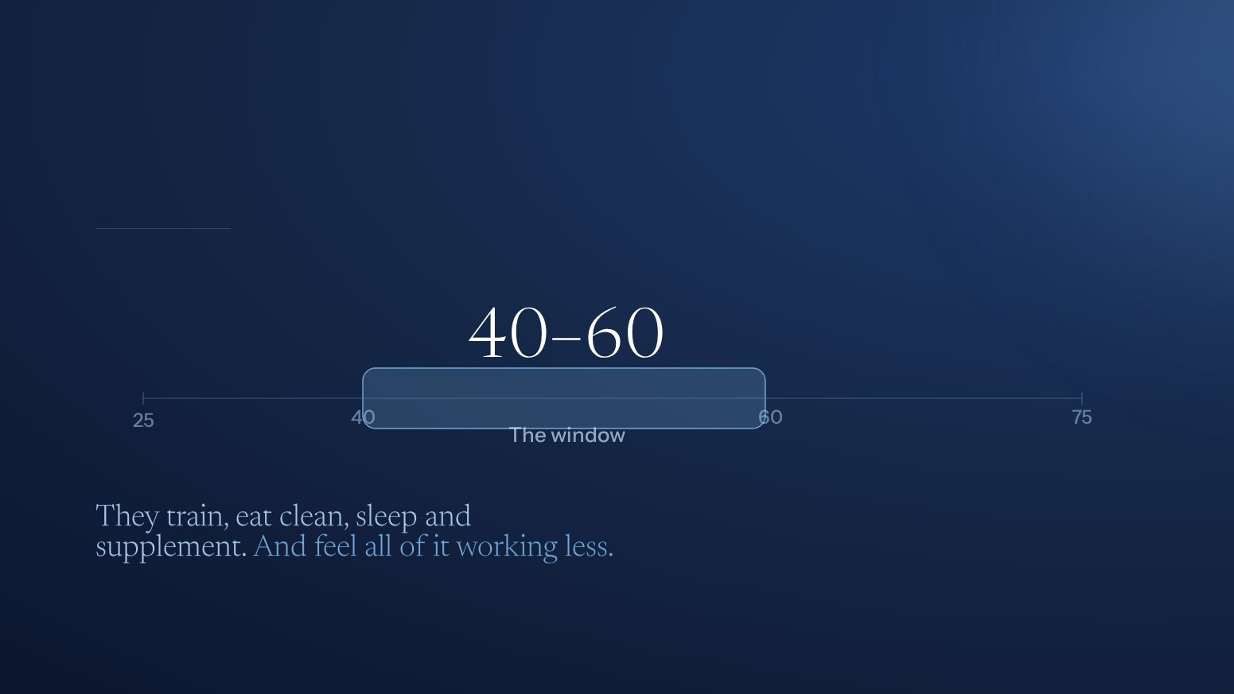
WHO LIVES AT THAT LEVEL
For the ones doing everything right.
Notes:
Slide 66 — For the ones doing everything right.
For the ones doing everything right.
So who is this for.
Not the sick. Not the desperate.
The ones doing everything right.
Mid forties to mid sixties. They train. They eat clean. They sleep. They supplement.
And they can feel all of it working less than it used to.
That is the loudest health conversation on the internet right now. And the category underneath it does not have a name.
(pause)
It is still ours to take.

Slide 15
Three fair questions.
01
02
03
Too good to be true?
Why have I not heard of it?
Why is it not on a shelf?
All three have the same answer.

Slide 16
Somebody offered
to buy it.
It started with a phone call.
Before there was a company, there was a technology.
And a buyer with a check.
That phone call is where all three answers start.

Slide 17
There was one condition.
Take it off the market. Let it disappear.
A fortune, to make sure nobody ever felt it.

Slide 18
THE FOUNDER
We said no.
Verdis Norton had built billion-dollar companies.
He knew exactly what he was turning down.
He said no anyway.
One person chose people over a payday.

Slide 19

Nearly two decades later.
Tens of
Thousands
$2B
35
Zero
nearly, in global sales
loyal for a decade or more
countries, and still growing
true competitors
Privately held. Profitable. Disciplined. Built to last.
Notes:
Slide 5 — Nearly two decades later.
Nearly two decades later.
[ Jarom's section ]
(Jarom is presenting)

Slide 20
Use the science video animation here
Notes:
Play the film here. In the web deck this frame plays automatically.

Slide 21
STEWARD OF REDOX SIGNALING
A product that cannot be copied
in a category that supports a $2T industry.
All this, launched in a channel made to empower YOU.
Seven patents. Thousands of protected discoveries. An FDA-registered facility.
And growing…

Slide 22
THE OPENING
You already missed the first $2B.
Do not miss the next 10.
That is the piece I wanted to own.

Slide 23
INTERMISSION
Take ten minutes.
When we come back: how people are turning this into something they own.
Next is what it can be.
ASEA

Slide 24
So what?
Is this a category you want to own a piece of?

Slide 25
THE QUESTION
Now that you know
about the shift,
Is this the opportunity for you?
ASEA

Slide 26
How do you evaluate
an opportunity?
Before you look at ours, decide what you are looking for.
A trillion dollar question.

Slide 27
JUDGE ANY OPPORTUNITY
Ask yourself the following questions:
01
02
03
04
05
Does it make a life better every day?
Can the science be copied, or is it defended?
Can the company be trusted?
Will I get the support I need?
Is there a system?
Ask them of anyone who offers you something.

Slide 28
THE PLAN
28 / 35
FIVE FOR FIVE
Here is how ASEA scores.
01
02
03
04
05
Every day
Defended
Trusted
Supported
A system
ASEA Redox, taken daily, whether or not a given week feels different.
Seven patents, thousands of protected discoveries, an FDA-registered facility.
Nearly two decades, 35 countries, privately held, commissions paid every cycle.
A sponsor, a team, and training that starts the day you say yes.
LIFT, Club One and Activate. One model, three systems.
An opportunity unlike anything you have seen.
ASEA

Slide 29
THE FIFTH QUESTION
Yes. There is a system.
A success model that launches, rewards and compounds.
Each designed to go at your pace but match your goals.
System 01
System 02
System 03
LIFT
Club One
Activate
How you do the work
How you get rewarded
How you work the plan
Launch, invite, follow up, teach, until your first activation.
The right behaviors get recognized and rewarded, so momentum holds.
Activation repeats through your team, and income compounds.
You choose the level.

Slide 30
Then activation
changes the math.
Activation yields faster, more exponential growth, while retention sustains and extends the longevity of the business.
ASEA
Source: ASEA modelling, Diamond in 10 Track, enroll four and activate two. Requires meeting all qualifications in every cycle. An illustration of the plan's mechanics under stated assumptions, not a projection, promise or average. Most Brand Partners will not achieve this. See ASEA's Income Disclosure Statement.

Slide 31
What you are
probably thinking.
01
02
03
04
05
I am not a salesperson.
I do not have time.
I do not know enough people.
Is this a pyramid thing?
What if it does not work?
Neither am I. I recommend things I use.
This gets built in the margins.
You need a few who will listen.
Real customers reorder a real product.
Then you used something you liked for a few months.
ASEA
I had the same thoughts.

Slide 32
WHAT NORMAL LOOKS LIKE HERE
People just like you
are already doing this.
Full-time jobs. Families. Ordinary weeks.
They chose a path and worked the plan.

Slide 33
A path that works for you.
01
02
03
Age Strong
Earn something
Own a bigger piece
You pick. We support.

Slide 34
Cellular Intelligence
Activated.
If you missed the first $2B in sales, do not miss the next 10.

