Slide 1

The Next Generation of ASEA.
One company. One direction. A clear view of where we are going, and why now.
Notes:
Slide 1 — The Next Generation of ASEA.
[ Jarom's section ]
(Jarom is presenting)

Slide 2
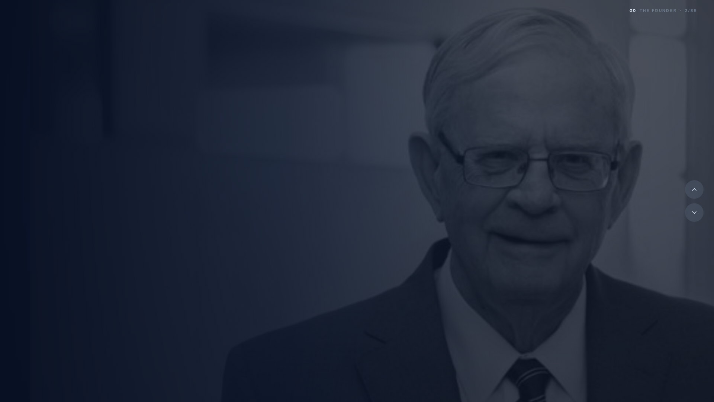
VERDIS NORTON, OUR FOUNDER
It started when someone said no.
Offered a fortune to take the technology off the market and let it disappear; he turned it down. We exist because one person chose people over a payday.
Notes:
Slide 2 — It started when someone said no.
It started when someone said no.
[ Jarom's section ]
(Jarom is presenting)

Slide 3


THE CHOICE TO SHARE IT
He put it in people’s hands. Not a boardroom.
He gave the breakthrough to kitchen tables instead of a corporation, because the truest way to change a life is a person who cares enough to share what changed theirs.
Notes:
Slide 3 — He put it in people’s hands. Not a boardroom.
He put it in people's hands. Not a boardroom.
[ Jarom's section ]
(Jarom is presenting)

Slide 4
THE VISION
A company worth
building a life around.
He set out to build a legacy, not a quick win. Something that would outlast him and stand the test of time.
Notes:
Slide 4 — A company worth building a life around.
A company worth building a life around.
[ Jarom's section ]
(Jarom is presenting)

Slide 5
Nearly two decades later.
Tens of
Thousands
$2B
35
Zero
nearly, in global sales
loyal for a decade or more
countries, and still growing
true competitors
Privately held. Profitable. Disciplined. Built to last.
Notes:
Slide 5 — Nearly two decades later.
Nearly two decades later.
[ Jarom's section ]
(Jarom is presenting)

Slide 6
A LESSON IN STRATEGY
Strategy begins with the courage to think critically.
Notes:
Slide 6 — Strategy begins with the courage to think critically.
[ Jarom's section ]
(Jarom is presenting)

Slide 7
PERSPECTIVE
A clearer view.
Three years away created space to reflect on ASEA and the future.
Notes:
Slide 7 — A clearer view.
[ Jarom's section ]
(Jarom is presenting)

Slide 8
EIGHTEEN MONTHS AGO
We went to work.
Notes:
Slide 8 — We went to work.
[ Jarom's section ]
(Jarom is presenting)

Slide 9
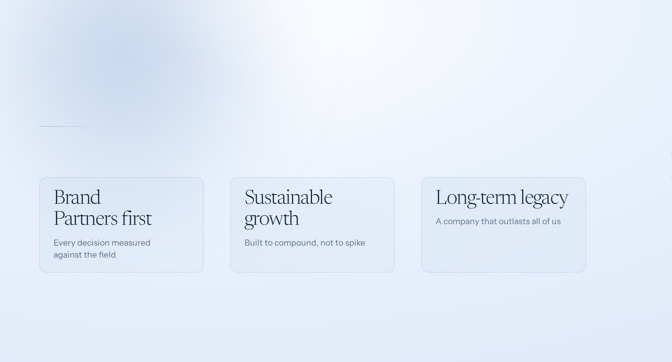
OUR STRATEGIC INTENT
Create focus.
Build with discipline.
A clear strategic intent tells every team what matters most, and what does not. It aligns resources, decisions and execution behind one future.
One company. One direction.
Notes:
Slide 9 — Create focus. Build with discipline.
[ Jarom's section ]
(Jarom is presenting)

Slide 10
OUR DECLARATION
We are doubling
down on you.
While others pause, pivot, regroup, or struggle to adapt, we are innovating for the future of direct selling.
Notes:
Slide 10 — We are doubling down on you.
[ Jarom's section ]
(Jarom is presenting)

Slide 11

THE OPENING
Direct selling is entering the largest period of growth in its history.
Notes:
Slide 11 — Direct selling is entering the largest period of growth in its history.
[ Jarom's section ]
(Jarom is presenting)

Slide 12
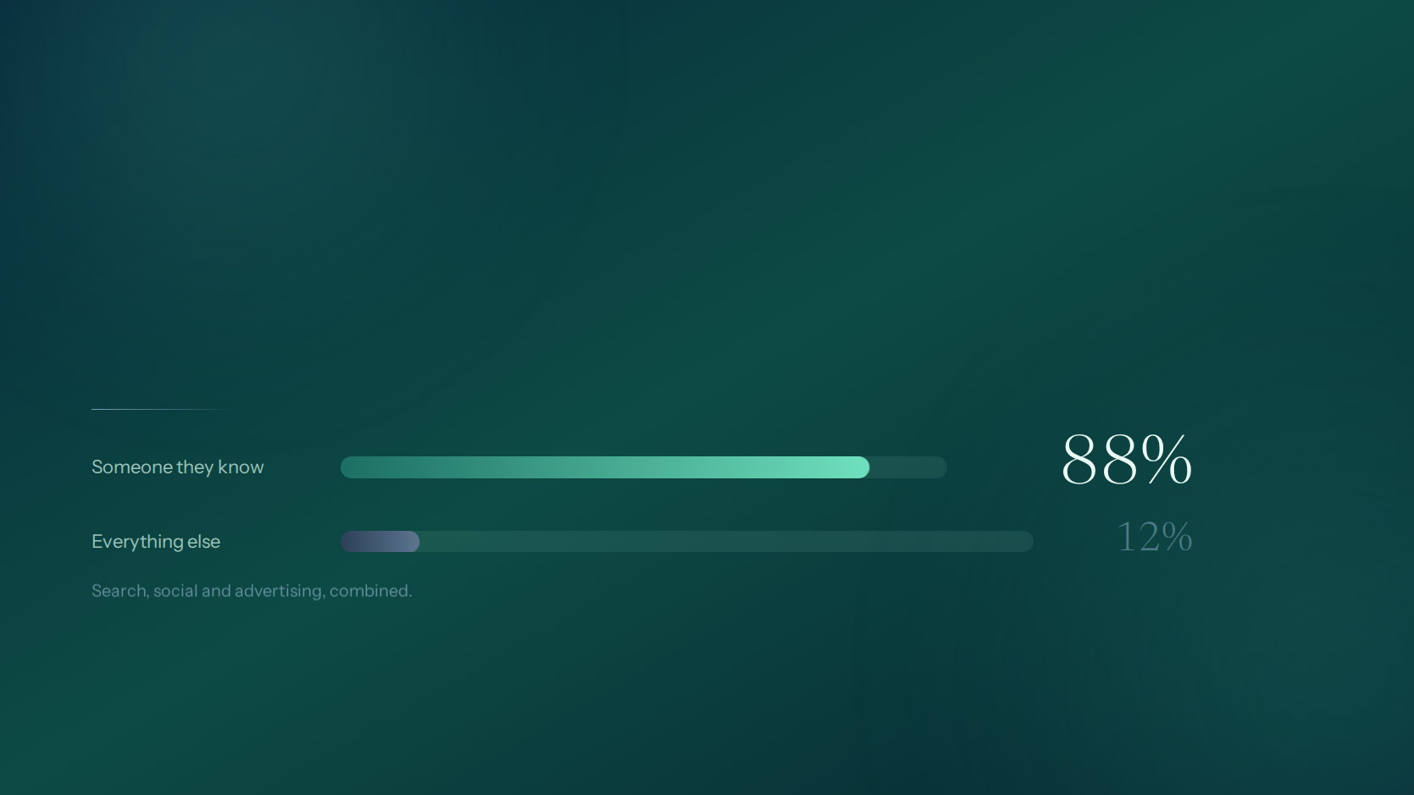
THE TRUST ADVANTAGE
As content becomes infinite and artificial with AI, trust and human connection become scarce.
Human relationship becomes the advantage.
Notes:
Slide 12 — As content becomes infinite and artificial with AI, trust and human connection become scarce.
[ Jarom's section ]
(Jarom is presenting)

Slide 13
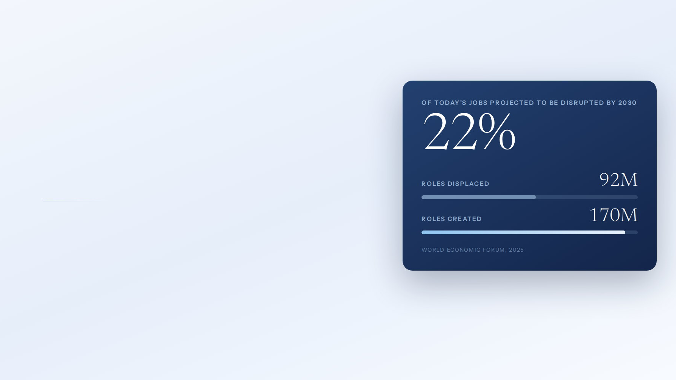
THE ACCELERATOR
AI is reshaping work. And rewriting who gets to build.
Corporate roles and required skills are changing faster. At the same time, AI gives ordinary people leverage to create, personalize, follow up, and scale a business of their own.
The work is changing. So is who can do it.
Notes:
Slide 13 — AI is reshaping work. And rewriting who gets to build.
[ Jarom's section ]
(Jarom is presenting)

Slide 14

THE COLLAPSE
The side hustle was the fallback.
Now the fallback is closing too.
For twenty years, the answer to a shrinking job was a second income on the side. That answer is being automated out from underneath people, in every category at once.
$0.25
AI
0
Per mile, once fleets drive themselves
Avatars replace the influencer
Margin left in the gig economy
This is the exit closing.
Notes:
Slide 14 — The side hustle was the fallback. Now the fallback is closing too.
[ Jarom's section ]
(Jarom is presenting)

Slide 15

THE OPENING
And the doorway that opens
is the biggest one yet.
When the old routes close, people do not stop needing income. They start looking for something they can own. Direct selling is the one model built for exactly that moment.
The wave belongs to those who innovate and move first.
Notes:
Slide 15 — And the doorway that opens is the biggest one yet.
[ Jarom's section ]
(Jarom is presenting)

Slide 16
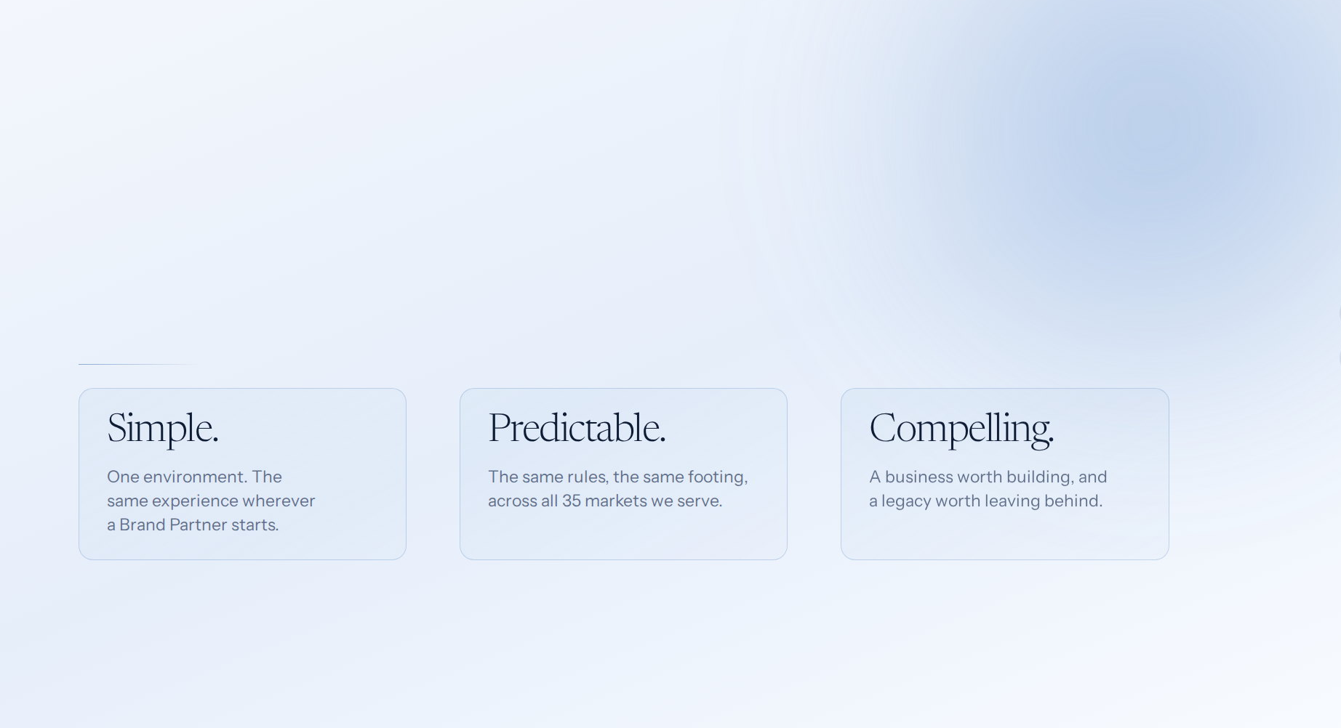
OUR SIMPLE GOAL
Create an environment where a Brand Partner can build something that lasts.
Notes:
Slide 16 — Create an environment where a Brand Partner can build something that lasts.
[ Jarom's section ]
(Jarom is presenting)

Slide 17
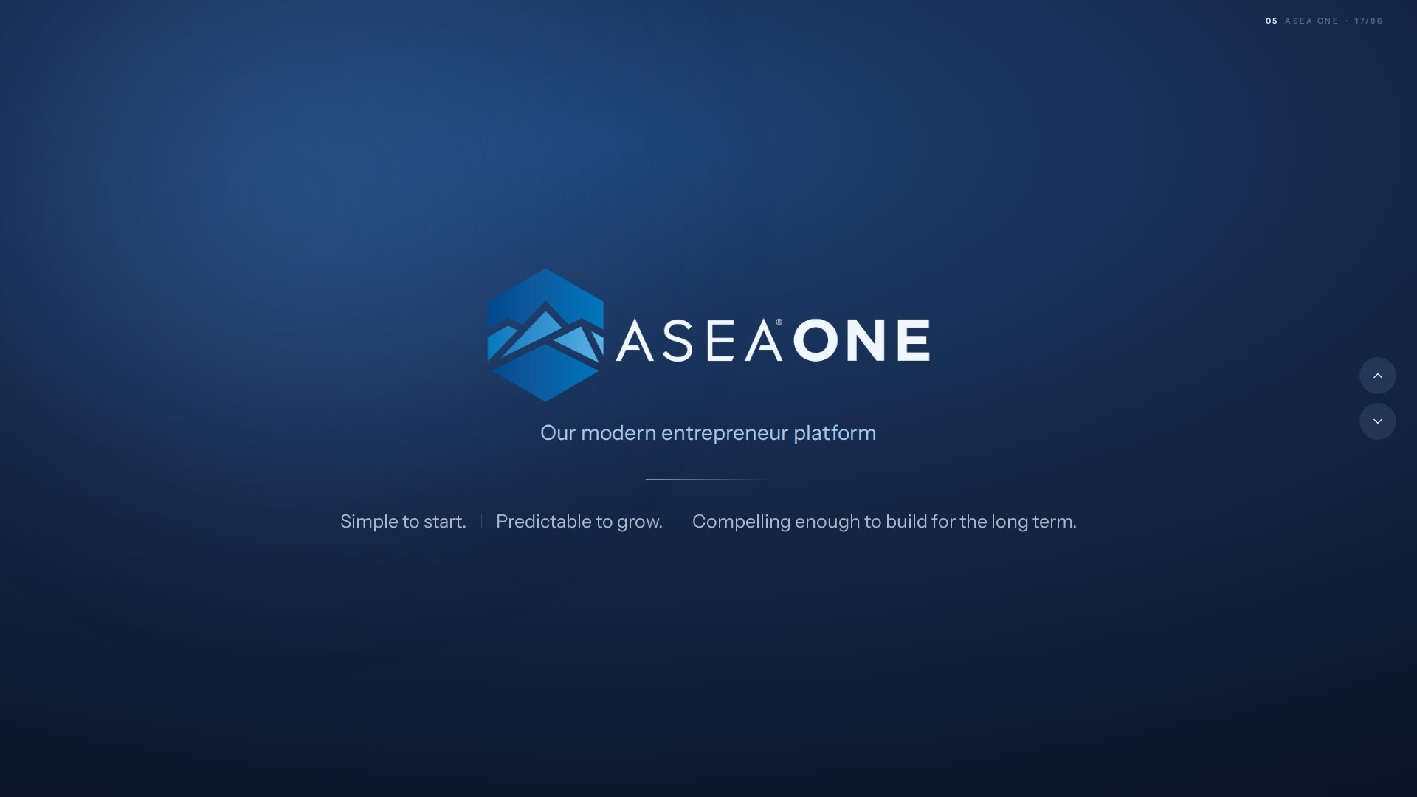
LAUNCHED JANUARY 2026
And it rewards you for sharing something real.
Notes:
Slide 17 — LAUNCHED JANUARY 2026
[ Jarom's section ]
(Jarom is presenting)

Slide 18
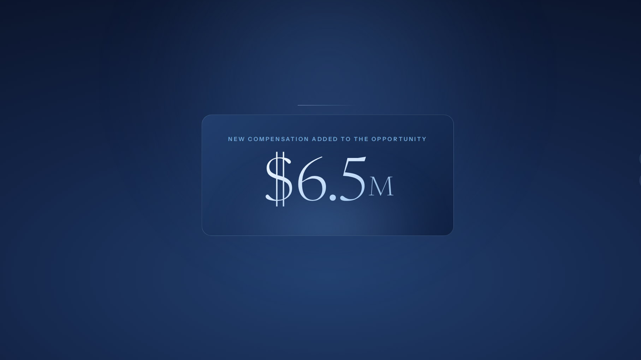
A CLEAR SIGNAL
We invested in you.
New money into ASEA ONE, to show our commitment to Brand Partners in the economics of the opportunity, not simply in words.
Funded by the company. Paid to the field.
Notes:
Slide 18 — We invested in you.
[ Jarom's section ]
(Jarom is presenting)

Slide 19
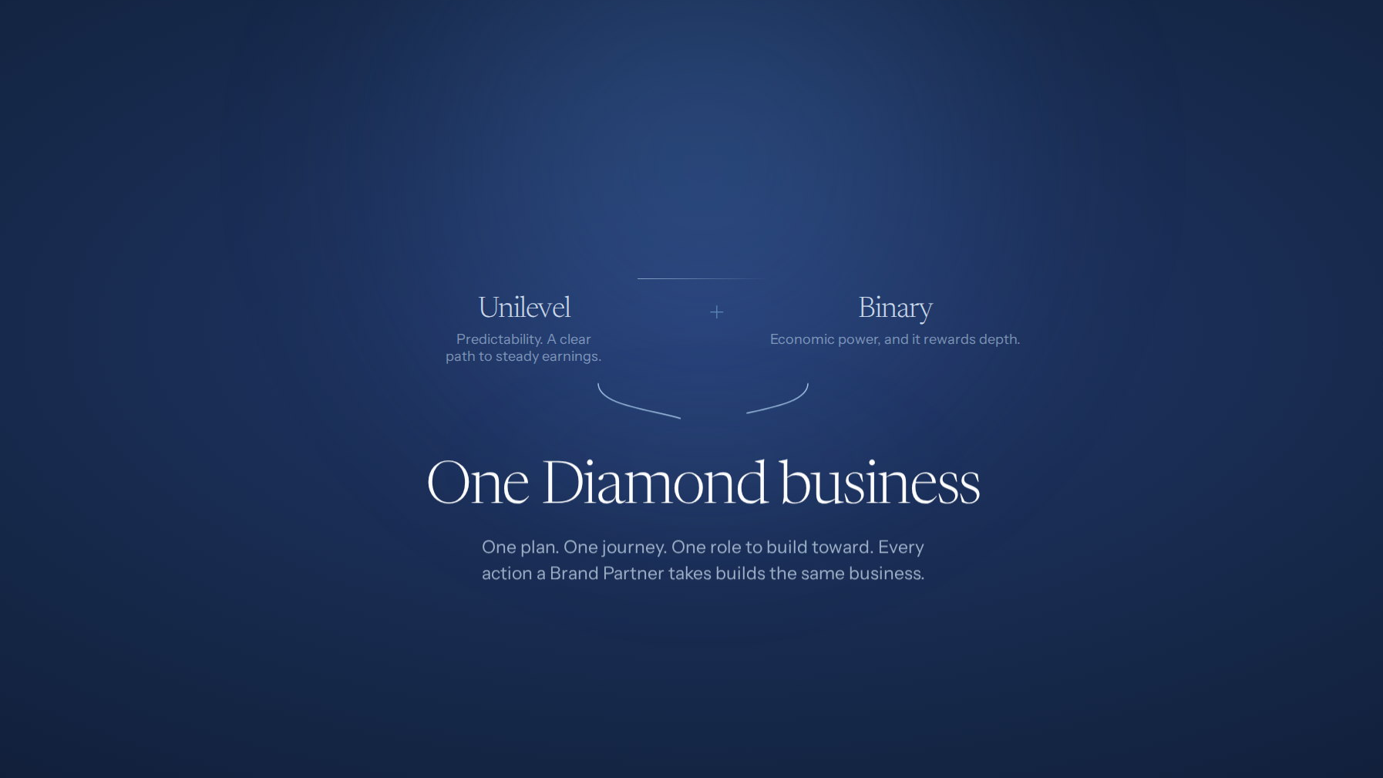
THE ASEA ONE INNOVATION
Two structures.
One Diamond business.
No choosing. No starting over.
Notes:
Slide 19 — Two structures. One Diamond business.
[ Jarom's section ]
(Jarom is presenting)

Slide 20
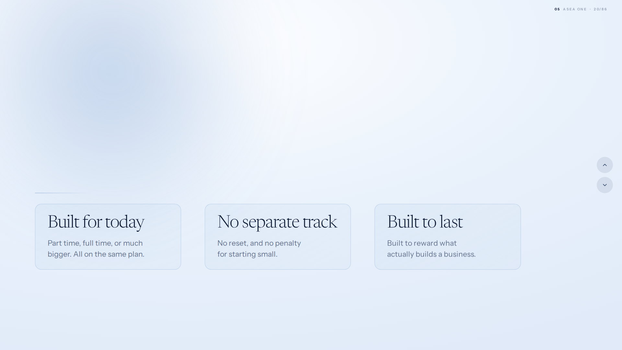
BUILT FOR ANYONE
The engine that lets anyone, from any walk of life, share something real.
Notes:
Slide 20 — The engine that lets anyone, from any walk of life, share something real.
[ Jarom's section ]
(Jarom is presenting)

Slide 21
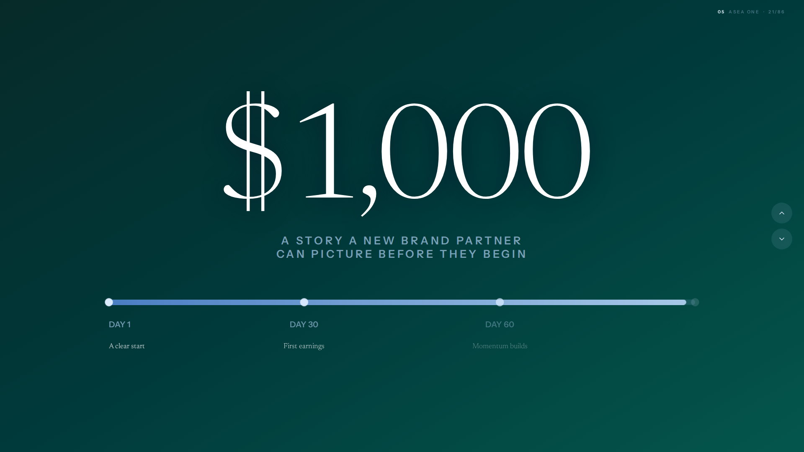
THE FIRST 90 DAYS
First rank reached. Early belief becomes action.
Notes:
Slide 21 — THE FIRST 90 DAYS
[ Jarom's section ]
(Jarom is presenting)

Slide 22
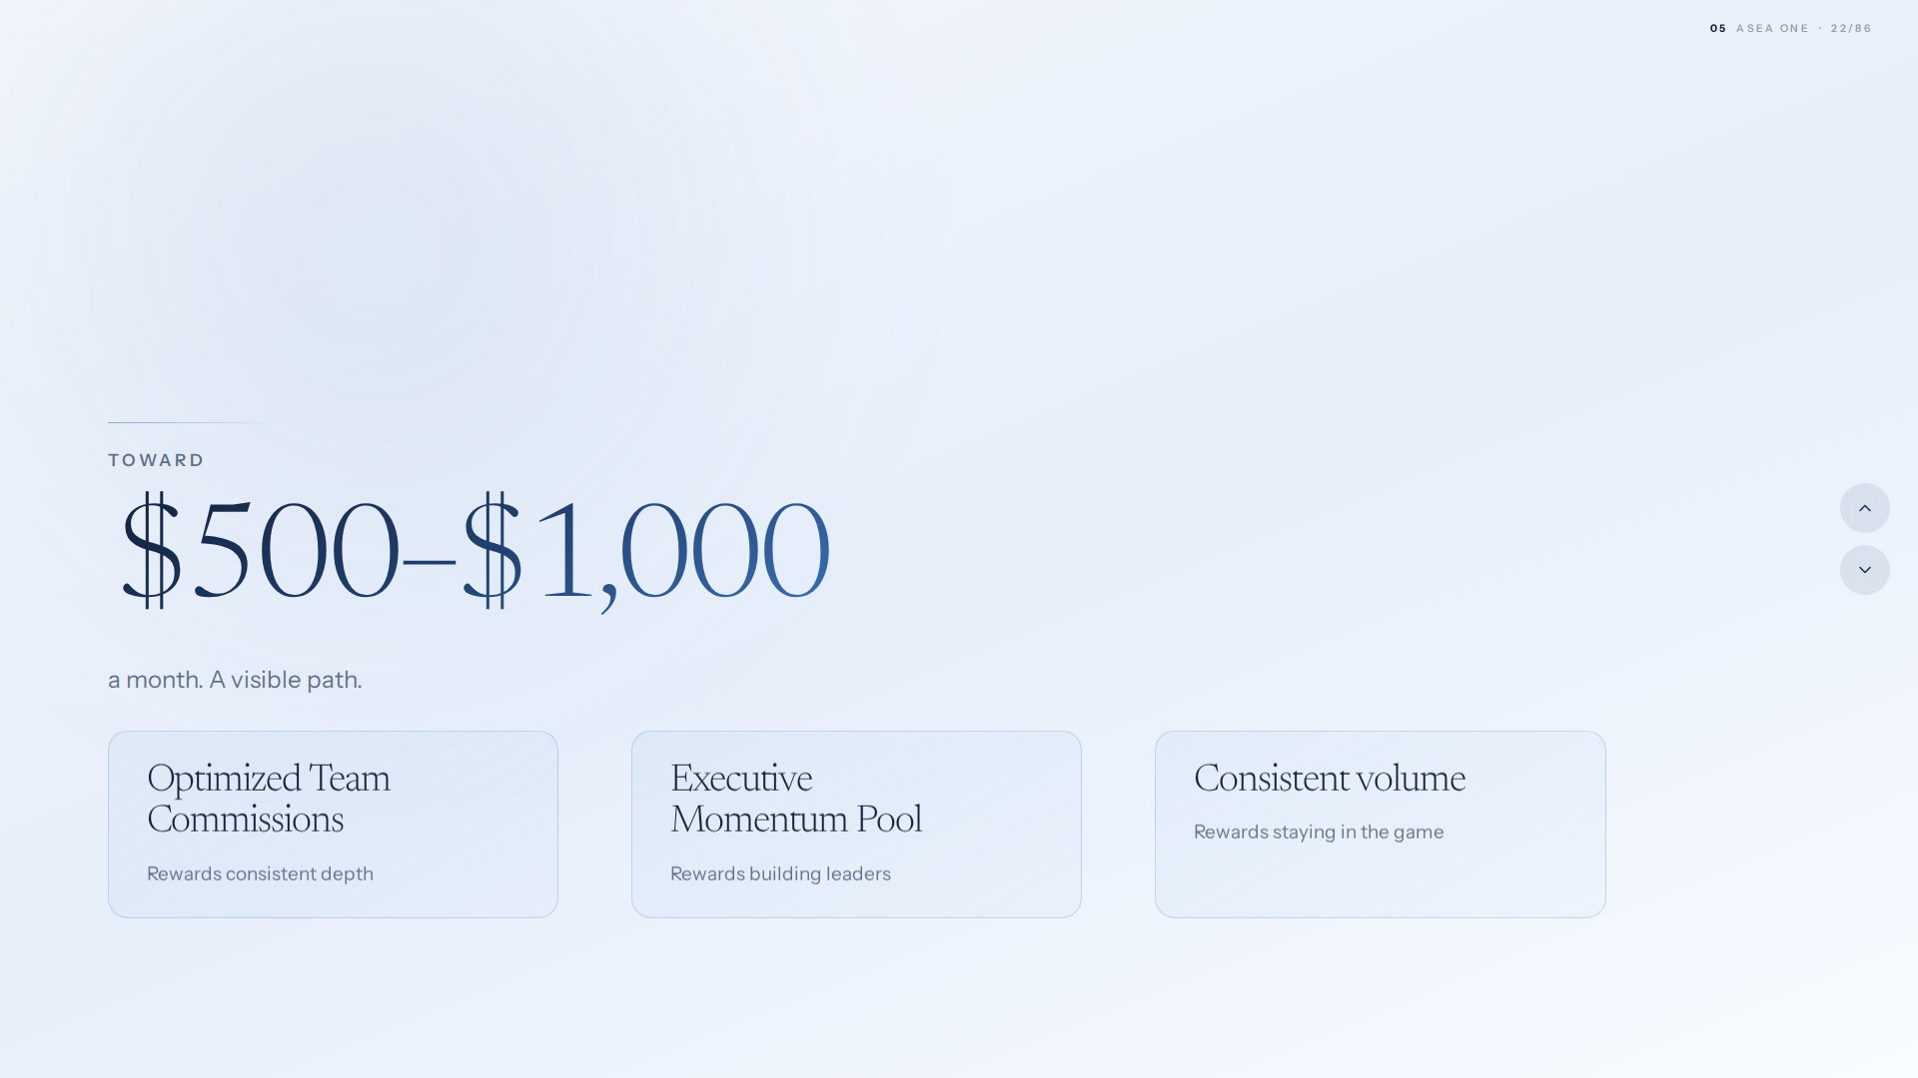
BUILDING RESIDUAL INCOME
A residual base you can build on.
Notes:
Slide 22 — A residual base you can build on.
[ Jarom's section ]
(Jarom is presenting)

Slide 23
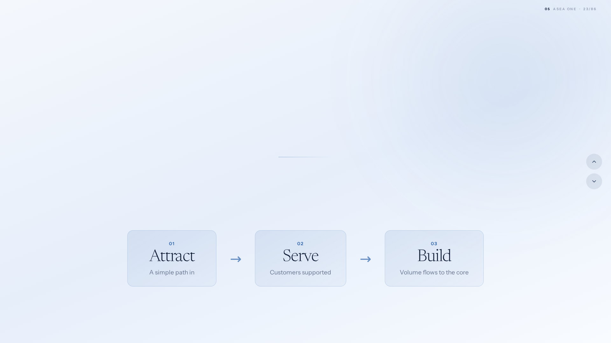
THE CUSTOMER ENGINE
A fully integrated customer acquisition engine.
Affiliates and product sharers attract and serve customers through a simple path, while full volume flows seamlessly into the core tree structure and the compensation plan.
Notes:
Slide 23 — A fully integrated customer acquisition engine.
[ Jarom's section ]
(Jarom is presenting)

Slide 24
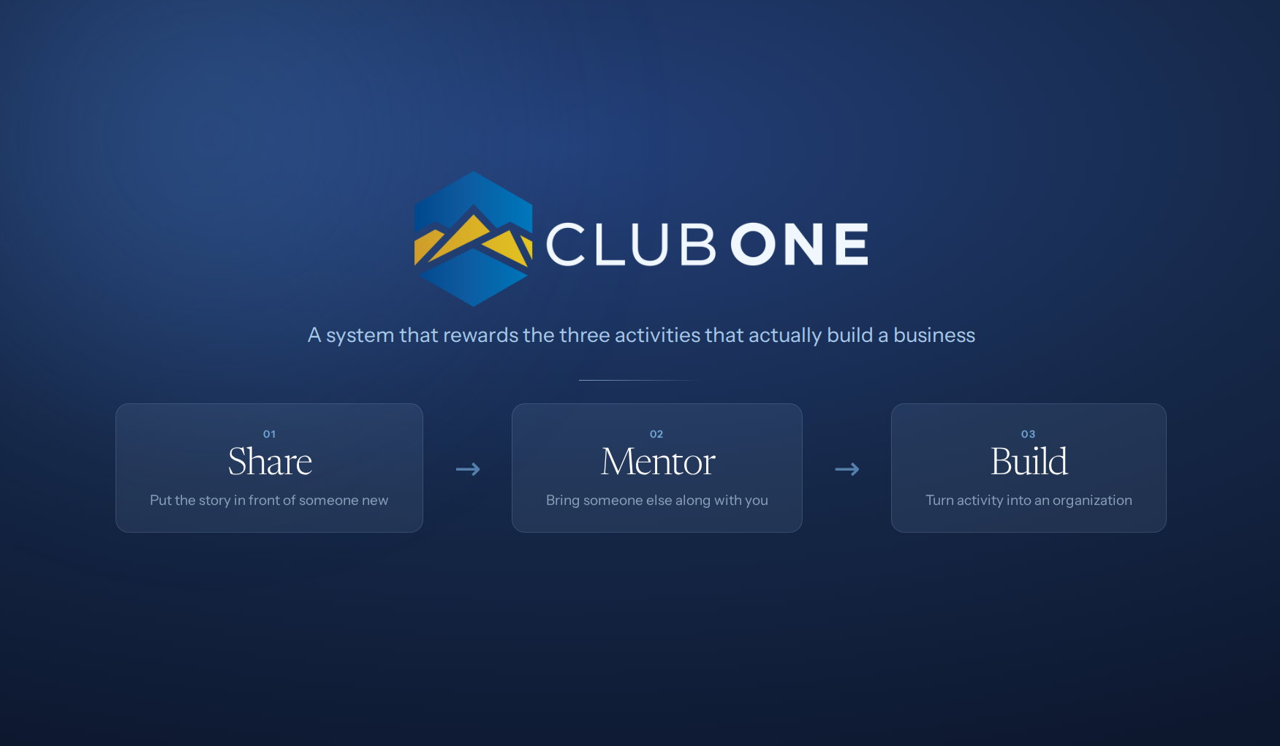
RECOGNITION, BUILT IN
Recognised in the moment, not once a year.
Notes:
Slide 24 — RECOGNITION, BUILT IN
[ Jarom's section ]
(Jarom is presenting)

Slide 25
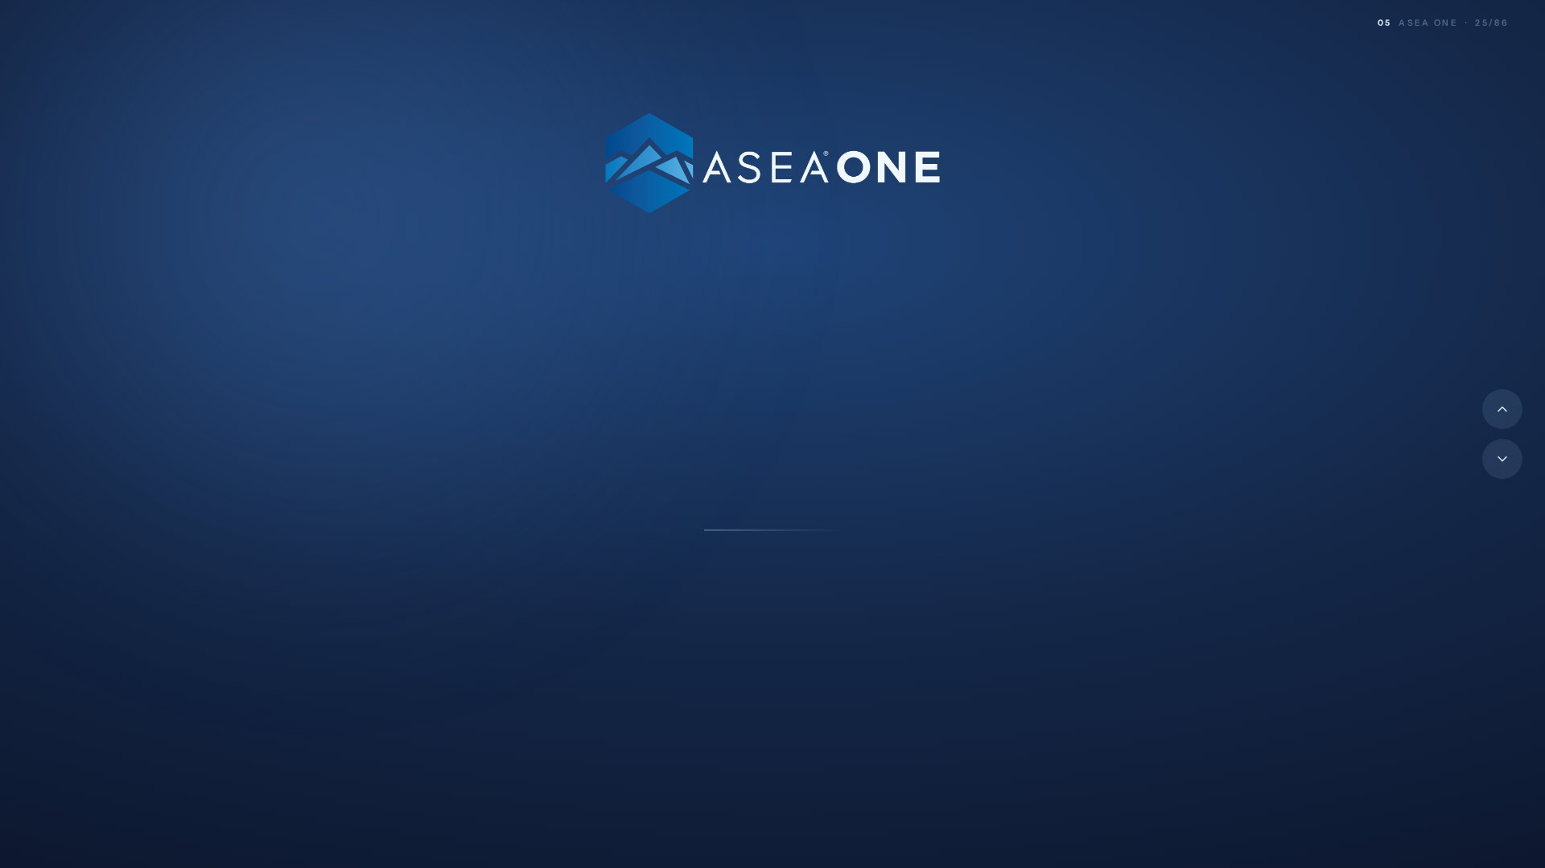
Our entrepreneur
foundation for the future.
Early momentum. Predictable income. Customer acquisition. Recognition that lands when it matters.
Built to reward sharing something real.
Notes:
Slide 25 — Our entrepreneur foundation for the future.
[ Jarom's section ]
(Jarom is presenting)

Slide 26
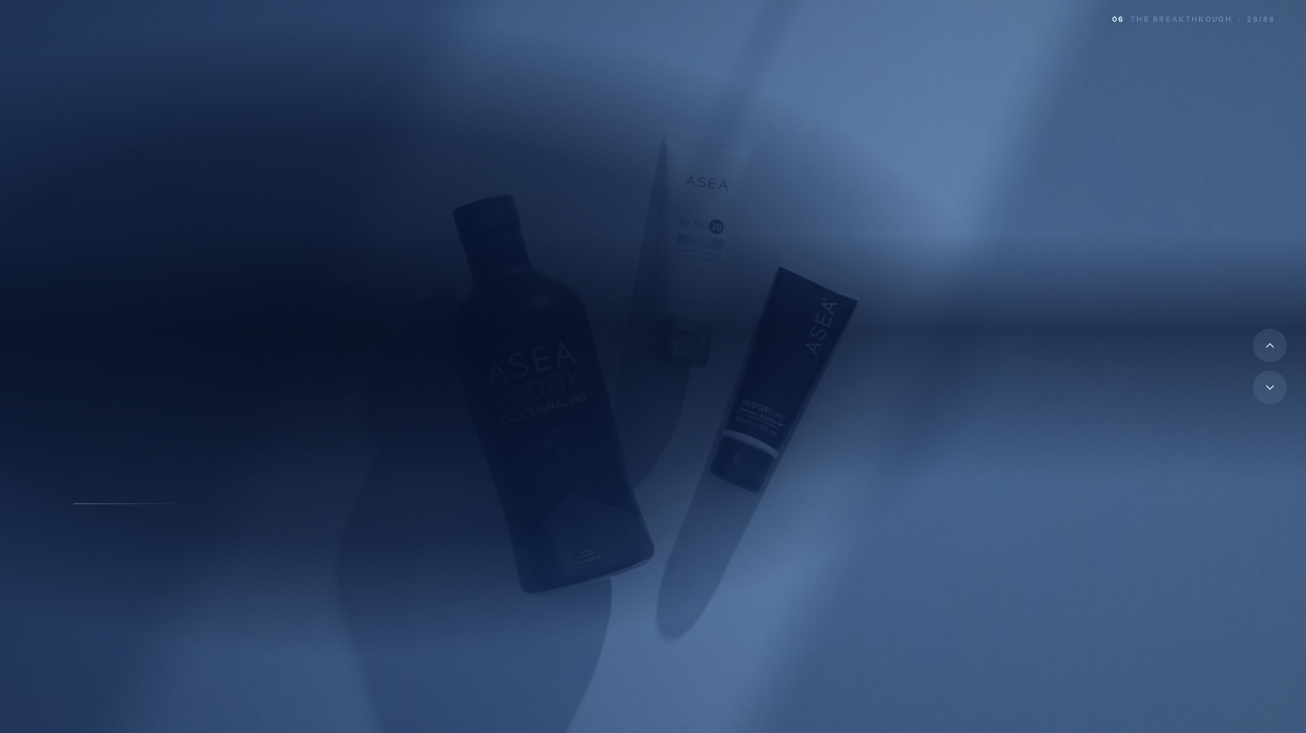
THE REDOX BREAKTHROUGH
Redox is our breakthrough. Nobody else has it.
One technology, stabilized outside the body for the first time. Two decades of work, protected, and still unmatched.
Notes:
Slide 26 — Redox is our breakthrough. Nobody else has it.
[ Jarom's section ]
(Jarom is presenting)

Slide 27
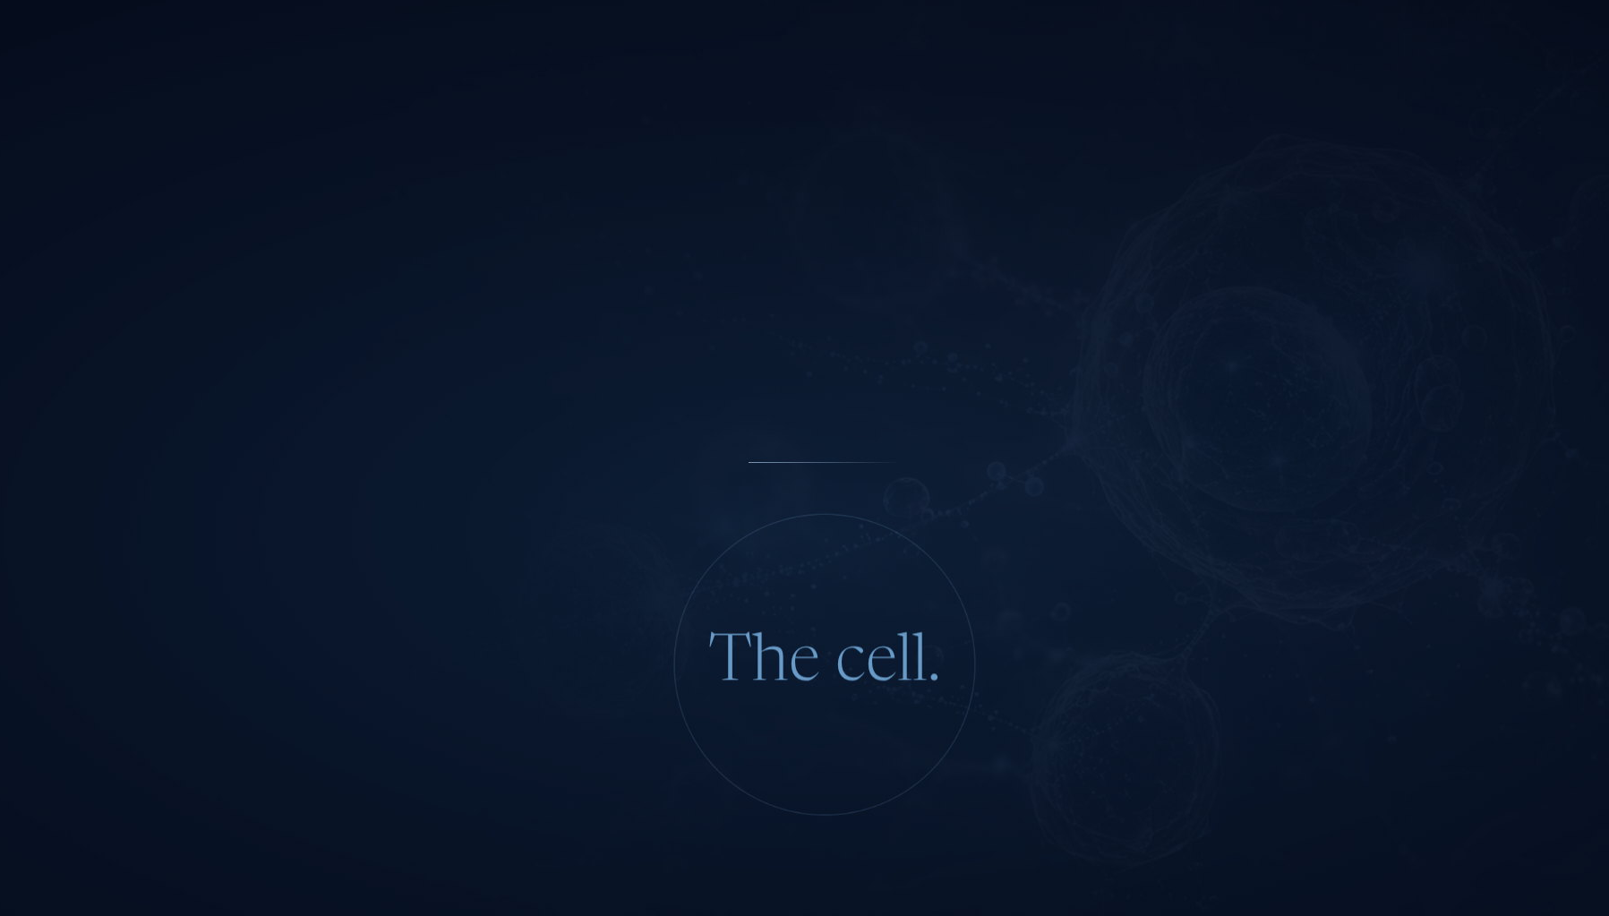
THE NEXT GREAT WELLNESS CATEGORY
A new category emerged.
It was hiding in plain sight. Every major health trend is moving to the same place.
Notes:
Slide 27 — A new category emerged.
[ Jarom's section ]
(Jarom is presenting)

Slide 28

THE MACRO SHIFT
Wellness has become a $2 trillion daily priority.
Consumers are no longer satisfied with occasional fixes. Wellness is becoming continuous, personalized and increasingly science-led. The market is moving toward interventions that work closer to the body’s underlying biology, not simply another product on the shelf.
Bigger than any single product trend.
Notes:
Slide 28 — Wellness has become a $2 trillion daily priority.
[ Jarom's section ]
(Jarom is presenting)

Slide 29
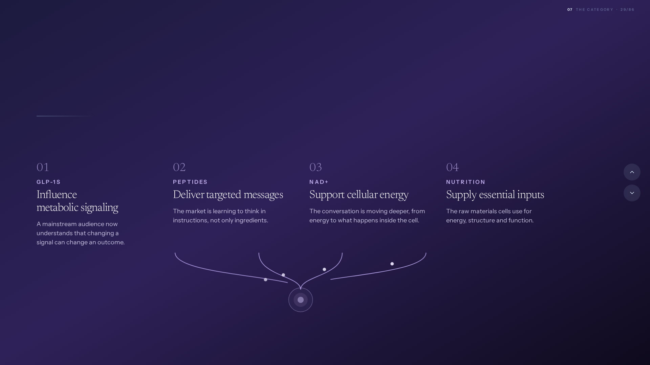
THE CONVERGENCE
Different movements.
The same upstream direction.
Four of the biggest forces in wellness are chasing different outcomes. Follow each one far enough and they arrive at the same place.
They all point at the cell.
Notes:
Slide 29 — Different movements. The same upstream direction.
[ Jarom's section ]
(Jarom is presenting)

Slide 30
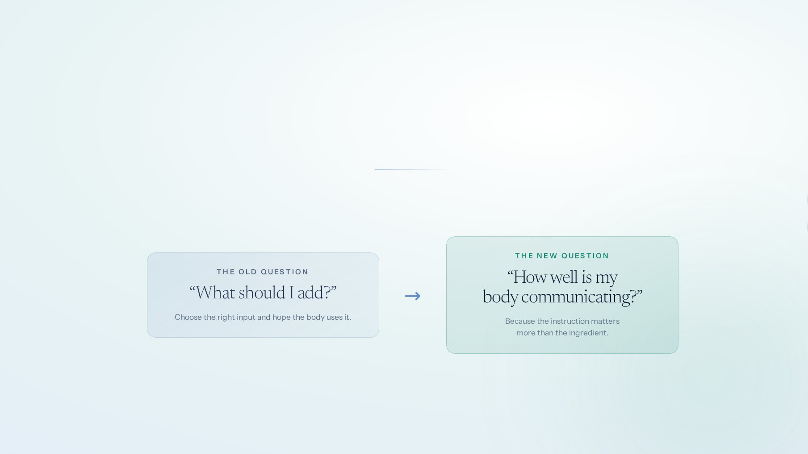
THE INFLECTION POINT
The ingredient era is becoming the signaling era.
Nutrition still matters. Inputs still matter. But consumers are beginning to understand that the body is not simply a container to fill. It is an intelligent, responsive system.
That changes what people are actually shopping for.
Notes:
Slide 30 — The ingredient era is becoming the signaling era.
[ Jarom's section ]
(Jarom is presenting)

Slide 31
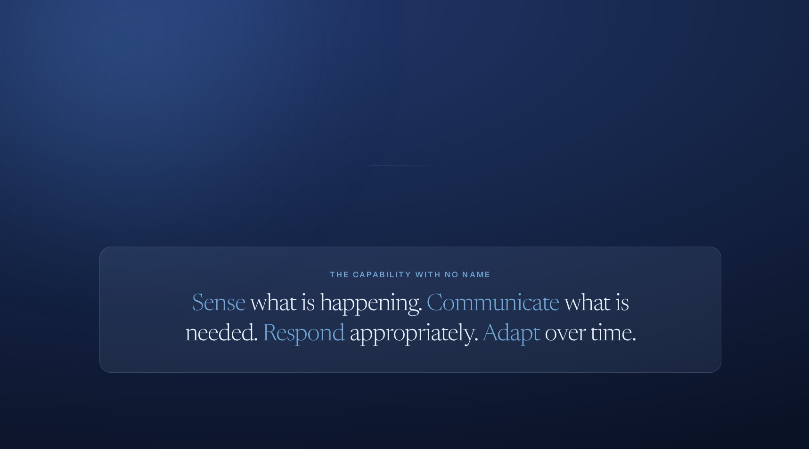
THE MISSING CATEGORY
Every trend has a name. The foundation they share does not.
GLP-1s. Peptides. NAD+. Longevity. Functional nutrition. Each speaks to one pathway, one target, one outcome.
Notes:
Slide 31 — Every trend has a name. The foundation they share does not.
[ Jarom's section ]
(Jarom is presenting)

Slide 32

INTRODUCING
Cellular Intelligence
The remarkable ability of your cells to sense, communicate, respond and adapt.
Notes:
Slide 32 — Cellular Intelligence
[ Jarom's section ]
(Jarom is presenting)

Slide 33

CELLULAR INTELLIGENCE AT WORK
Your cells are in constant conversation.
Notes:
Slide 33 — Your cells are in constant conversation.
[ Jarom's section ]
(Jarom is presenting)

Slide 34
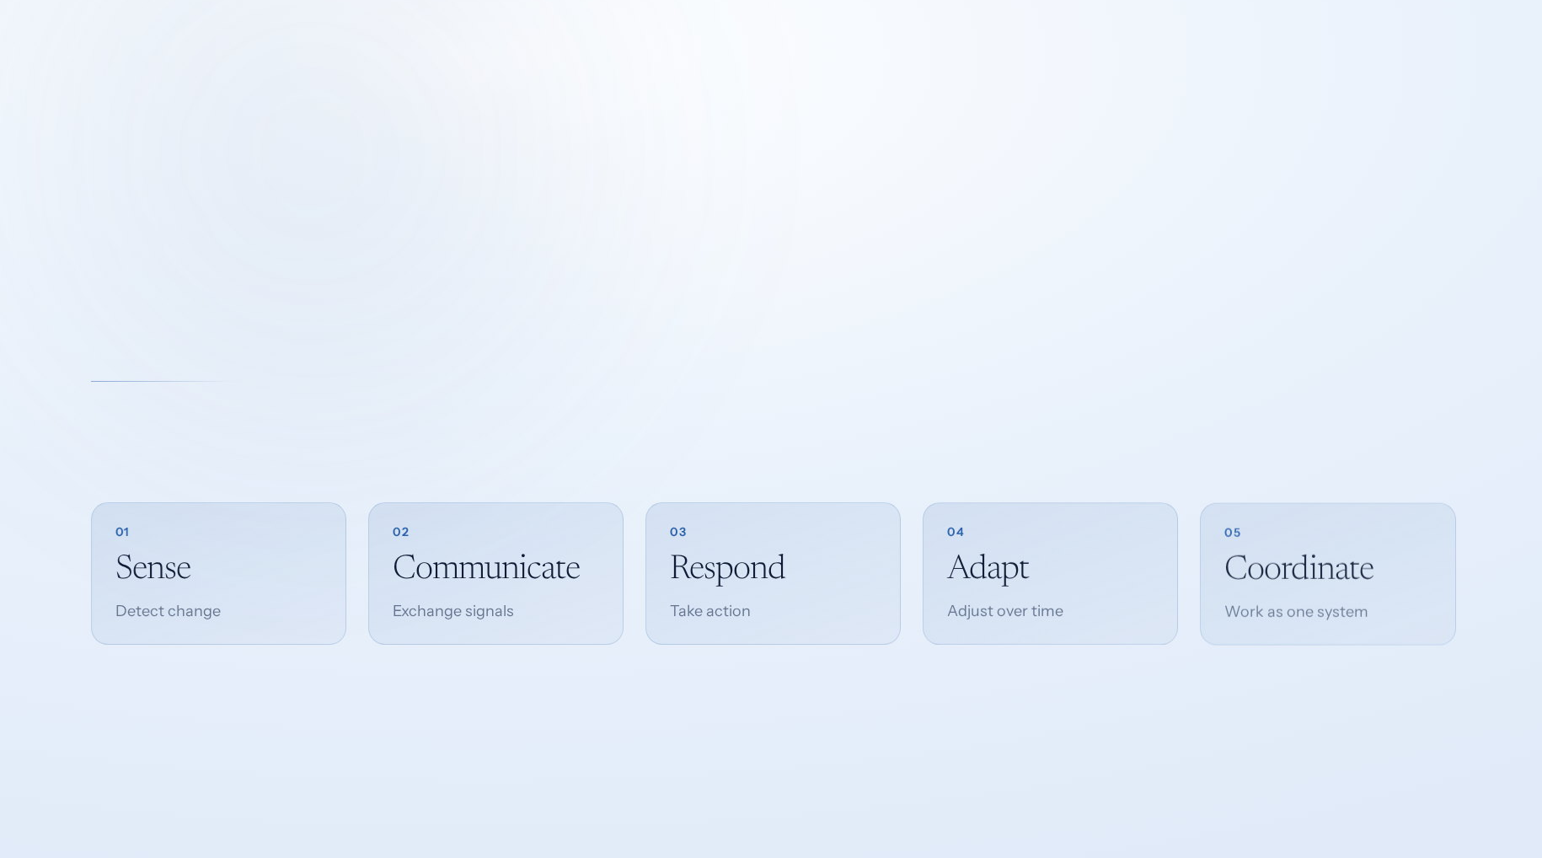
WHAT IS CELLULAR INTELLIGENCE
Your body already knows what to do.
Every second, cells read their environment, exchange signals, coordinate action, and adjust. It is intelligence already built into life, and communication is how it works.
Notes:
Slide 34 — Your body already knows what to do.
[ Jarom's section ]
(Jarom is presenting)

Slide 35
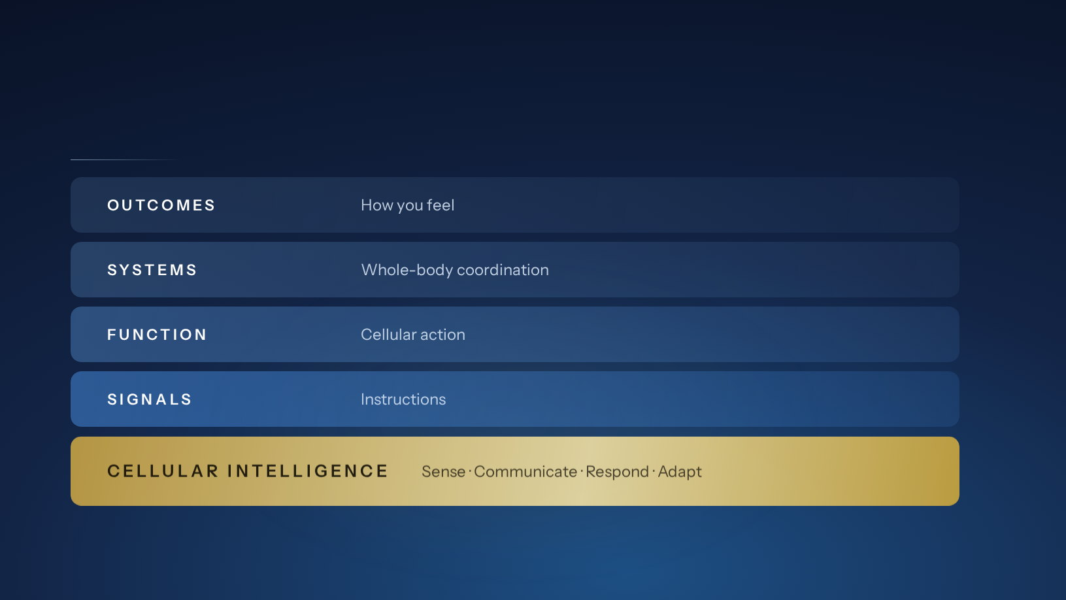
THE CELLULAR INTELLIGENCE HIERARCHY
The foundation the whole stack is built on.
Notes:
Slide 35 — The foundation the whole stack is built on.
[ Jarom's section ]
(Jarom is presenting)

Slide 36
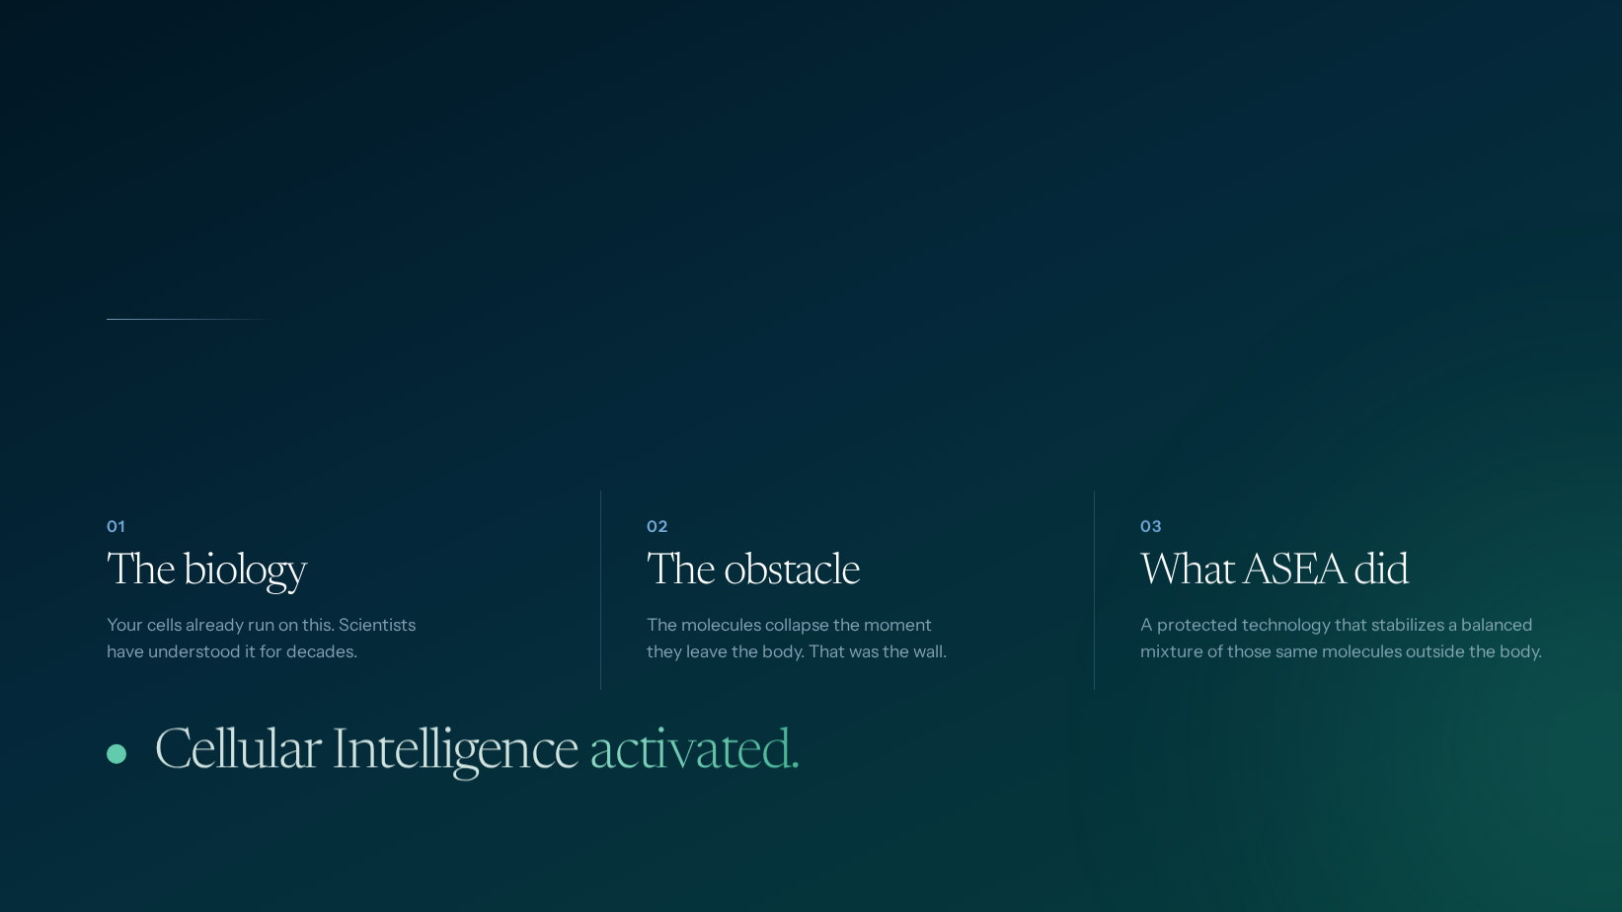
POWERED BY REDOX
ASEA Redox Technology activates Cellular Intelligence.
Redox signaling is not new science. The body has always used these molecules to carry its instructions. The problem was never the biology. It was that no one could hold these molecules stable outside of it.
Notes:
Slide 36 — ASEA Redox Technology activates Cellular Intelligence.
[ Jarom's section ]
(Jarom is presenting)

Slide 37
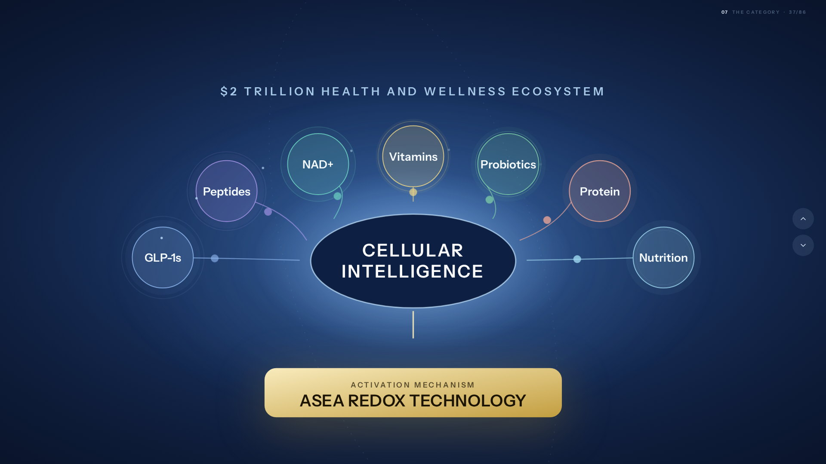
THE FOUNDATIONAL CATEGORY
Cellular Intelligence powers the $2T wellness economy.
Notes:
Slide 37 — Cellular Intelligence powers the $2T wellness economy.
[ Jarom's section ]
(Jarom is presenting)

Slide 38
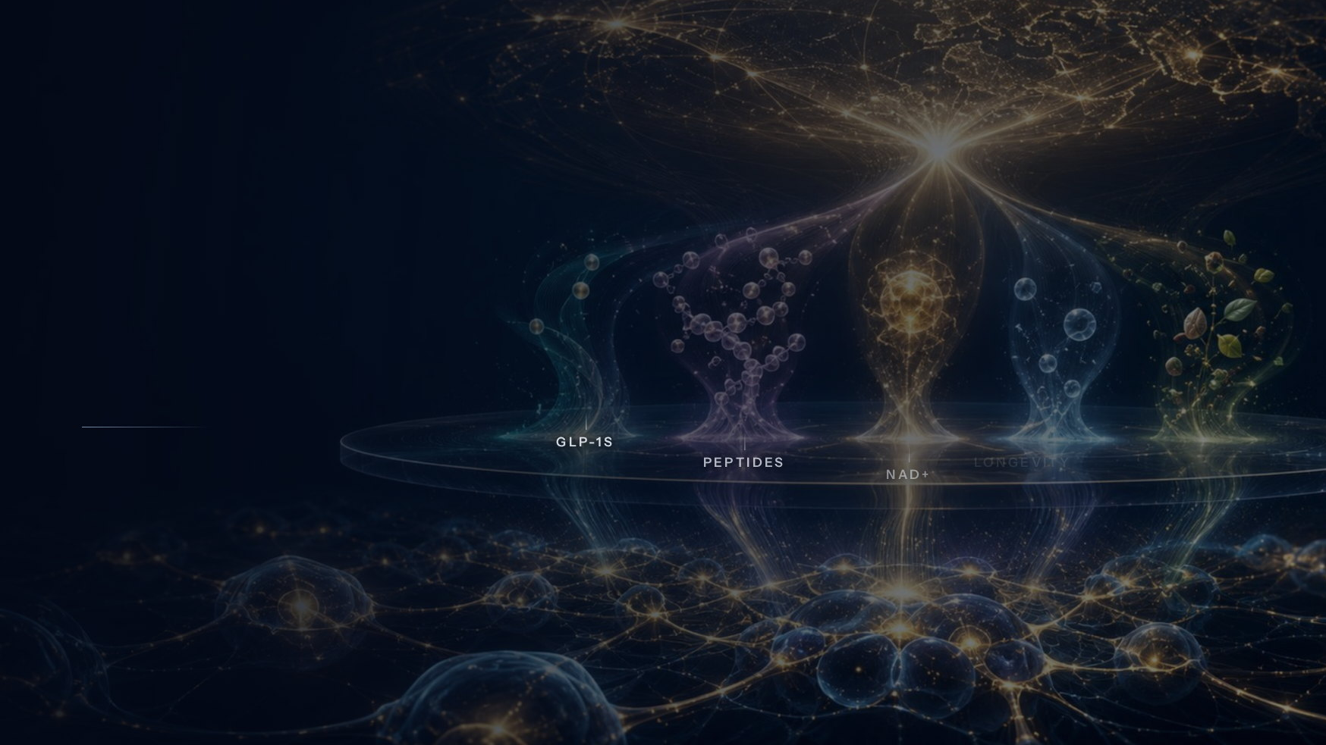
THE CATEGORY OPPORTUNITY
$2T market.
One cellular foundation.
Every movement in wellness rises from the same place. We are the only company standing at its foundation.
Notes:
Slide 38 — $2T market. One cellular foundation.
[ Jarom's section ]
(Jarom is presenting)

Slide 39
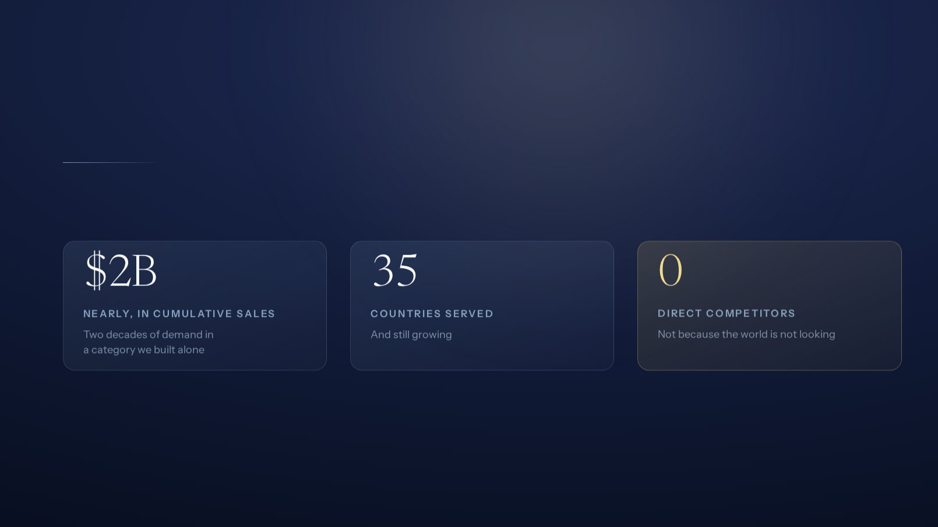
WHY ASEA
The category is new. Our foundation is not.
Nearly two decades pioneering redox signaling, before the market had language for it. A position we have held since before anyone was looking.
We learned how to hold its signal.
Notes:
Slide 39 — The category is new. Our foundation is not.
[ Jarom's section ]
(Jarom is presenting)

Slide 40
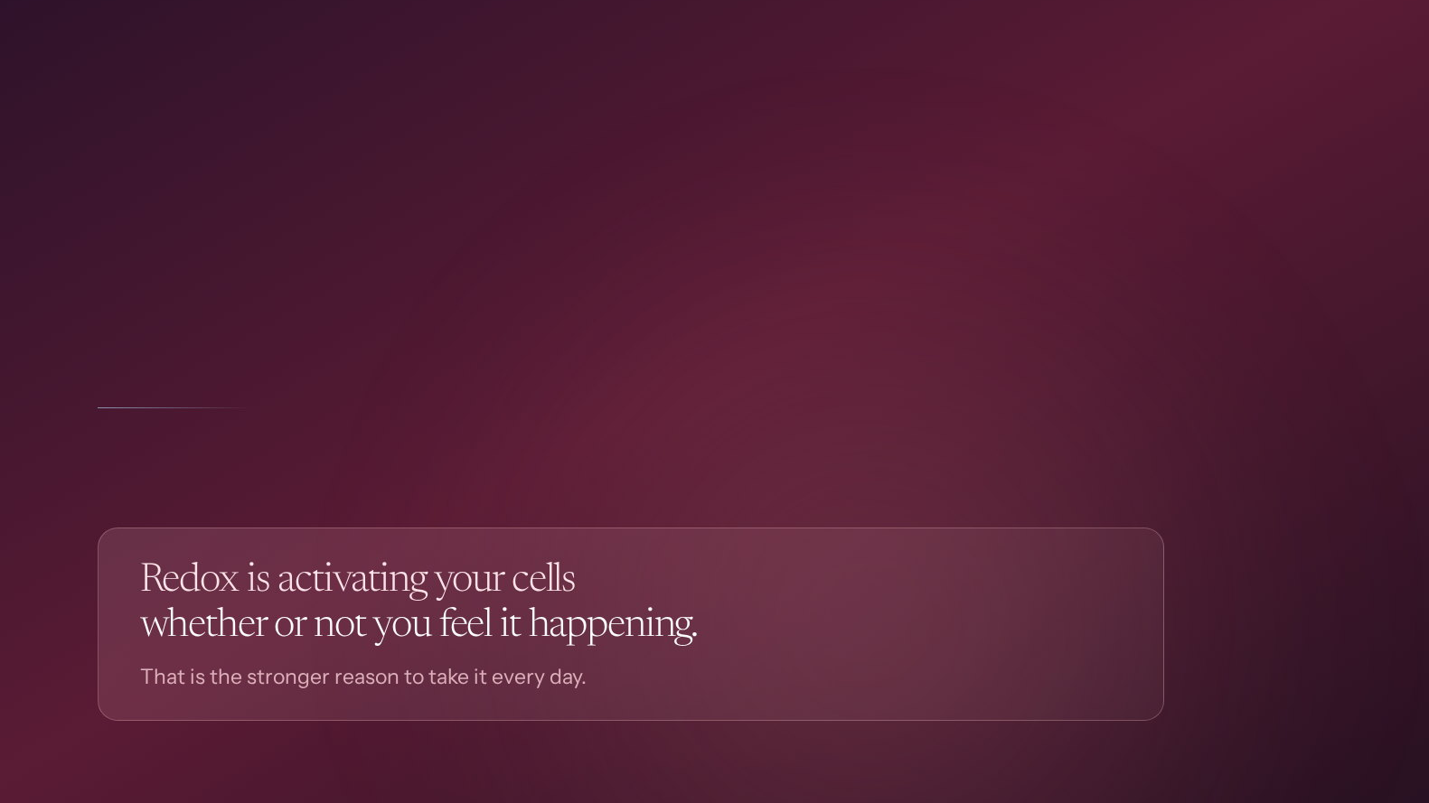
THE HARD TRUTH
Our breakthrough is unique, our message has been fragmented and complicated for a mainstream healthy 40+ consumer audience.
Too much of what we said rested on the miraculous experience. That works for the few who feel something dramatic, and it quietly loses everyone else.
Notes:
Slide 40 — Our breakthrough is unique, our message has been fragmented and complicated for a mainstream healthy 40+ consumer audience.
[ Jarom's section ]
(Jarom is presenting)

Slide 41
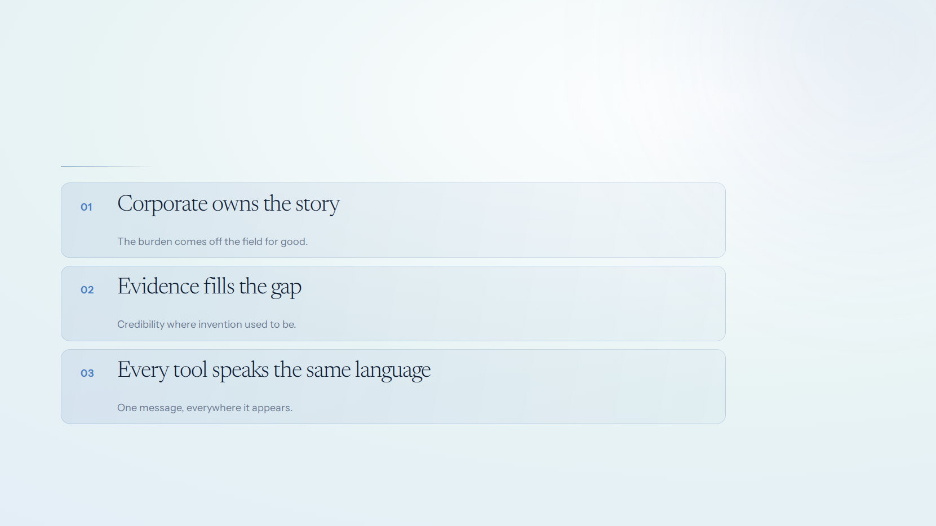
THE MANDATE
One story. One message.
One source of truth.
Notes:
Slide 41 — One story. One message. One source of truth.
[ Jarom's section ]
(Jarom is presenting)

Slide 42

UP NEXT
A shareable message.
A category to carry it.
Notes:
Slide 42 — A shareable message. A category to carry it.
[ Jarom's section ]
(Jarom is presenting)

Slide 43

The relaunch of Redox.
Twenty years of science.
Notes:
Slide 43 — The relaunch of Redox.
[ Jarom's section ]
(Jarom is presenting)

Slide 44
THE RELAUNCH OF REDOX
Every part.
Rebuilt at once.
Not a refresh. Not a campaign. The brand, the story, the tools, the training, and the plan to put all of it in your hands.
Notes:
Slide 44 — Every part. Rebuilt at once.
Every part. Rebuilt at once.
Thank you, Jarom.
Twenty years ago this company bet everything on a molecule nobody could hold. We won that bet.
Today we relaunch it.
Not a refresh. Not a new label. Not a campaign.
The brand. The story. The tools. The training.
Every part, rebuilt at once.

Slide 45

THE REBRAND
A relaunch starts with the brand.
Brand is not a logo. It is every signal a person receives before they ever decide. We rebuilt all of them.
LOOKS LIKE
SOUNDS LIKE
FEELS LIKE
A bottle you want on the counter
One story, in plain language
Proof you can hold
The words, the claims, the category we named. The same sentence in every market.
Confidence instead of hope. Nobody has to oversell what they are handing someone.
Packaging, colour, type, photography, and a visual system that finally matches the science.
MOVES LIKE
PROVES
SCALES
Film, motion, arrival
Evidence under every line
One system, 35 markets
How it enters a room, a feed, a conversation. Designed, not left to chance.
Two decades of science, sitting behind each claim, ready when someone pushes back.
Every asset built from the same core, so the brand holds wherever it lands.
Notes:
Slide 45 — A relaunch starts with the brand.
A relaunch starts with the brand.
And a relaunch starts with the brand.
Brand is not a logo. It is every signal a person receives before they ever decide.
(walk the six, do not read them)
What it looks like. What it sounds like. What it feels like in your hand.
How it moves. What it proves. And whether it holds in all 35 markets.
We rebuilt all of it.

Slide 46
WHAT IT LOOKS LIKE
This is what it
looks like.
Notes:
Slide 46 — This is what it looks like.
This is what it looks like.
So let me start with the part you can see.
(pause)
This is what it looks like.

Slide 47
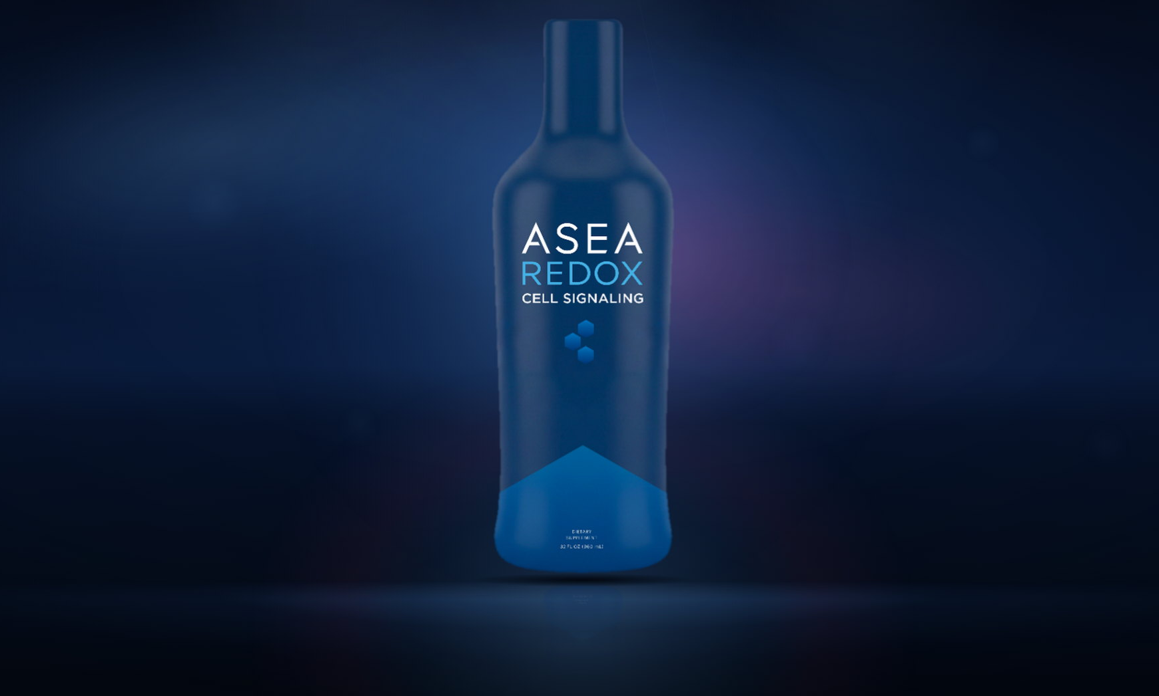
Notes:
Slide 47
[ the reveal — no words on screen ]
(say nothing)
(let the light find it and let it rise all the way in)
(the room should get there before you do)
(when it settles, and only then)

Slide 48
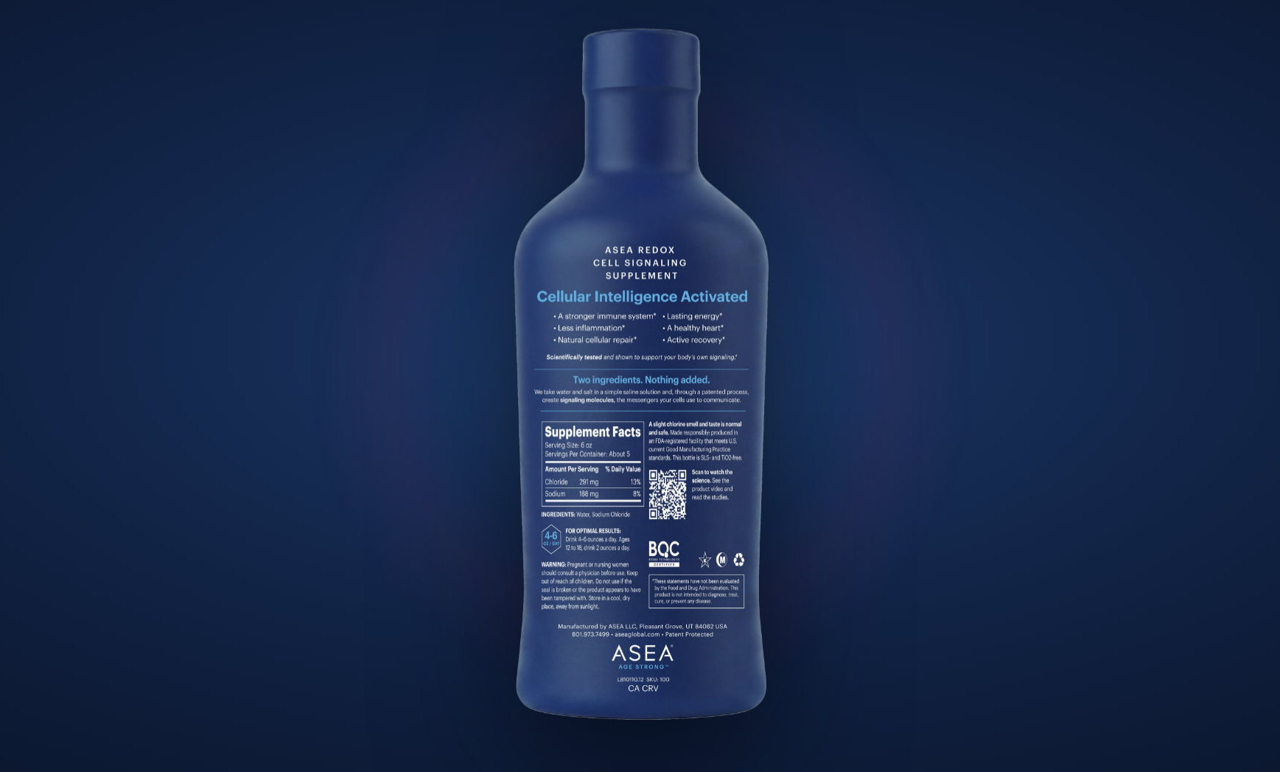
Notes:
Slide 48
[ the back of the bottle ]
Now turn it around.
(let them look)
Everything they need to know is right here.

Slide 49
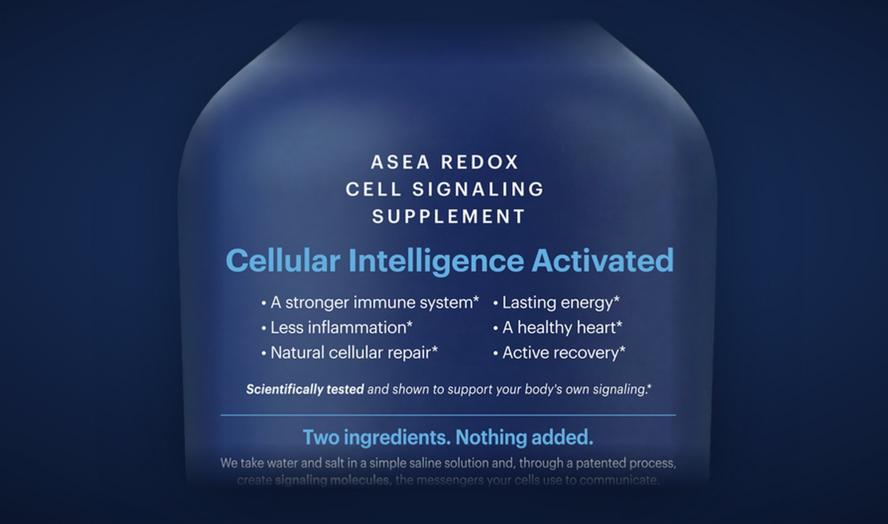
Notes:
Slide 49
[ the top of the label ]
Up close.
A stronger immune system. Less inflammation. Natural cellular repair.
Lasting energy. A healthy heart. Active recovery.
And the line that names all of it: Cellular Intelligence Activated.
Hold that list. We come back to it in a moment.

Slide 50
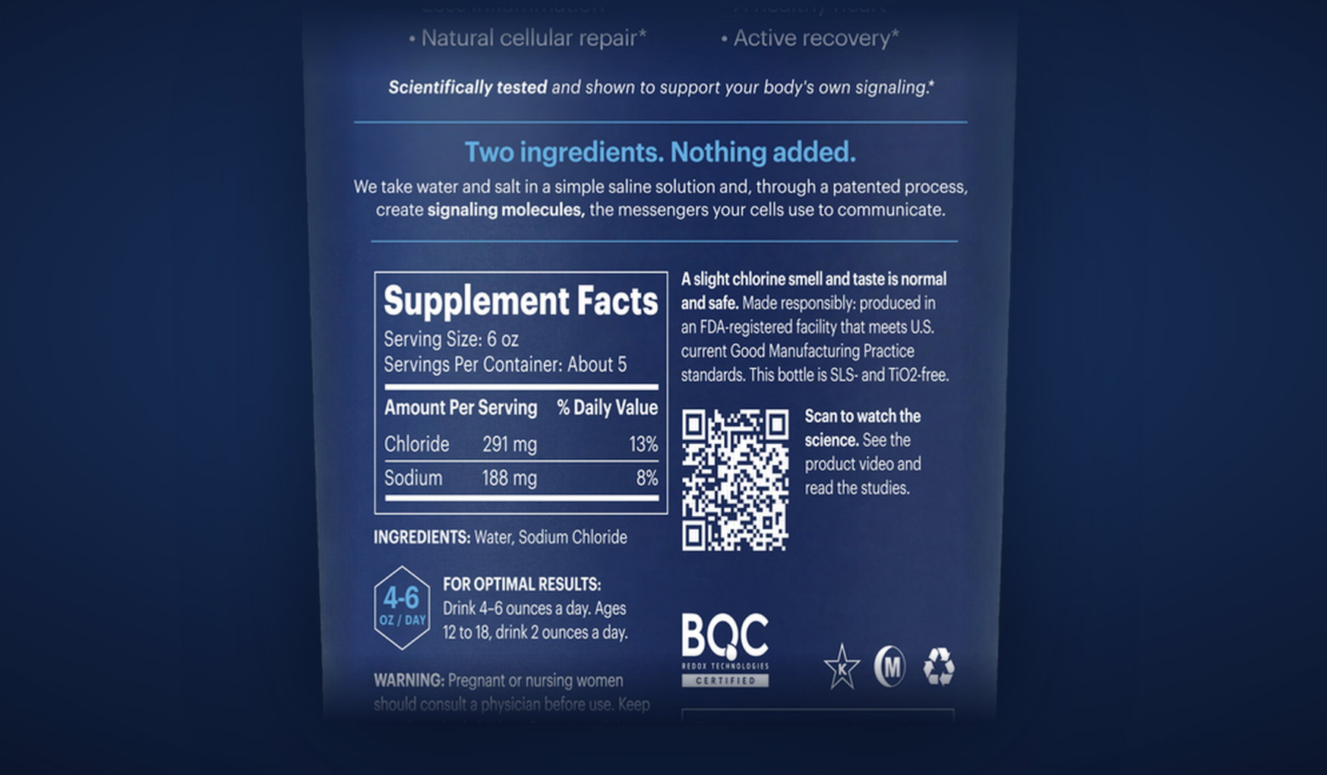
Notes:
Slide 50
[ the bottom of the label ]
And the part a careful person checks.
Two ingredients. Water and sodium chloride.
Four to six ounces a day. Ages twelve to eighteen, two ounces.
Nothing hidden, nothing to explain away.

Slide 51

THE MESSAGE ON THE BACK
The whole story, printed on the bottle.
Whoever picks it up reads the same words you would give them. No gap between what we say on stage and what they hold in their hand.
PRINTED ON EVERY BOTTLE
Cellular Intelligence Activated
Scientifically tested and shown to support your body’s own signaling.*
Notes:
Slide 52 — The whole story, printed on the bottle.
The whole story, printed on the bottle.
This is the message panel.
Whoever picks it up reads the same words you would give them.
No gap between what we say on this stage and what they hold in their hand.

Slide 52

AND HOW TO TAKE IT
Simple enough to never explain twice.
FOR OPTIMAL RESULTS
OUNCESA DAY
4–6
Ages 12 to 182 ounces a day
Servings per containerAbout 5
Serving size 6 oz · Ingredients: water, sodium chloride
One instruction, printed on the bottle. Nobody needs a chart, and nobody has to guess.
Notes:
Slide 53 — Simple enough to never explain twice.
Simple enough to never explain twice.
And how to take it.
Four ounces a day. Two in the morning, two at night.
That is the whole instruction. Nobody needs a chart.

Slide 53
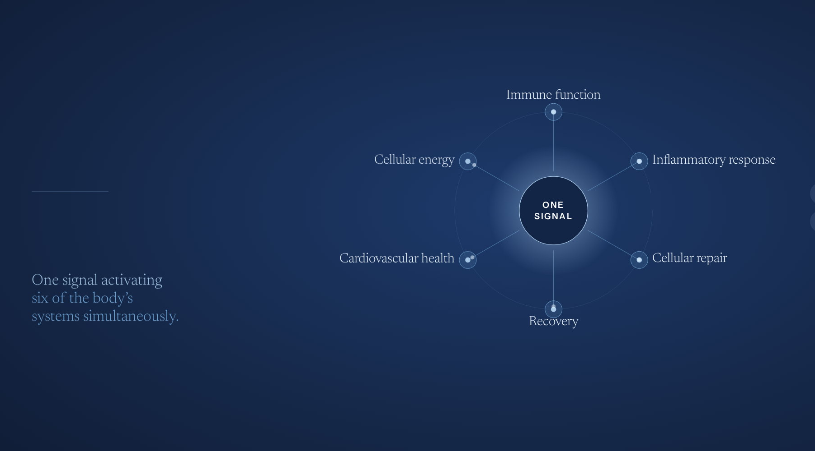
WHAT THOSE BENEFITS ACTUALLY ARE
One signal.
Every system.
The same molecules reach every major system at once, and speak to each one in the language it already knows.
Notes:
Slide 54 — One signal. Every system.
One signal. Every system.
So what does it actually do.
The same molecules reach every major system at once.
Immune function. Inflammatory response. Cellular repair. Cellular energy. Cardiovascular health. Recovery.
One signal activating six of the body’s systems simultaneously.

Slide 54
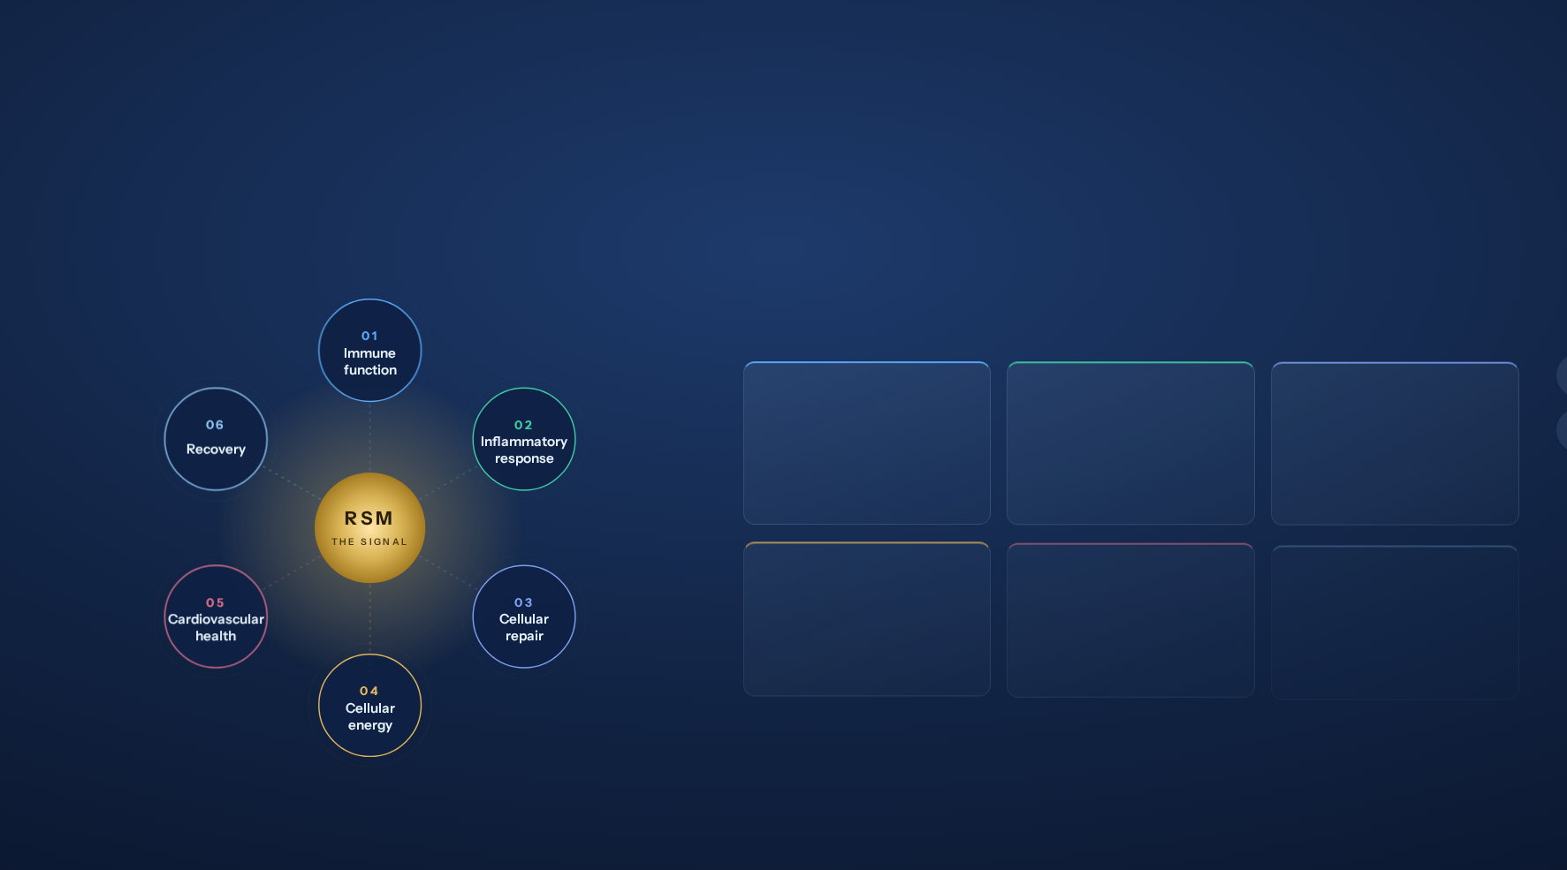
THE ANSWER TO “WHAT DOES IT DO?”
Six systems activated. One signal.
One product. One activation. Six of the body’s fundamental systems responding at the same time — each one measured, each one published.
01
02
03
IMMUNE FUNCTION
INFLAMMATORY RESPONSE
CELLULAR REPAIR
Your body’s own protection, working many times harder.
Less everyday inflammation, measured.
The body’s repair instructions, turned up 20–31%.
Aspen Lab Study 2026 · 16-week clinical
Aspen Lab Study 2026 · IL-1β reduced
Tauret Labs 2017 · 5 cellular signal genes
04
05
06
CELLULAR ENERGY
CARDIOVASCULAR HEALTH
RECOVERY
43 metabolic processes, shifted in 7 days.
The dangerous kind of cholesterol, down 6.3%.
You don’t feel enzyme efficiency. You feel this.
FASEB Supplement 2012 · 7-day crossover
Appalachian State 2014 · 12 weeks, n=106
Aspen Lab 2026 · the visible sum of the other five
Notes:
Slide 55 — Six systems activated. One signal.
Six systems activated. One signal.
(this is the answer to the question you get asked most)
Somebody says: what is it, what does it actually do.
ASEA Redox activates six of the body's fundamental systems simultaneously.
(walk the ring, left to right)
Immune function. Inflammatory response. Cellular repair.
Cellular energy. Cardiovascular health. Recovery.
(beat)
Not six products. One product. One signal. Six systems, at the same time.
And every one of those has a study behind it.

Slide 55

Cellular Intelligence
THIS IS
Activated.
A category with no competitor.
And no one else standing in it.
Notes:
Slide 56 — Cellular Intelligence
(no words on screen)
(beat)

Slide 56
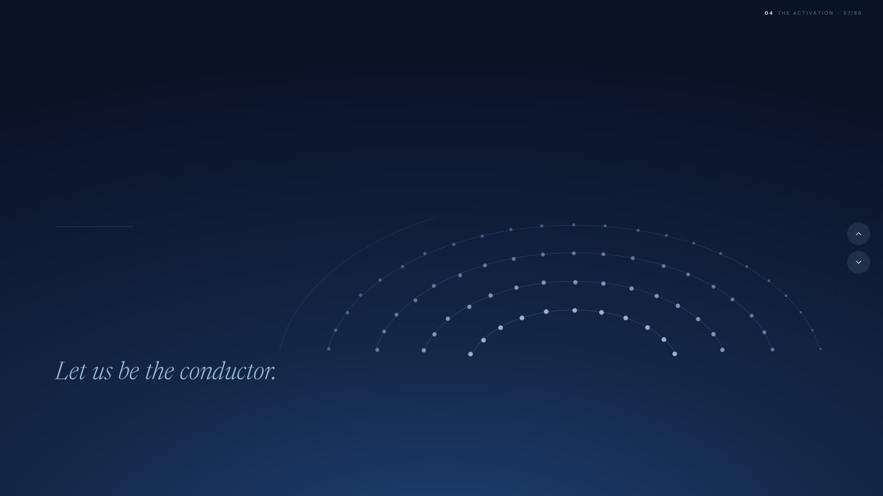
THE ORCHESTRA
An orchestra with no conductor is just noise.
Your body is that orchestra. The training, the food, every supplement in your routine. All of it talent, with no one to lead it.
Notes:
Slide 57 — An orchestra with no conductor is just noise.
An orchestra with no conductor is just noise.
Let me make it plain.
(the orchestra assembles behind you)
An orchestra with no conductor is just expensive noise.
Your body is that orchestra. The training. The food. Every supplement in your routine. All of it talent, with no one to lead it.
(the conductor arrives)
ASEA Redox adds more of those very same signaling molecules.
That is the conductor your cells were built to follow.
One signal. And every section hears it at once.

Slide 57
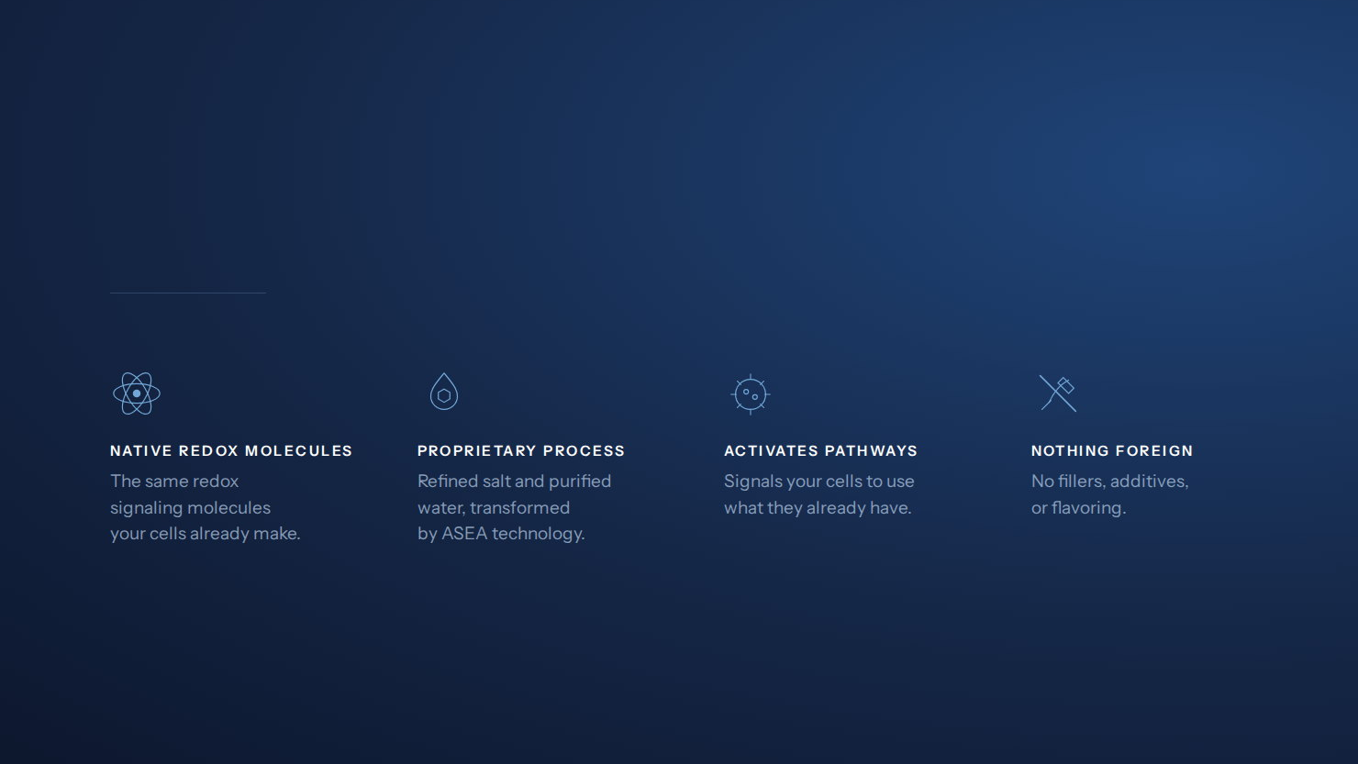
HOW IT WORKS
The same molecules your cells already make.
Notes:
Slide 58 — The same molecules your cells already make.
The same molecules your cells already make.
And this is what is actually in the bottle.
Native redox molecules. The same ones your cells already make.
A proprietary process. Refined salt and purified water, transformed by ASEA technology.
It activates pathways. It signals your cells to use what they already have.
(beat)
And nothing foreign. No fillers. No additives. No flavoring.
That is the whole ingredient list. That is the point.

Slide 58

THE LEVEL WE WORK AT
37 trillion cells.
One conversation.
Every one of them has a job, and the intelligence to know how to do it. When to repair. When to recover. When to perform. When to protect.
Notes:
Slide 59 — 37 trillion cells. One conversation.
37 trillion cells. One conversation.
Here is why.
Your body is powered by thirty seven trillion cells, in constant conversation.
Every one of them has a job, and the intelligence to know how to do it. When to repair. When to recover. When to perform. When to protect.
They are talking to each other right now. Every second of your life.
(beat)
Nothing in your body runs without that conversation.

Slide 59
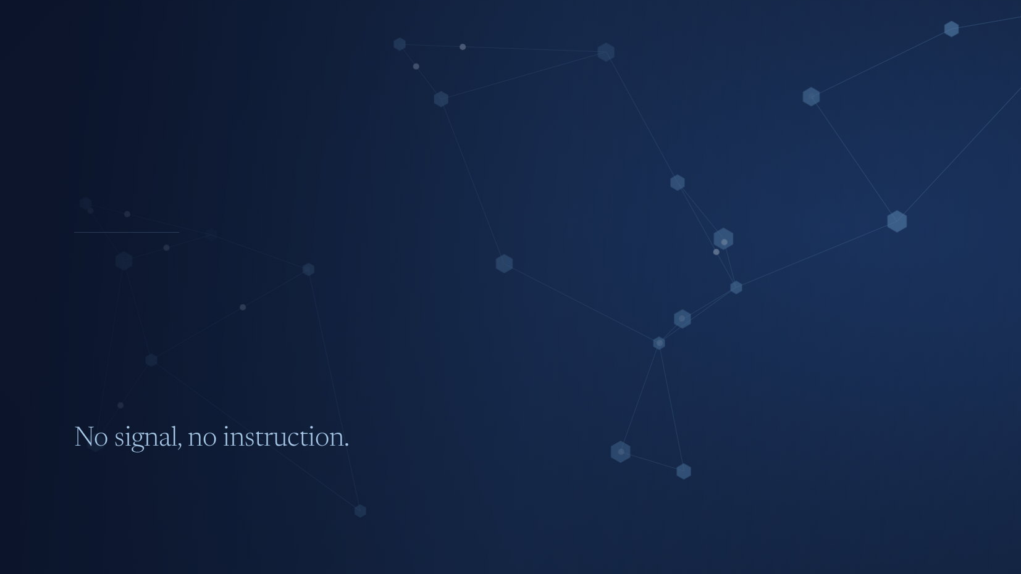
WHAT IT RUNS ON
The conversation runs on signal.
Redox signaling molecules are the messages themselves. Your cells make them, pass them between one another, and read them as instruction.
Notes:
Slide 60 — The conversation runs on signal.
The conversation runs on signal.
And that conversation runs on something physical.
Redox signaling molecules.
They are the messages themselves. Your cells make them, pass them between one another, and read them as instruction.
Repair here. Recover now. Perform. Protect.
They are how the body tells itself what to do.
(let the signal finish travelling, then)
No signal, no instruction.

Slide 60
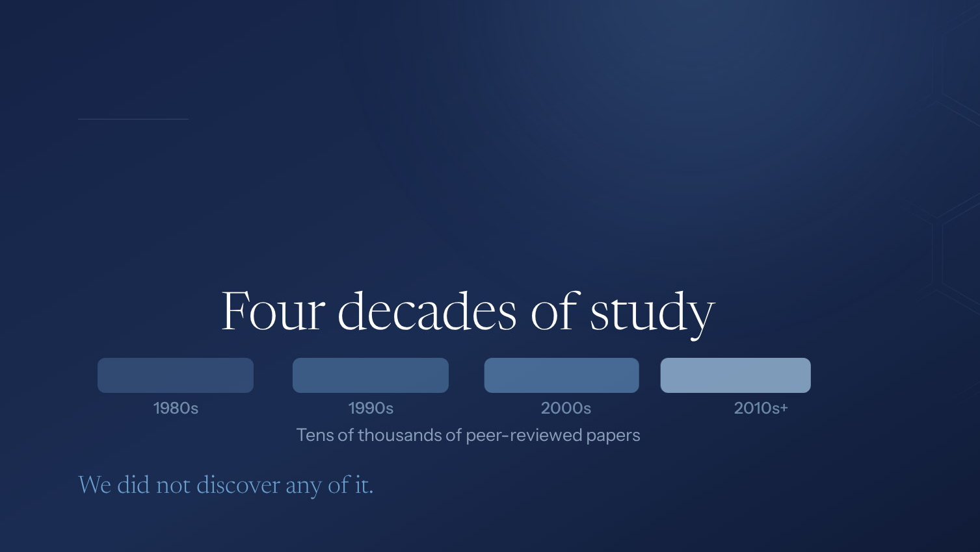
FORTY YEARS OF STUDY
The science was never the question.
An established field of biology, recognized at the highest levels of science. The molecules are real, and they have been studied for a very long time.
Notes:
Slide 61 — The science was never the question.
The science was never the question.
And before anyone asks whether this is new:
Redox signaling has been studied for forty years.
The biology was never in question. Thousands of papers, decades of work.
The science was never the problem.

Slide 61
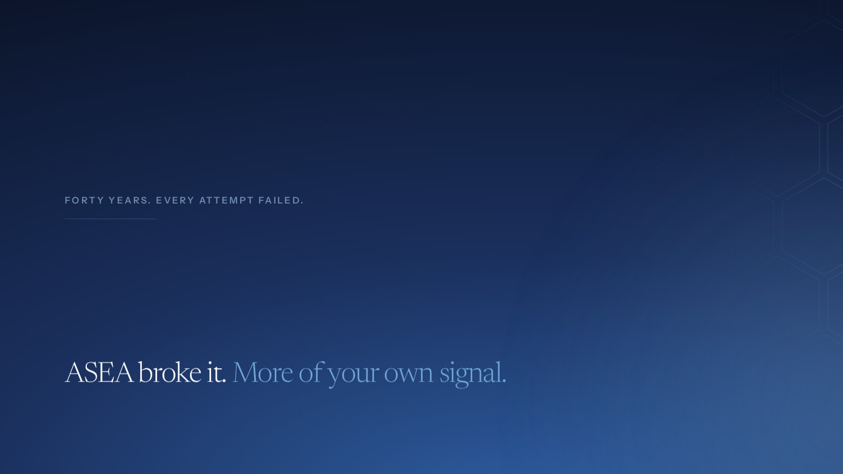
THE BREAKTHROUGH
Holding it stable outside the body was.
The molecules were always in you, and always too unstable to exist outside of you. For forty years that was the wall.
Notes:
Slide 62 — Holding it stable outside the body was.
Holding it stable outside the body was.
(beat)

Slide 62

OWNING THE STORY
A landmark story, told the way it deserves.
Twenty years of science, and a message finally built to carry it. Clear, credible, and the same in every market and every conversation.
Notes:
Slide 63 — A landmark story, told the way it deserves.
A landmark story, told the way it deserves.
Here is why this matters.
For two decades, the science has been extraordinary. Protected, proven, and unmatched.
Now the story is built to match it.
One message. Clear, credible, and the same in every market and every conversation.
(beat)
We own the story now. And you get to share it.

Slide 63
WHAT CHANGES WITH AGE
At some point, something shifts.
Doing everything you were told would work. And it stops working the way it used to.
Notes:
Slide 64 — At some point, something shifts.
At some point, something shifts.
Let me tell you the story we are going to tell the world. In a few weeks you will be saying it.
It starts like this.
At some point in your forties, something shifts.
You are doing everything you were told would work. And it stops working the way it used to.
Recovery takes longer. Energy drops. You do not bounce back.
Most people call that aging and accept it.
But aging is more than time.
(slow)
It is a communication breakdown. And it compounds.

Slide 64
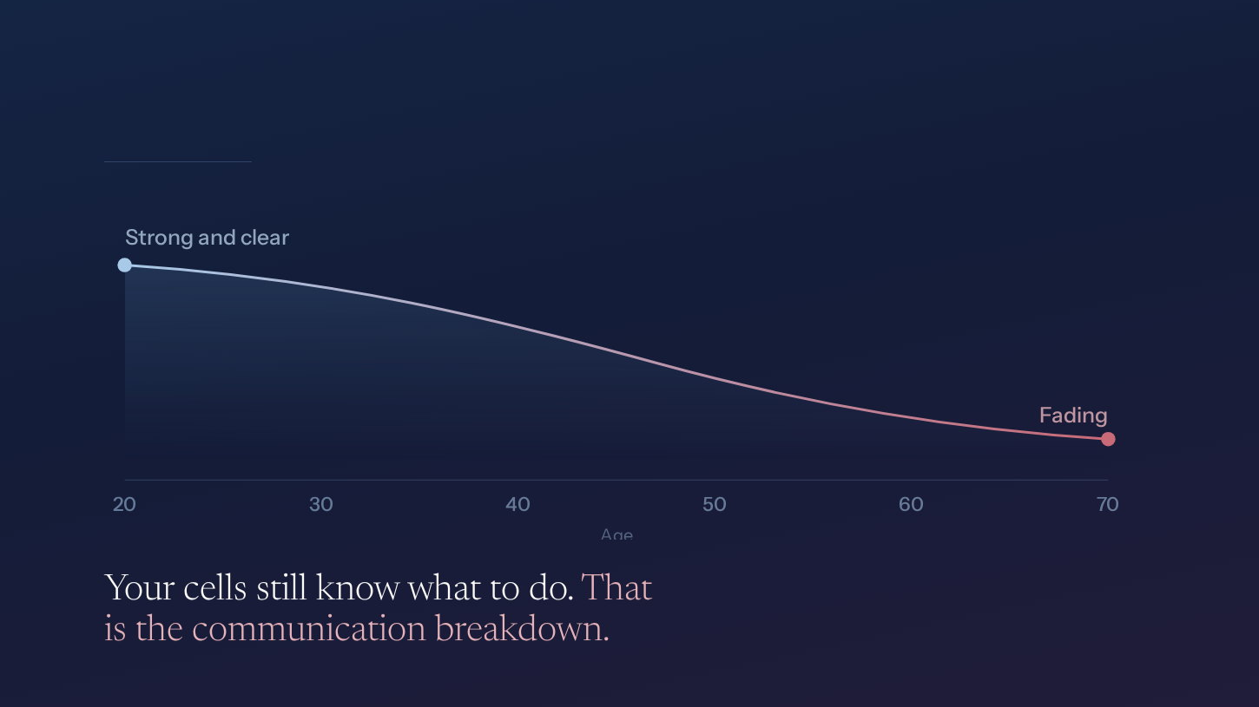
THE DECLINE
The signal fades.
Notes:
Slide 65 — The signal fades.
The signal fades.
When you are young, that signal is strong. Loud. Constant.
And as you age, it fades.
Not your cells. Your cells still know exactly what to do.
The messages that carry the instruction are simply getting quieter.
(pause, then land it)
That is the communication breakdown. That is what we have been calling aging.

Slide 65
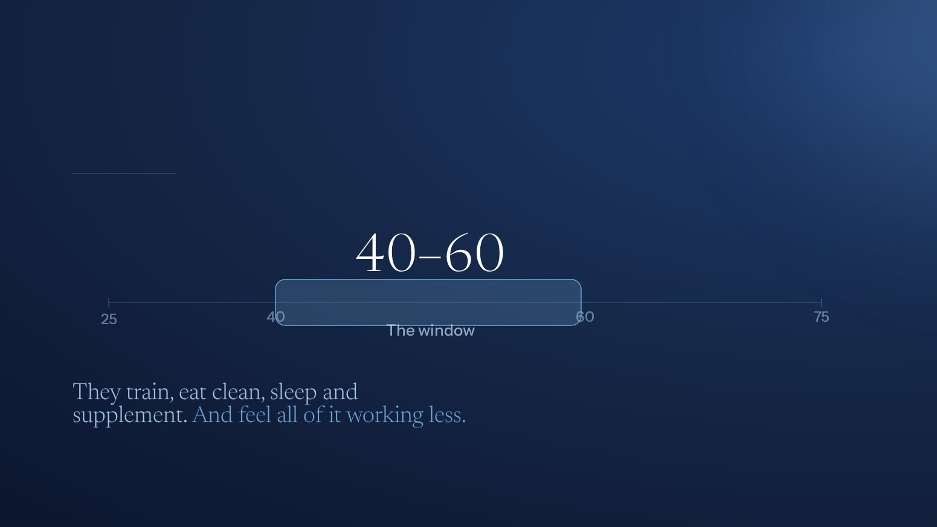
WHO LIVES AT THAT LEVEL
For the ones doing everything right.
Notes:
Slide 66 — For the ones doing everything right.
For the ones doing everything right.
So who is this for.
Not the sick. Not the desperate.
The ones doing everything right.
Mid forties to mid sixties. They train. They eat clean. They sleep. They supplement.
And they can feel all of it working less than it used to.
That is the loudest health conversation on the internet right now. And the category underneath it does not have a name.
(pause)
It is still ours to take.

Slide 66
WHAT THEY ARE ACTUALLY ASKING FOR
They are not asking to be young again.
Somewhere between forty and sixty, the conversation changes. People stop being told they can build, and start being told to manage. To slow down. To expect a little less each year.
AND THAT IS THE MOMENT WE ARE SPEAKING INTO
They are asking to stay strong.
Notes:
Slide 67 — They are not asking to be young again.
They are not asking to be young again.
So who is this actually for.
Somewhere between forty and sixty, the conversation changes.
People stop being told they can build, and start being told to manage. To slow down. To expect a little less every year.
(beat)
They are not asking to be young again.
They are asking to stay strong.

Slide 67
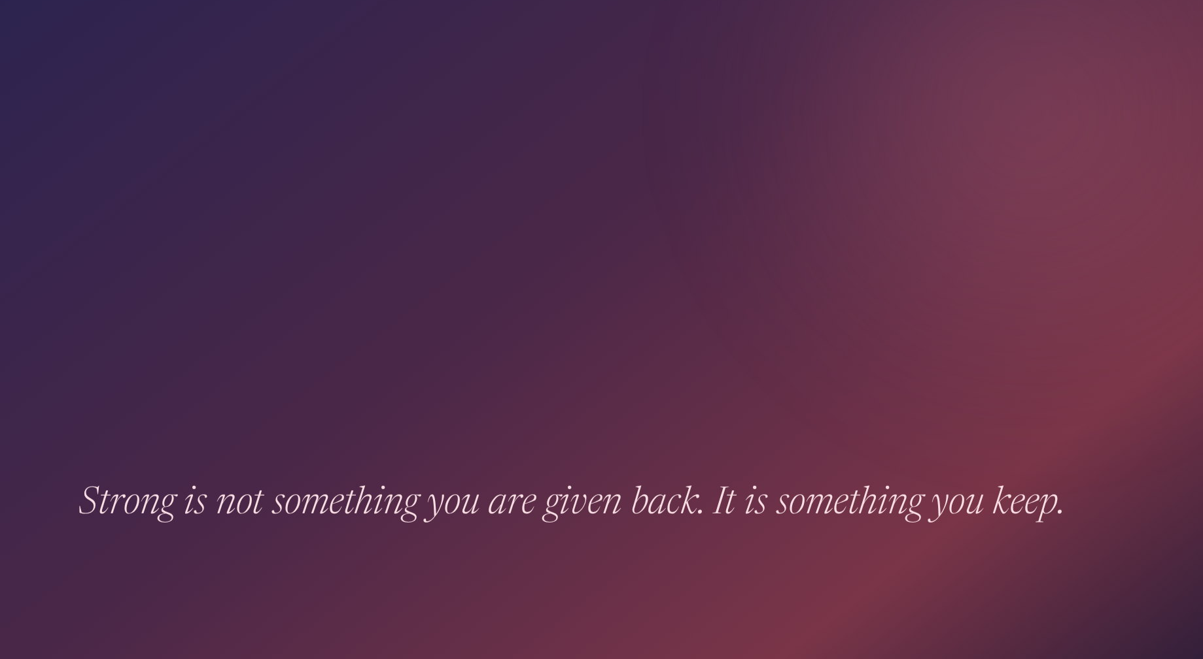
SO THIS IS OUR ANSWER
ASEA Redox is the refusal.
The refusal to let two decades of quiet decline become forty.
The refusal to let the body's own intelligence be undermined by time.
The refusal to let the signal go dark.
Notes:
Slide 68 — ASEA Redox is the refusal.
ASEA Redox is the refusal.
(beat)

Slide 68

THE PROMISE
Age Strong.
Not younger. Stronger.
For as long as you intend to keep going.
Notes:
Slide 69 — Age Strong.
Age Strong.
(let it sit)
Age Strong.
Not younger. Stronger. For as long as you intend to keep going.
(hand off to the experts)

Slide 69
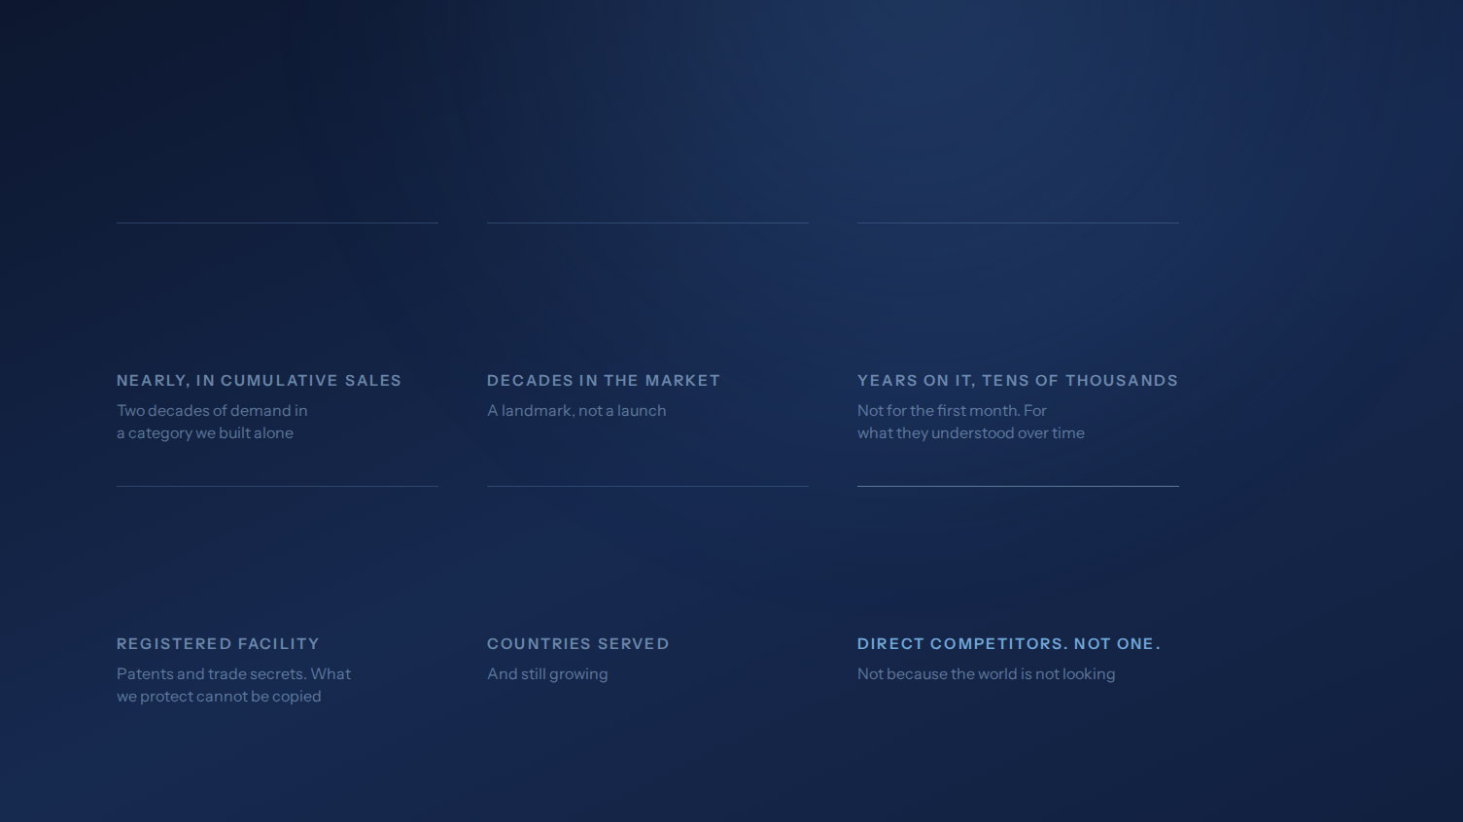
THE LEDGER
This is our story. And we can back it.
$2B
2
10+
FDA
35
0
Notes:
Slide 70 — This is our story. And we can back it.
This is our story. And we can back it.
(beat)

Slide 70
TAKING IT TO MARKET
None of this matters if we cannot empower you to tell it.
The science is settled. The story is written. What is left is whether it travels — and that has never been a belief problem. It is a design problem.
So we built you the entire ecosystem of tools that carry the message.
Notes:
Slide 71 — None of this matters if we cannot empower you to tell it.
None of this matters if it never leaves this room.
(shift gear here — this is the turn)
So that is the science, the category, and the people who need it.
But none of it matters if it never leaves this room.
The science is settled. The story is written. What is left is whether it travels.
And that has never been a belief problem. It is a design problem.
So we built you the whole system.

Slide 71
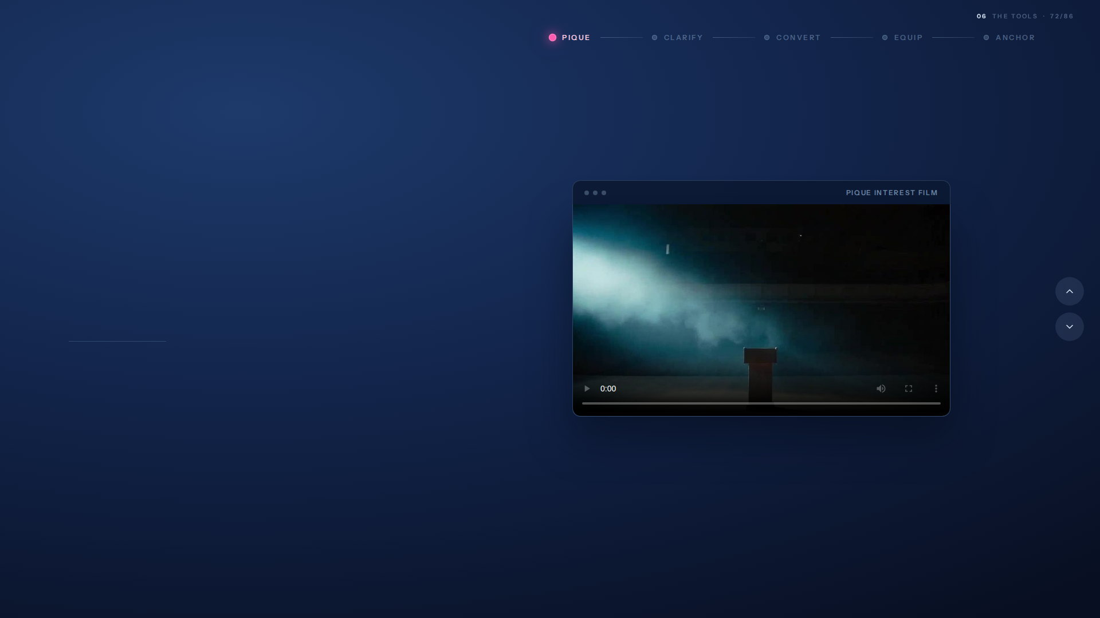
01
PIQUE · INTEREST
It all starts with piquing interest.
Pieces built to make someone curious enough to ask. No claims to defend, no science to carry — just a reason to lean in.
Plays from this folder — keep the .mp4 beside the presentation.
USE IT WHEN Someone follows you but has never asked about ASEA.
Notes:
Slide 72 — It all starts with piquing interest.
It all starts with piquing interest.
(beat)

Slide 72
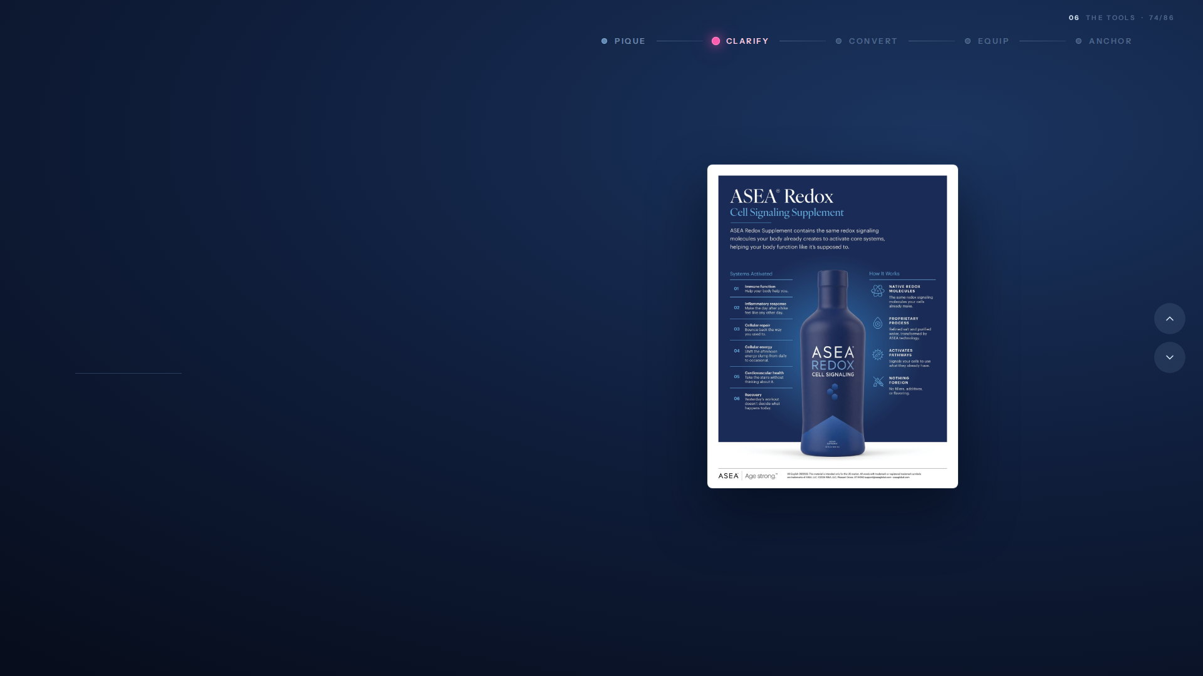
02
CLARIFY · THE SCIENCE
Then you hand them the whole answer.
The product information sheet. Two ingredients, the signaling story, the facts panel, and the dosage — all in one place they can keep.
One page. Print it, text it, hand it over.
USE IT WHEN They are interested, and now they want detail.
Notes:
Slide 74 — Then you hand them the whole answer.
Then you hand them the whole answer.
(beat)

Slide 73
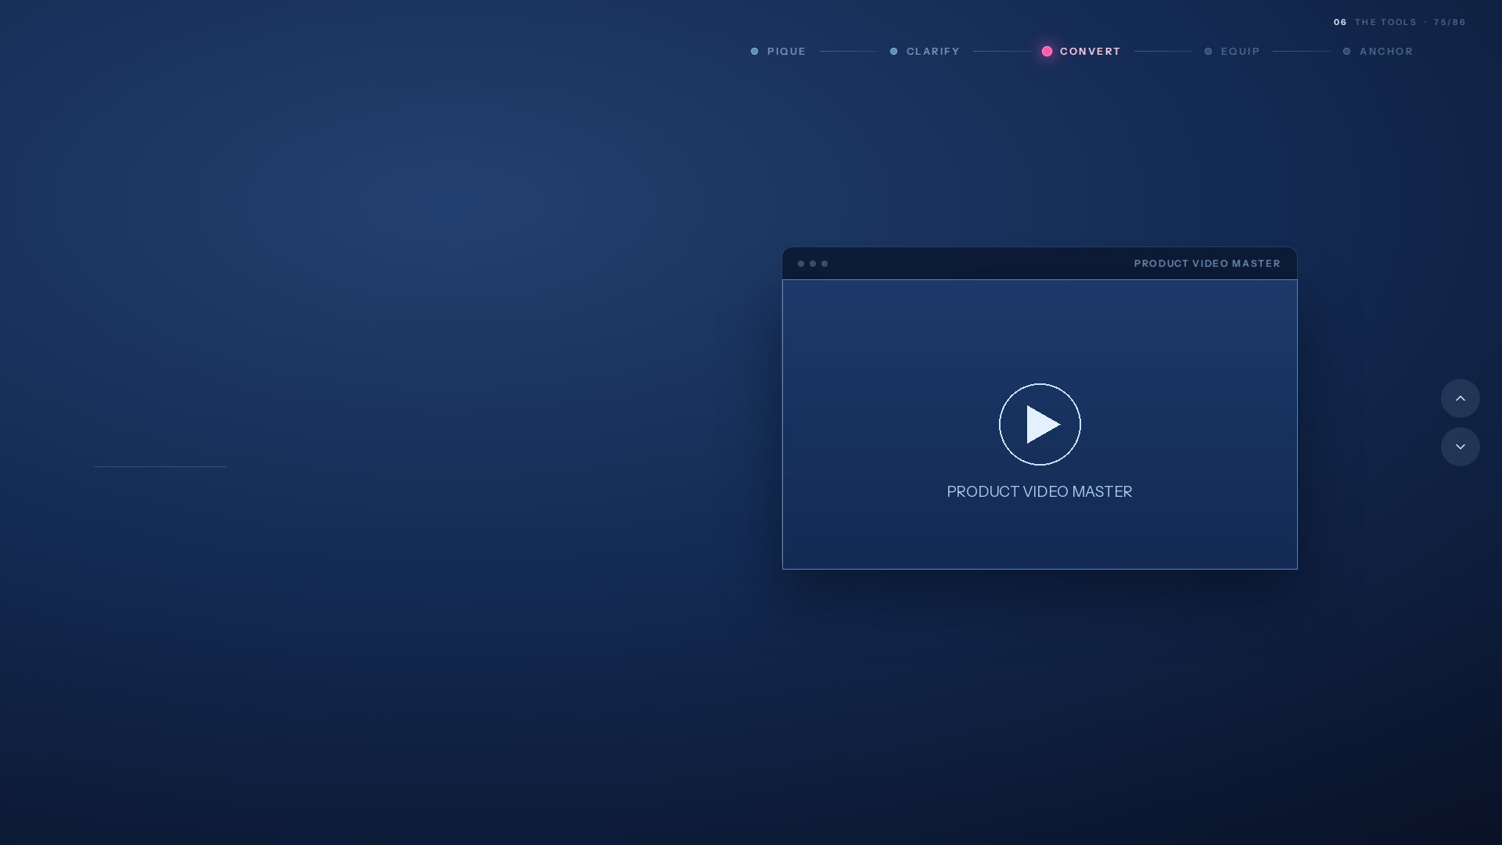
03
CONVERT · THE BELIEF
Then the film that turns interest into belief.
ASEA Redox Cell Signaling. The full story, told properly, so the decision gets made without you in the room.
Plays the same file as the full-screen slide that follows.
USE IT WHEN They understand it. Now they need to feel it.
Notes:
Slide 75 — Then the film that turns interest into belief.
Then the film that turns interest into belief.
(beat)

Slide 74
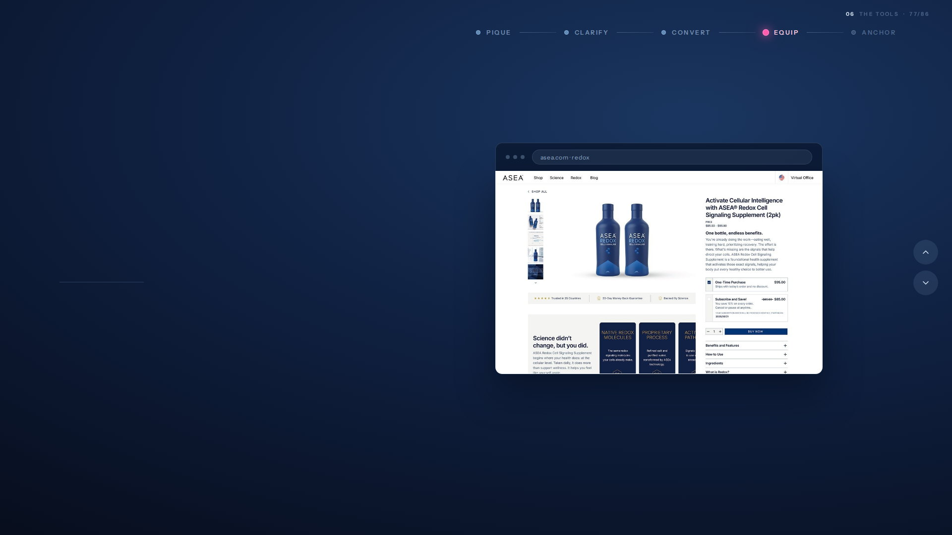
04
EQUIP · THE PURCHASE
Then a page that carries it the rest of the way.
The Redox product page. Every benefit laid out, every question answered, and the purchase one tap away — so what you hand someone keeps working long after the conversation ends.
Top of the live page.
USE IT WHEN They are ready to decide, and you want the strongest page in the industry doing the talking.
Notes:
Slide 77 — Then a page that carries it the rest of the way.
Then a page that carries it the rest of the way.
Four. Equip.
The product page. Every benefit, every question, every study, laid out properly.
This is not about taking you out of it.
It is about handing someone a tool that keeps selling after you have said goodnight.
You are still the reason they looked. The page is just better at the detail than any of us are at 10pm.

Slide 75
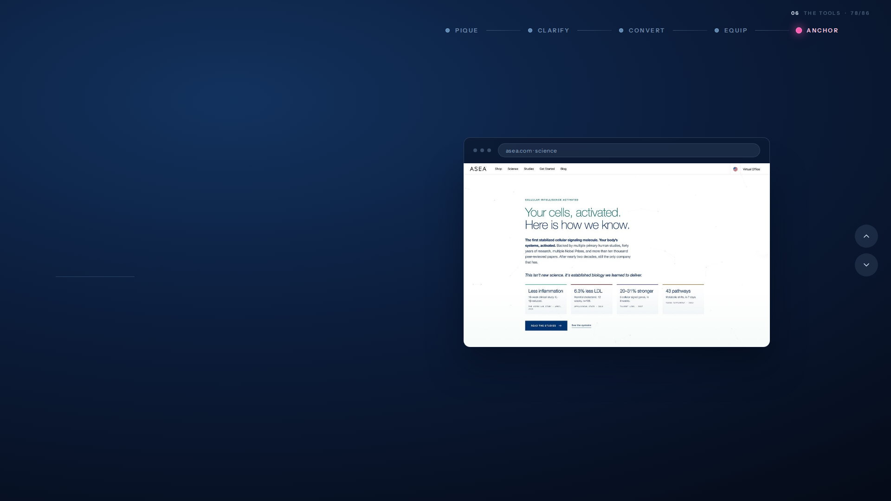
05
ANCHOR · THE PROOF
Backed by science, and more accessible than ever.
The science site and the published research. Independent, citable, and deep enough for the person who will not take your word for it.
Top of the live page.
USE IT WHEN Someone pushes back, or someone digs.
Notes:
Slide 78 — Backed by science, and more accessible than ever.
Backed by science, and more accessible than ever.
(beat)

Slide 76

THE FUNNEL
Five parts. One funnel.
Every stage has an asset. Every asset is built, translated and ready. You are never the one who has to make something up.
01
02
03
04
05
PIQUE
CLARIFY
CONVERT
EQUIP
ANCHOR
Interest films
Product sheet
Cell Signaling film
Product page
Science & research
Make them curious enough to ask.
One page that answers the detail.
The story that makes it land.
Carries it the rest of the way.
Proof for the ones who dig.
Curiosity to conviction, and not one gap you have to fill.
Notes:
Slide 79 — Five parts. One funnel.
Five parts. One funnel.
So look at the whole thing.
Pique. Clarify. Convert. Equip. Anchor.
Every stage has an asset. Every asset is built and translated.
Curiosity to conviction, and not one gap you have to fill.

Slide 77

WHERE ALL OF IT LIVES
One resource for the tools.
One for the science.
Everything we have built sits in one of two places. One holds every tool you need to share it. The other holds every piece of evidence behind it.
01
02
CELLULAR INTELLIGENCE ACTIVATED
THE SCIENCE OF ASEA
The resource for all of the tools.
The resource for all of the scientific backing.
The films, the product sheet, the language, the training, the funnel. Everything you reach for in a conversation lives here.
Published studies, the six systems and what each one measured, four decades of research. Every claim, with the work behind it.
When you need something to send.
When someone asks you to prove it.
Both are one scan away; on every piece we hand you.
Notes:
Slide 80 — One resource for the tools. One for the science.
One resource for the tools. One for the science.
So where does all of this actually live.
Two resources. That is the whole system.
Cellular Intelligence Activated holds every tool — the films, the sheet, the language, the funnel. Everything you reach for in a conversation.
The Science of ASEA holds every piece of evidence — the published studies, the six systems, four decades of research.
(beat)
One for when you need something to send. One for when someone asks you to prove it.
Both are one scan away, on every piece we hand you.

Slide 78
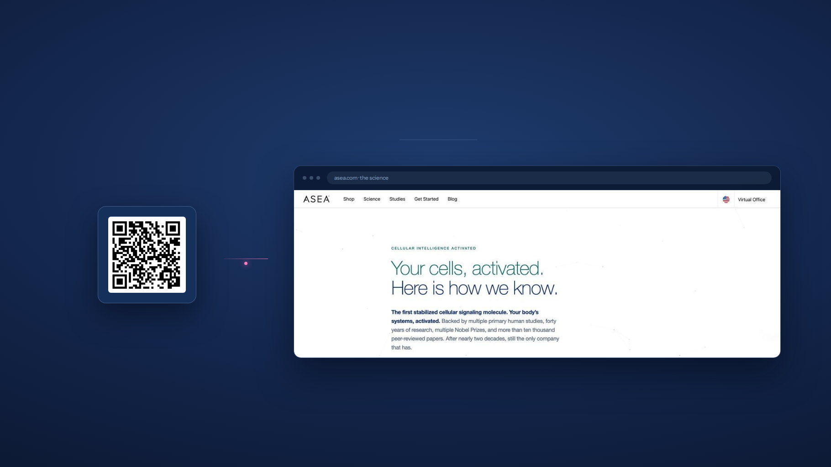
EVERYTHING YOU NEED TO SHARE IT
The tools are one scan away.
SCAN TO OPEN THE TOOLKIT
Scan to open learn.aseaglobal.com. The story, the science, the films, and the tools, everything you need to share ASEA.
Notes:
Slide 81 — The tools are one scan away.
The tools are one scan away.
Door one. Cellular Intelligence Activated.
Everything you need to share it, in one place.
(hold the QR up — give the room a moment to scan)

Slide 79
AND A DOOR INTO EVERYTHING ELSE
The science is one scan away.
PRINTED ON EVERY BOTTLE
Scan to watch the science. The product video and the published studies, straight from the bottle in their hand.
Notes:
Slide 83 — The science is one scan away.
The science is one scan away.
Door two. The Science of ASEA.
Published studies, the six systems, the whole evidence base.
(hold again — this is the one the sceptics will want)

Slide 80

THE PART WE CANNOT BUILD
None of this works without you.
We can build the bottle, the story, the films, the pages and the proof. We cannot be in the room when someone decides. That part has always been yours, and today it is the only part left.
Notes:
Slide 85 — None of this works without you.
None of this works without you.
(slow right down)
We can build the bottle. The story. The films, the pages, the proof.
We cannot be in the room when someone decides.
That part has always been yours. And after today, it is the only part left.
(beat)

Slide 81

THE INVITATION
So let’s begin.
Twenty years of science. A brand rebuilt. A category named. And a system waiting for the only people who can carry it.
Notes:
Slide 86 — So let’s begin.
So let’s begin.
Twenty years of science. A brand rebuilt. A category named.
And a system waiting for the only people who can carry it.
(beat)
So let us begin.
I have asked two of you to come up and talk about what this means from where you stand.
(invite them on)

